Slide 1
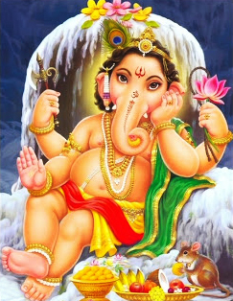
Ganesh: The Elephant God
By: Shayan Jiwani

Slide 2
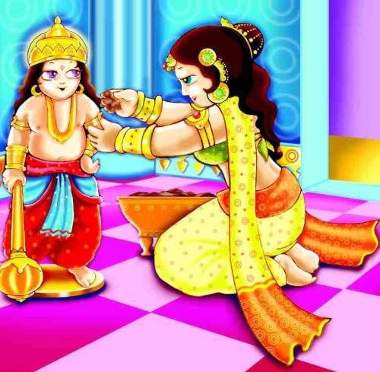
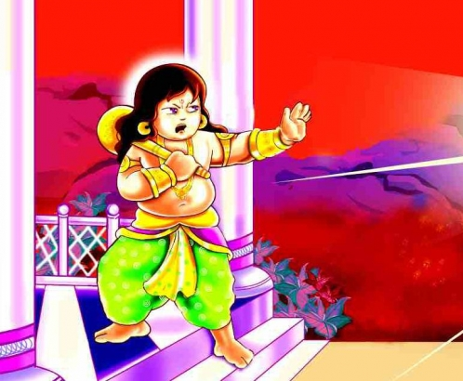

Slide 3
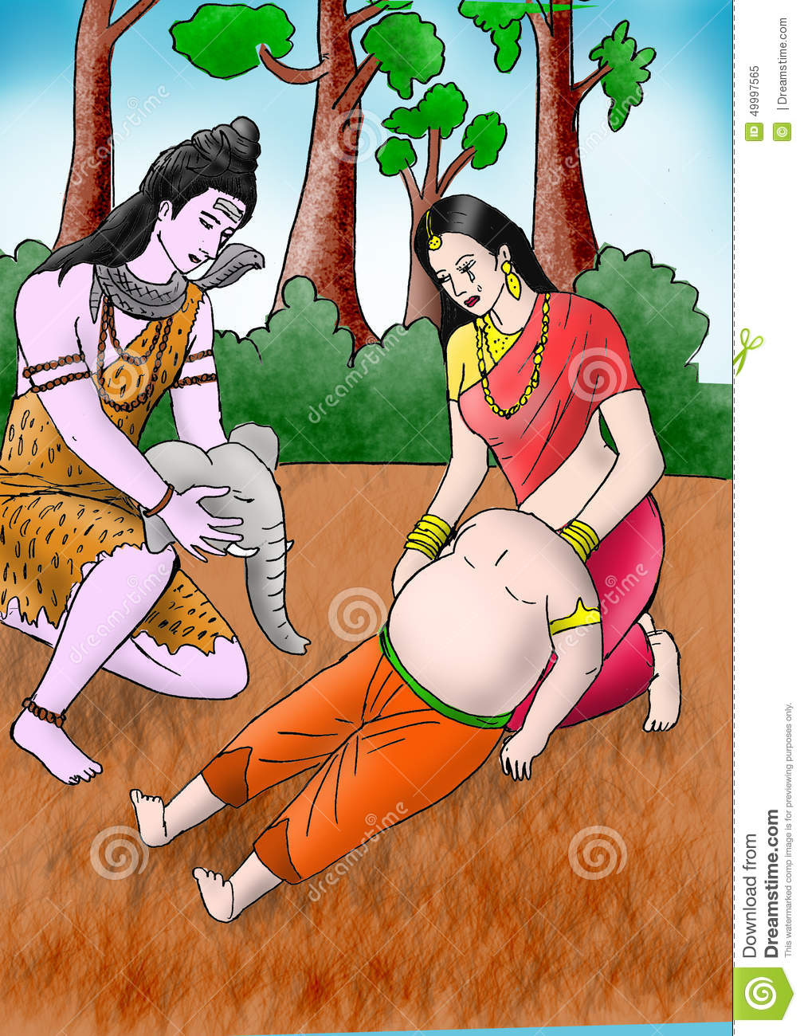

Slide 4
Birth
Parvati created Ganesh from the residue in her bath tub
Placed him outside to stand guard
Shiva breaks his head into a thousand pieces
Parvati demands Shiva bring him back to life
First head he finds is that of an elephant
Shiva gives Ganesh powers to compensate

Slide 5
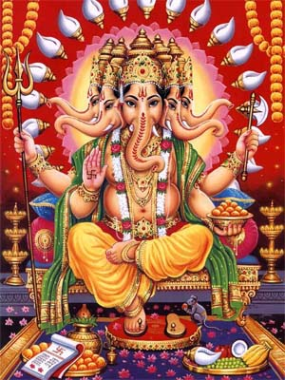
Appearance
Dwarfish and potbellied
Complexion is reddish
Items in his hand
Broken tusk
Elephant head
Multiple arms
Multiple heads
Riding his rat (Vahana)

Slide 6
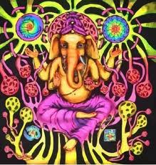
Roles and Duties
Creator and Remover of obstacles
Controls outcomes of one’s endeavors
God of Good Luck
People must say puja to him

Slide 7
Historical Background
Five Periods of Time:
Scribe for Mahabharata
Rapid spread of Ganesh
Mahapuranas- Ganesh born into Siva’s family
Formalization of Ganesh’s theology
Modern Ganesh: one of the greatest Gods
Ideas of Dualism? Pryzulski
Spirits of the Mountain → Ganapati

Slide 8
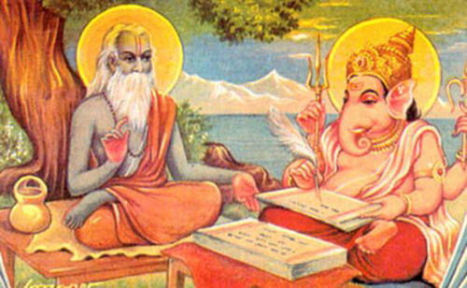
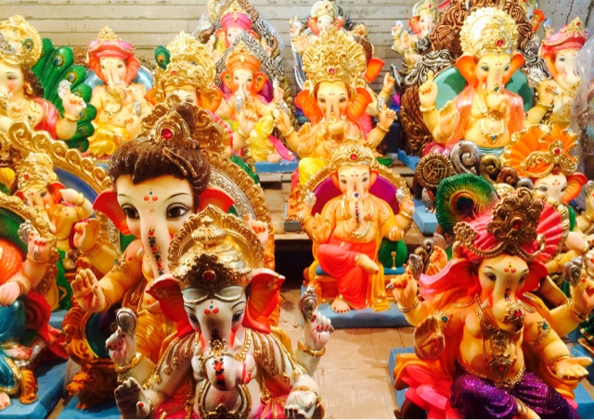

Slide 9
Origin of his Elephant Head
Shiva Purana: Ganesh from items in bath tub
Skanda Purana: Skanda completed Ganesh
Varaha Purana: Shiva initially gave the head in addition to serpent threads
Brahmavaivarta Purana: planet Shani’s curse → head replaced by king of the elephants
http://anibrain.com/how-lord-ganesha-got-his-elephant-head/

Slide 10
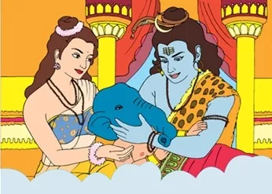

Slide 11
Four Elements define Ganesh’s origin
Already conflict between Shiva and Parvati
Birth is always unusual
Shiva becomes more attracted to Parvati when Ganesh blocks his path
Belief of beheading enhances auspiciousness

Slide 12
King of the Harvest
Agriculture crucial in South Asia
Mushak Vahan: “rider on a rat”
Cornsheaves swinging side to side parallel trunk of an elephant
Modakas- ingredients are part of the harvest
Various Rituals in regards to Harvest:
Undir Bi
Line of ashes
Panch Mahals
Kandesh

Slide 13
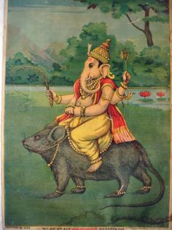

Slide 14
Festival and Miracle
Ganesh Chaturthi
Ten day festival celebrating his birth
Idols of Ganesh elevated
Panapratishtha → shhodashopachara
Immersed in rivers in the end
Idols also painted → Parade of Idols on floats
Ganesh Milk Miracle
Priests claim Ganesh drank milk offerings

Slide 15
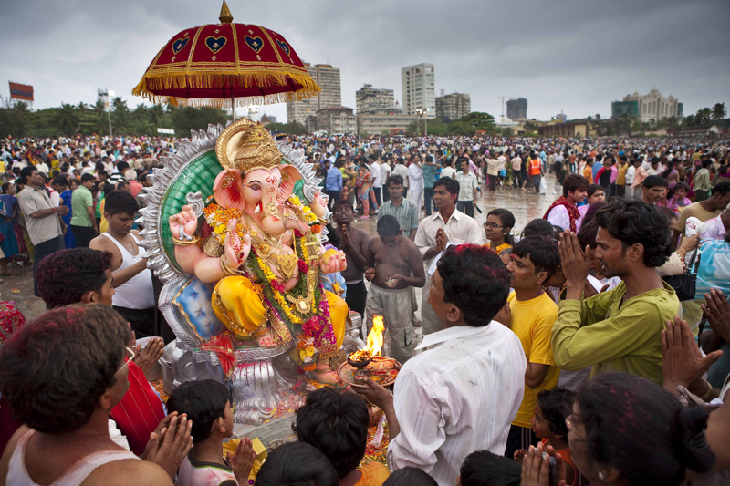

Slide 17
THE END

