Slide 1
母乳喂养
麥仲明
11月8日2014年

Slide 2
什么是母乳喂养
母乳喂养: 用母亲的奶水喂养自己孩子的方式。
母乳喂养还有：
蛋白质
脂肪
钙和铁
即维生素等
是婴儿生长发育的最佳选择

Slide 3
母乳喂养正确方法
放松自己
坐着或躺着
让孩子靠近妈妈， 鼻子正对着乳头
孩子身体成一直线，孩子的肚子贴着妈妈的肚子
让孩子靠近乳房

Slide 6
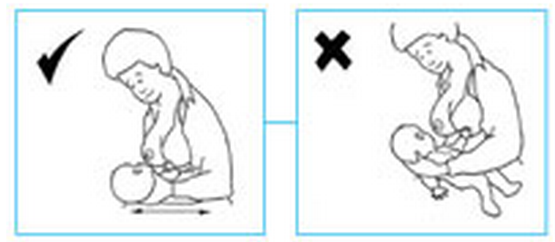
母乳喂养正确方法

Slide 7
正确喂养姿势

Slide 8
母乳喂养需要喂水吗

Slide 9
Health Literacy
What do you think “Health literacy” encompasses?
“58% of Black and 66% of Hispanic adults exhibited “basic” or “below basic” health literacy compared to only 28% of white adults”
Notes:
The clinical domain -activities associated with the health care provider-patient interaction, clinical encounters, diagnosis and treatment of illness, and medication. filling out a patient information form for an office visit, understanding dosing instructions for medication, and following a health care provider’s recommendation for a diagnostic test.
■ prevention domain encompasses those activities associated with maintaining and improving health, preventing disease, intervening early in emerging health problems, and engaging in selfcare and self-management of illness. Examples are following guidelines for age-appropriate preventive health services, identifying signs and symptoms of health problems that should be addressed with a health professional, and understanding how eating and exercise habits decrease risks for developing serious illness.
■ The navigation of the health care system domain encompasses those activities related to understanding how the health care system works and individual rights and responsibilities. Examples are understanding what a health insurance plan will and will not pay for, determining eligibility for public insurance or assistance programs, and being able to give informed consent for a health care service. (HHS, 2003, p. 37)

Slide 10
Pictorial Teachings
Recall at the beginning of the presentation, how difficult it was to understand without pictures…
Studies show pictures, especially in health teaching, enhance ability to recall and understand information. Also, increases adherence to methods shown.
http://www.spring-nutrition.org/publications/training-materials/nigeria-community-and-facility-infant-and-young-child-feeding
Notes:
Adherence involves two steps: accepting the message as something the person should act on and then actually carrying out the recommended actions.
The Delp and Jones study, where 234 emergency room patients were given written instructions with and without pictures for managing lacerations, found that, not only were instructions with pictures more likely to be read and remembered, they also found that people who received the illustrated instructions were more likely to do what was recommended in the instructions (77% versus 54%.)
Subjects were interviewed by phone three days later and asked if they had read the instructions (attention). If they had, they were asked a series of questions about information in the handout (recall) and also about what they had done to care for their wounds (adherence).

Slide 11
Pa-Oh ethnic group, Myanmar
Community Based Safe Motherhood
Notes:
community based safe motherhood
maternal health care in antenatal, delivery and postnatal period including breastfeeding and family planning.
pictorial handbook developed in Pa-Oh’s social and cultural context.
Pre-post surveys taken
3-day session held in women’s homes, village leaders’ homes or village health volunteers’ homes every week
Health communication increased with pictures ,especially with low literacy
Health knowledge is key to understand rights and health status in order to seek appropriate health services

Slide 12
Pictorial Teaching
Matlab, Bangladesh
3 year research, from 2003-2006
increase of 8.9% to 34.2% between 1st and 2nd (or successive) antenatal visits when using PC
13% increase in delivering in a facility
Training of Birth Attendants
7 month long course
Maintains a standard minimum of information
Notes:
Cohort given PC kits that included information about 5 dangers of pregnancy
1. Ante Partum Hemorrhage
2. Pre-Eclamptic Toxemia
3. Prolonged Labor
4. Mal-Presentation
5. Post Partum Hemorrhage
At each prenatal visit, nurse shows woman 5 signs of pregnancy and asked to explain. When do not understand, nurse explains it
Remember previous reading of training of BA and realized they were illeteriate? Then used song and dance?

Slide 13
Where do we go from here?
Pictorials
Culture specific

Slide 15
Where do we go from here?
Pictorials
Culture specific
US
immigrants

