Slide 1
Resource Extraction and Enchained Inequities in PNG: A Cultural Political Economy
Bruce Knauft
Emory University
Atlanta, USA

Slide 2
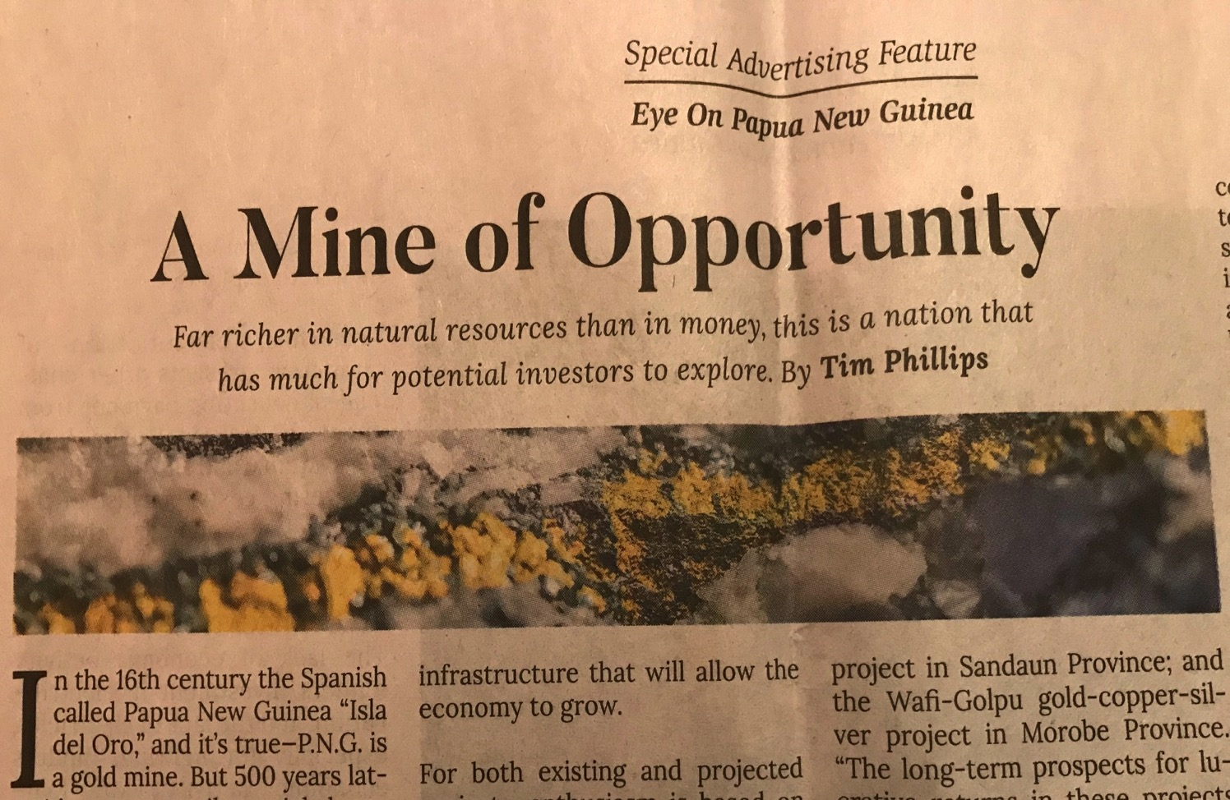

Slide 3
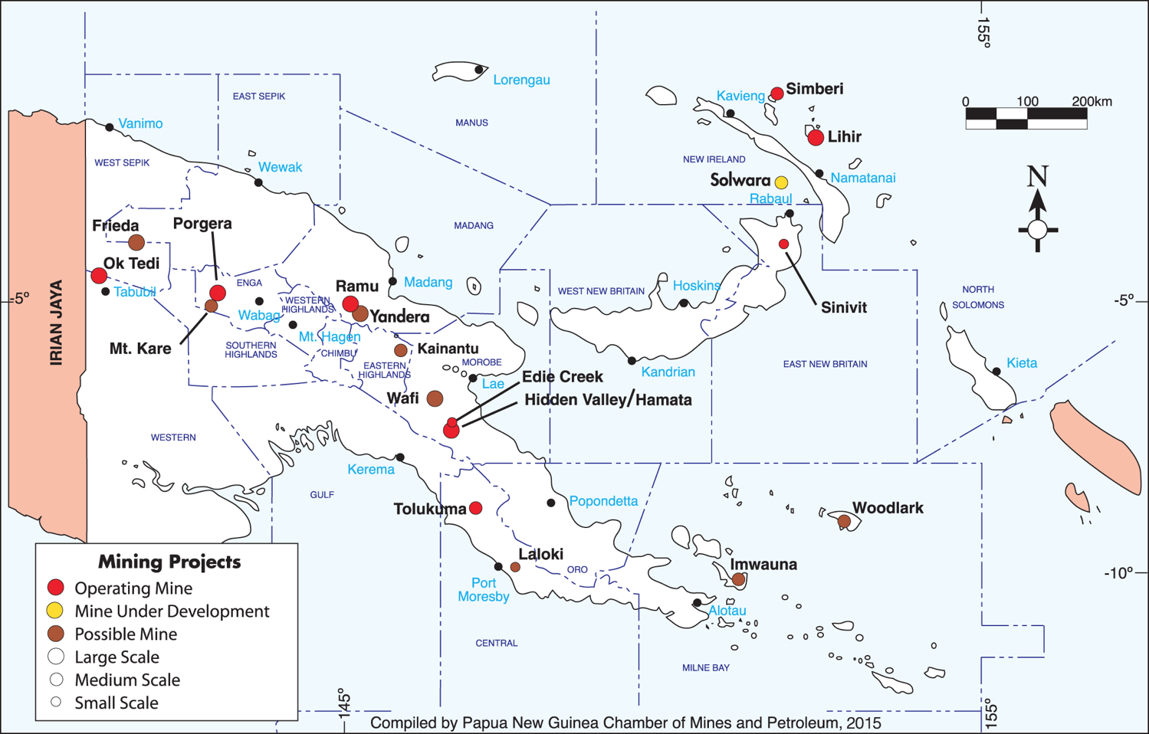

Slide 4
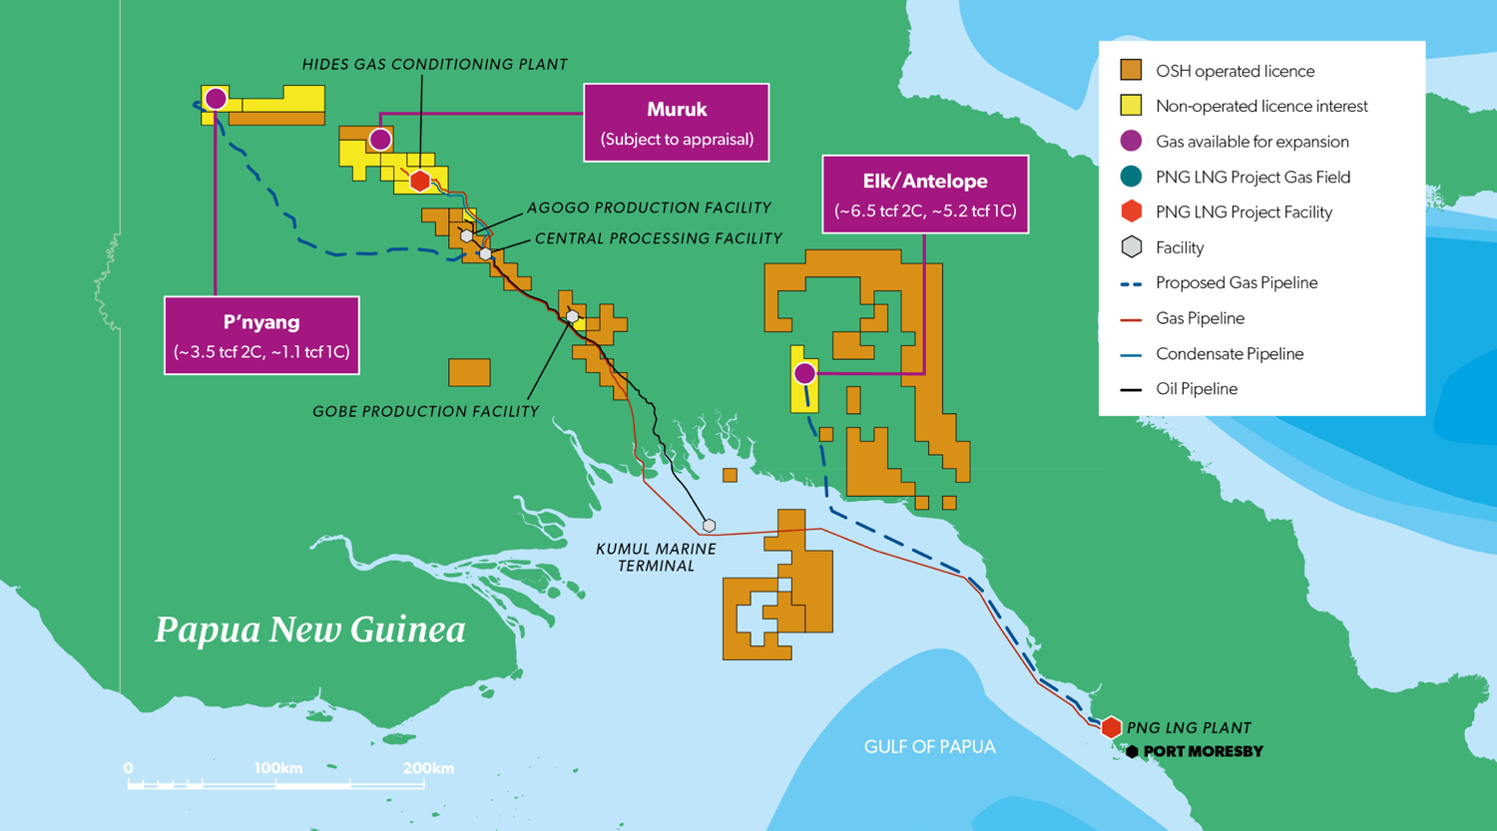

Slide 5
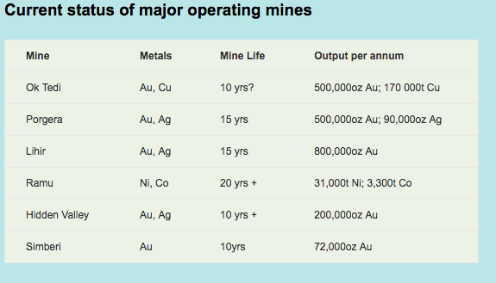

Slide 6
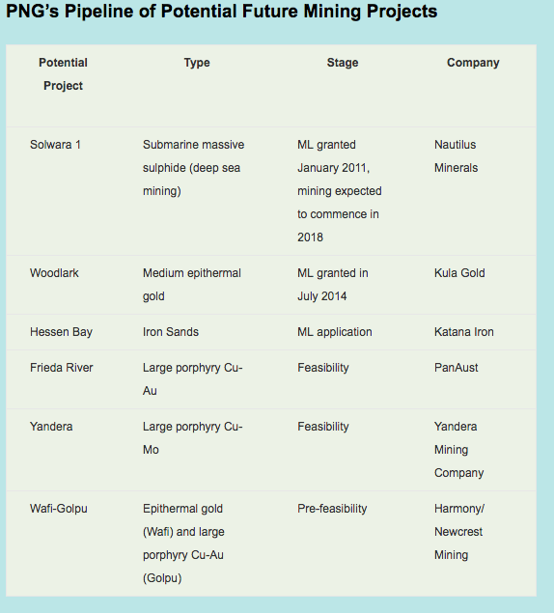

Slide 7
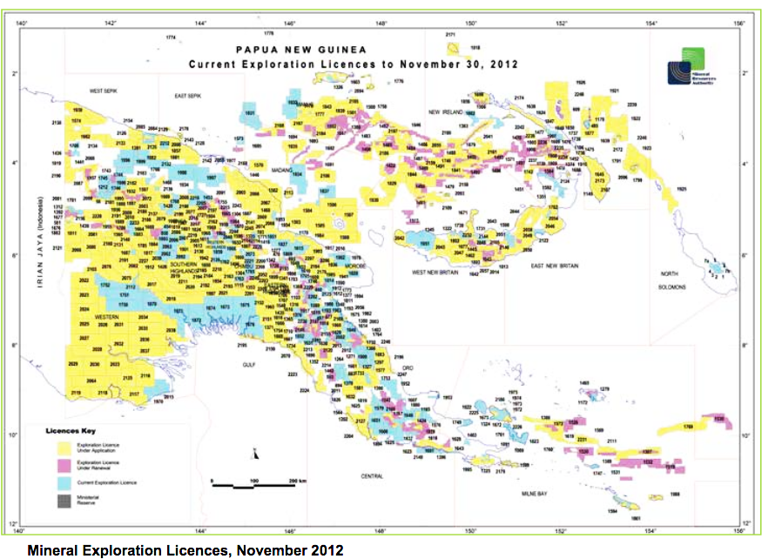

Slide 8
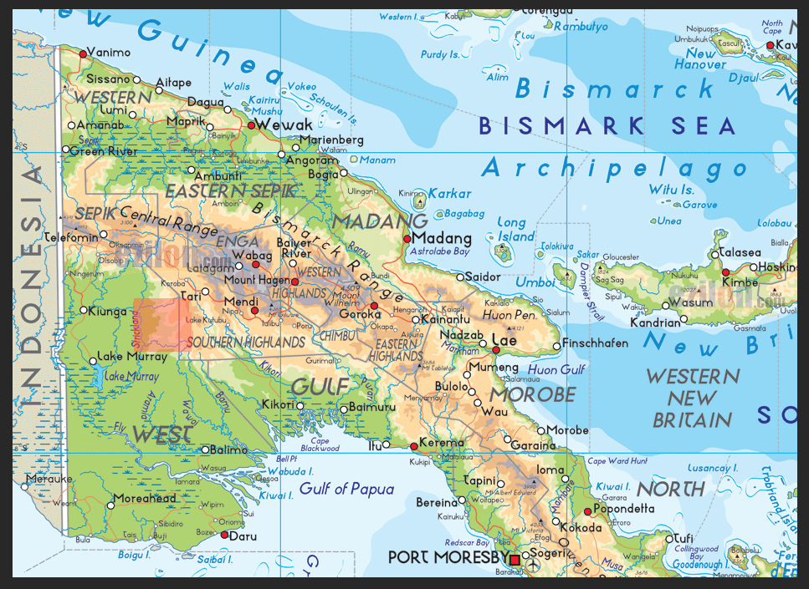

Slide 9
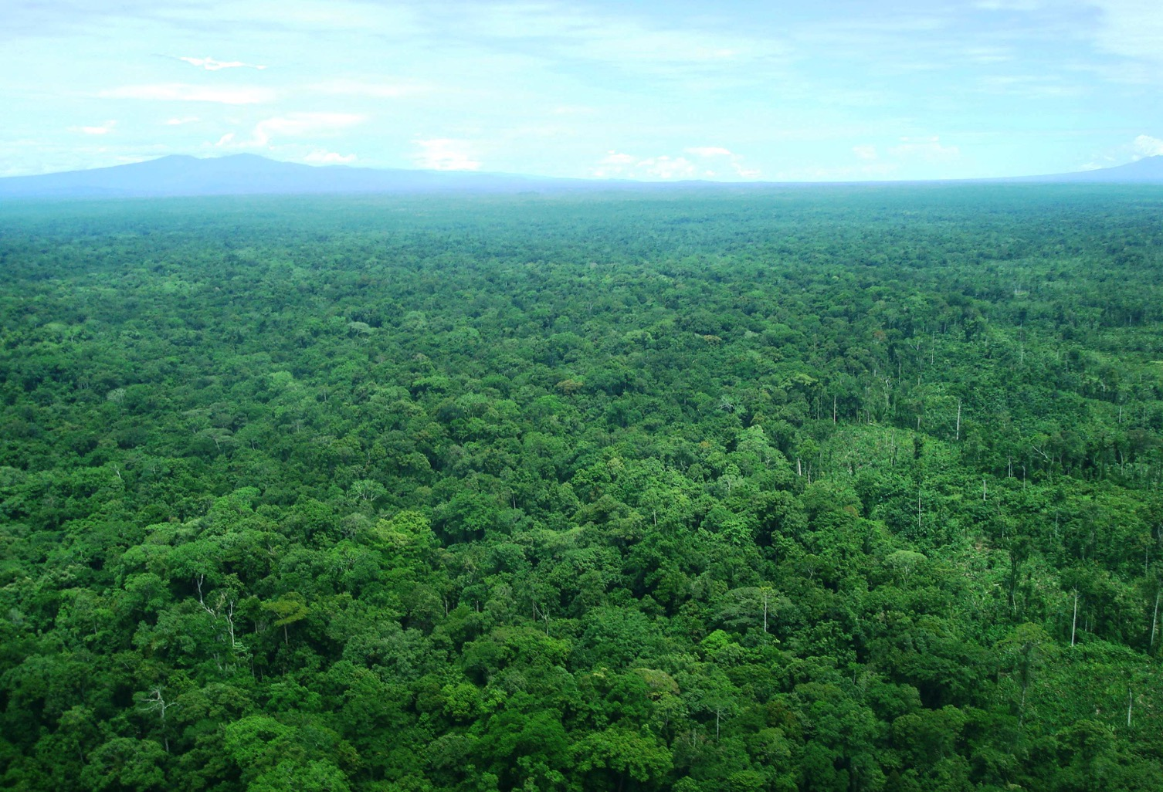

Slide 10
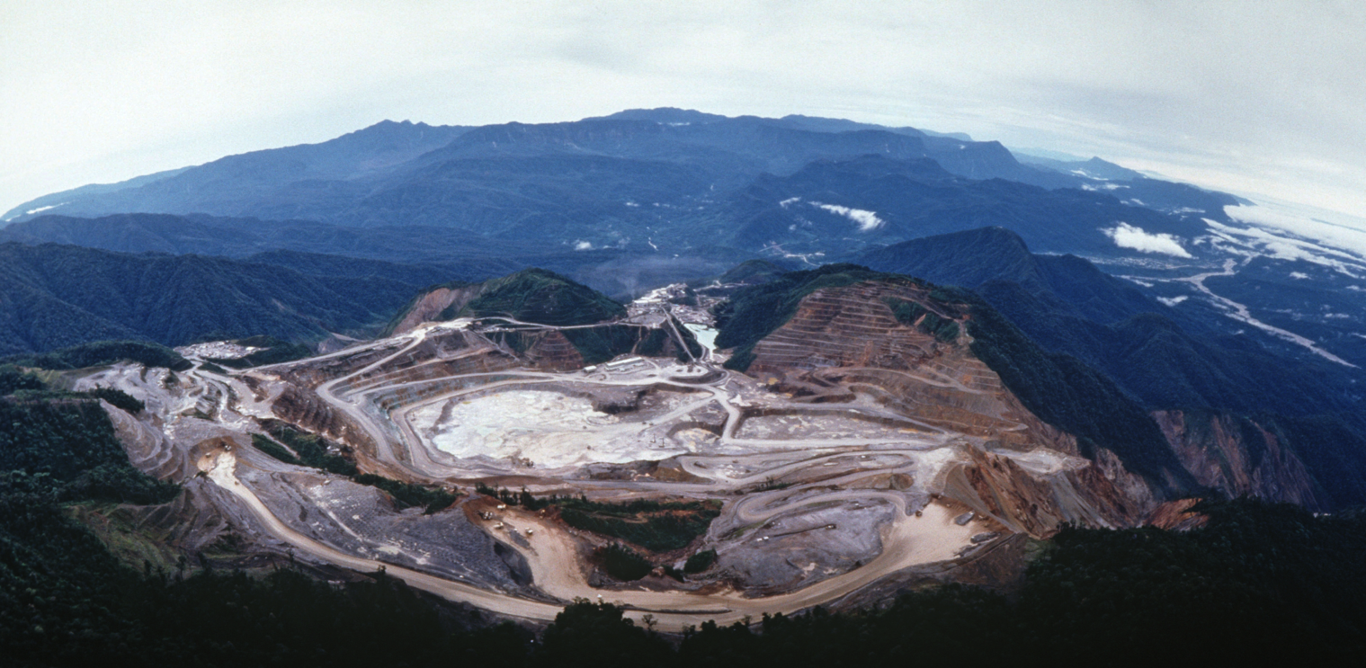

Slide 11
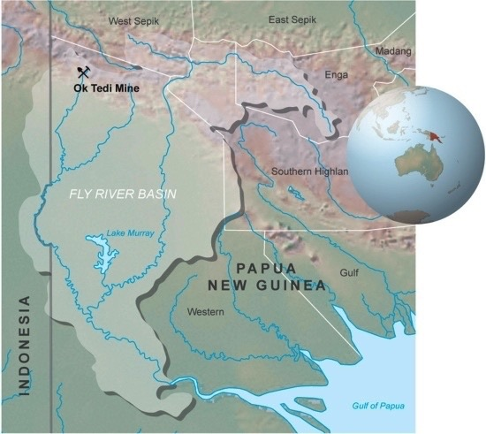

Slide 12
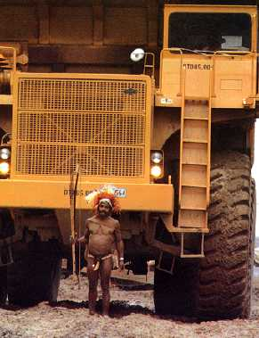

Slide 13
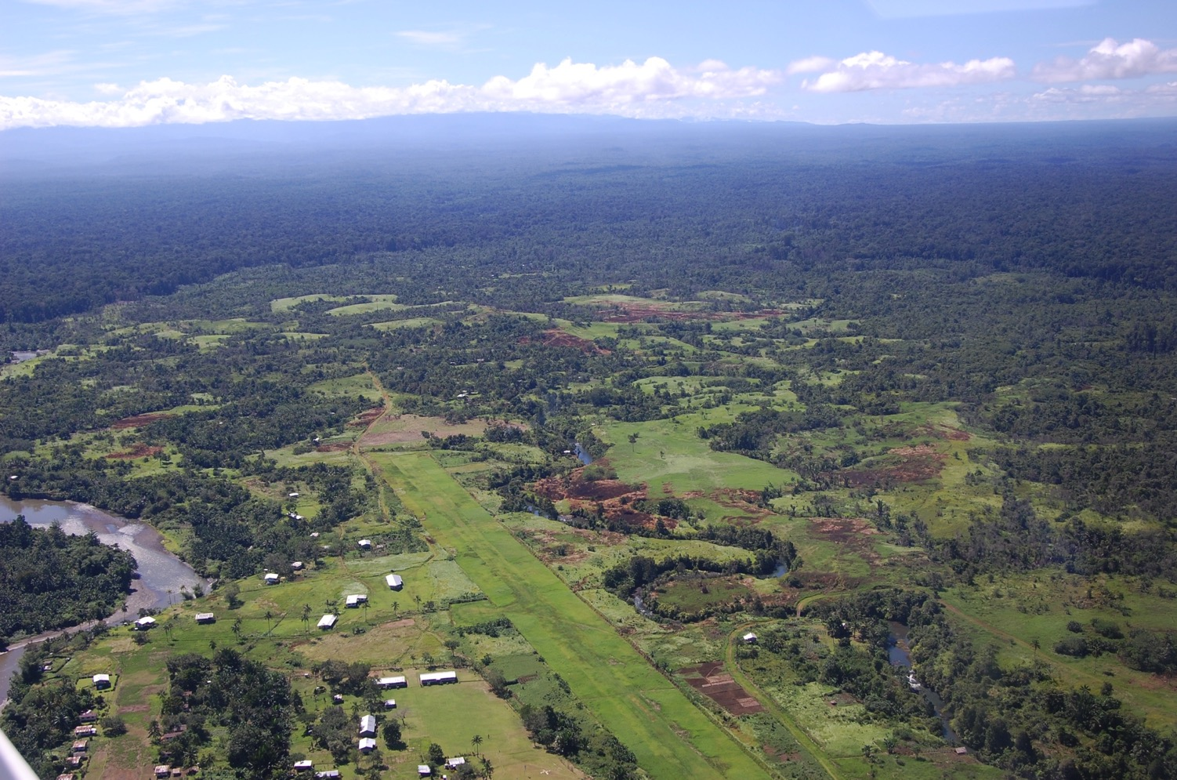

Slide 14
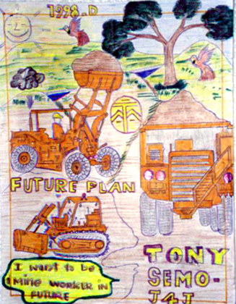

Slide 15
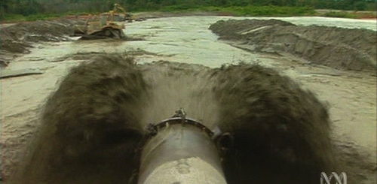

Slide 16
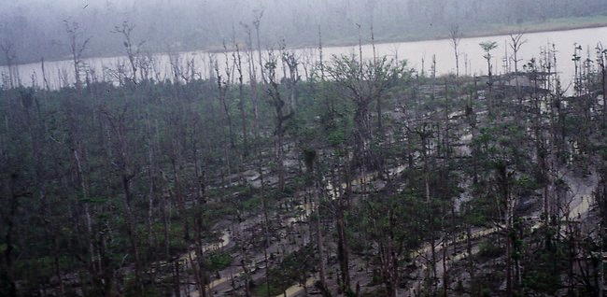

Slide 17
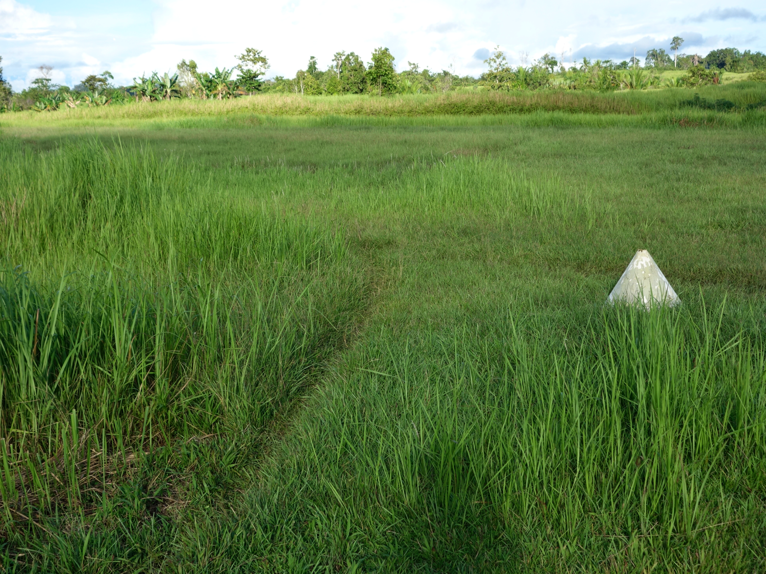

Slide 18
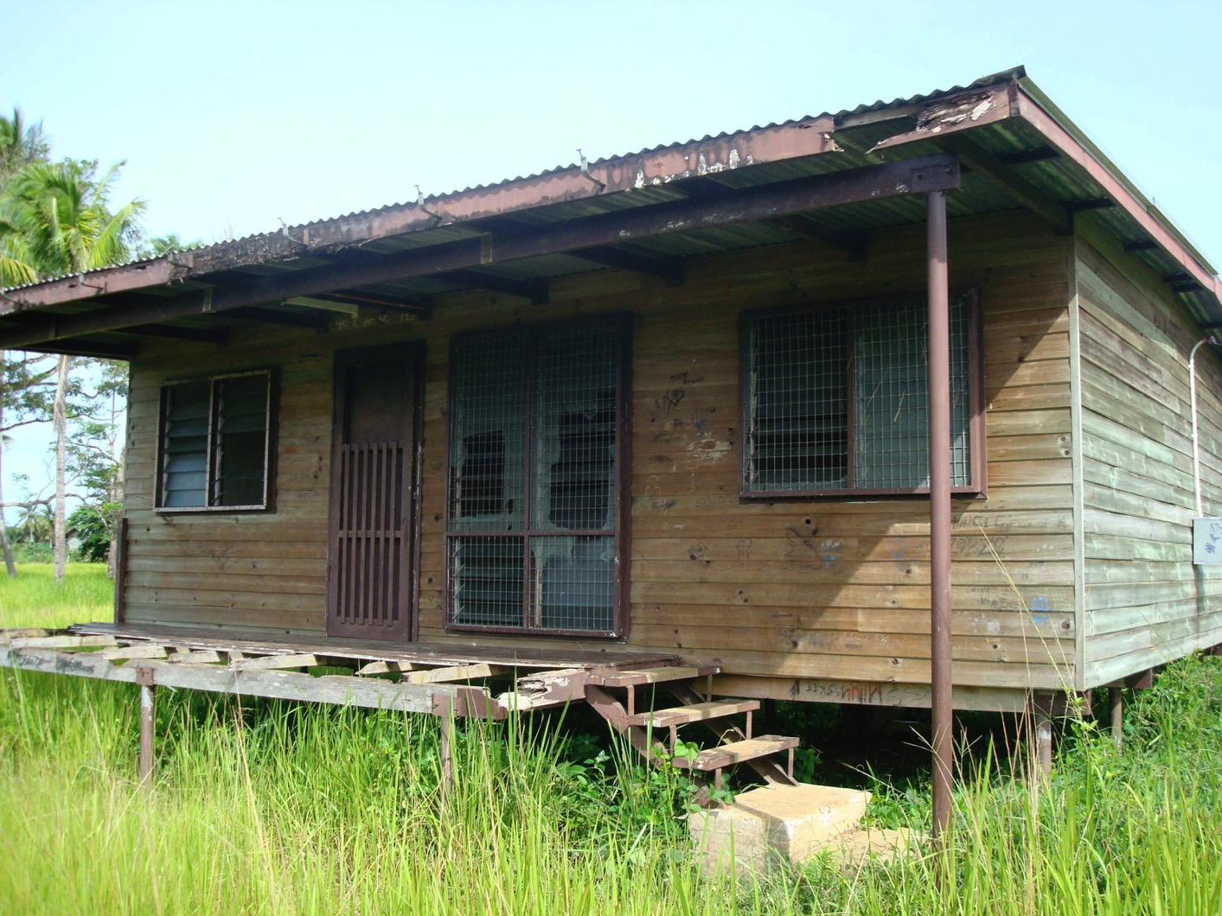

Slide 19
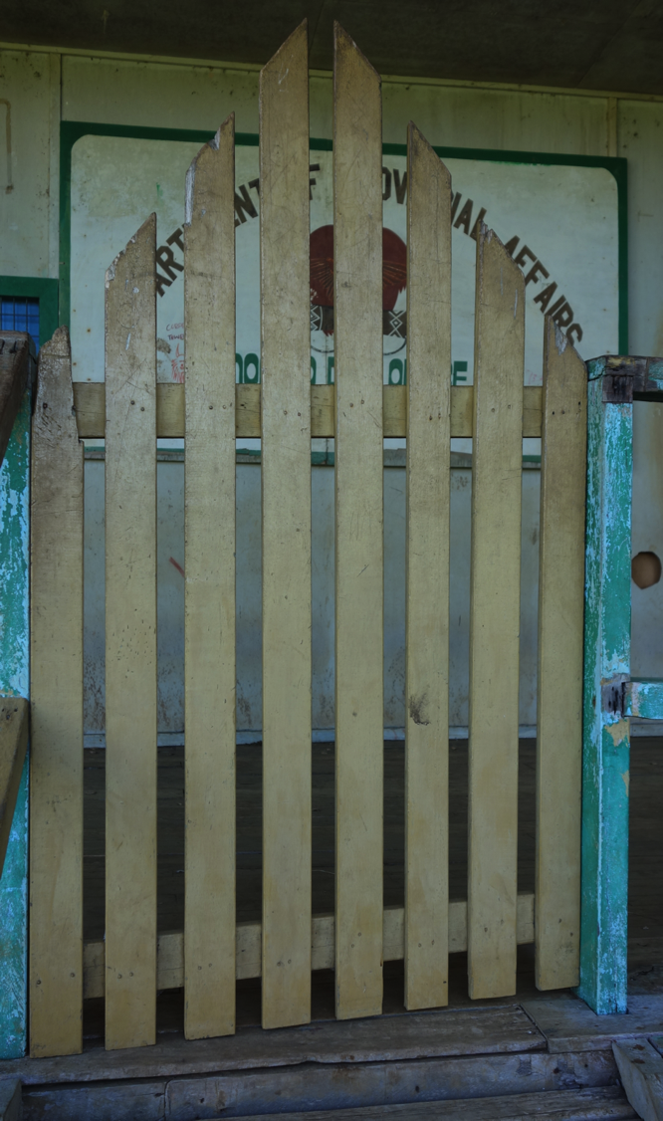

Slide 20
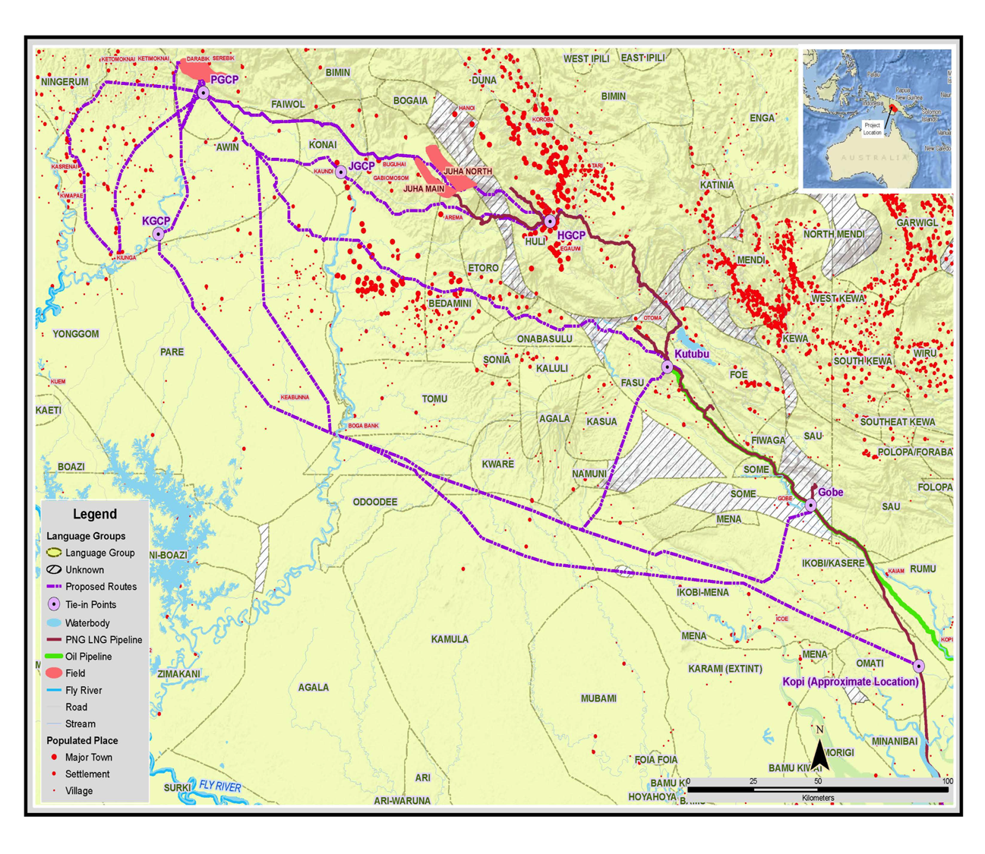

Slide 21
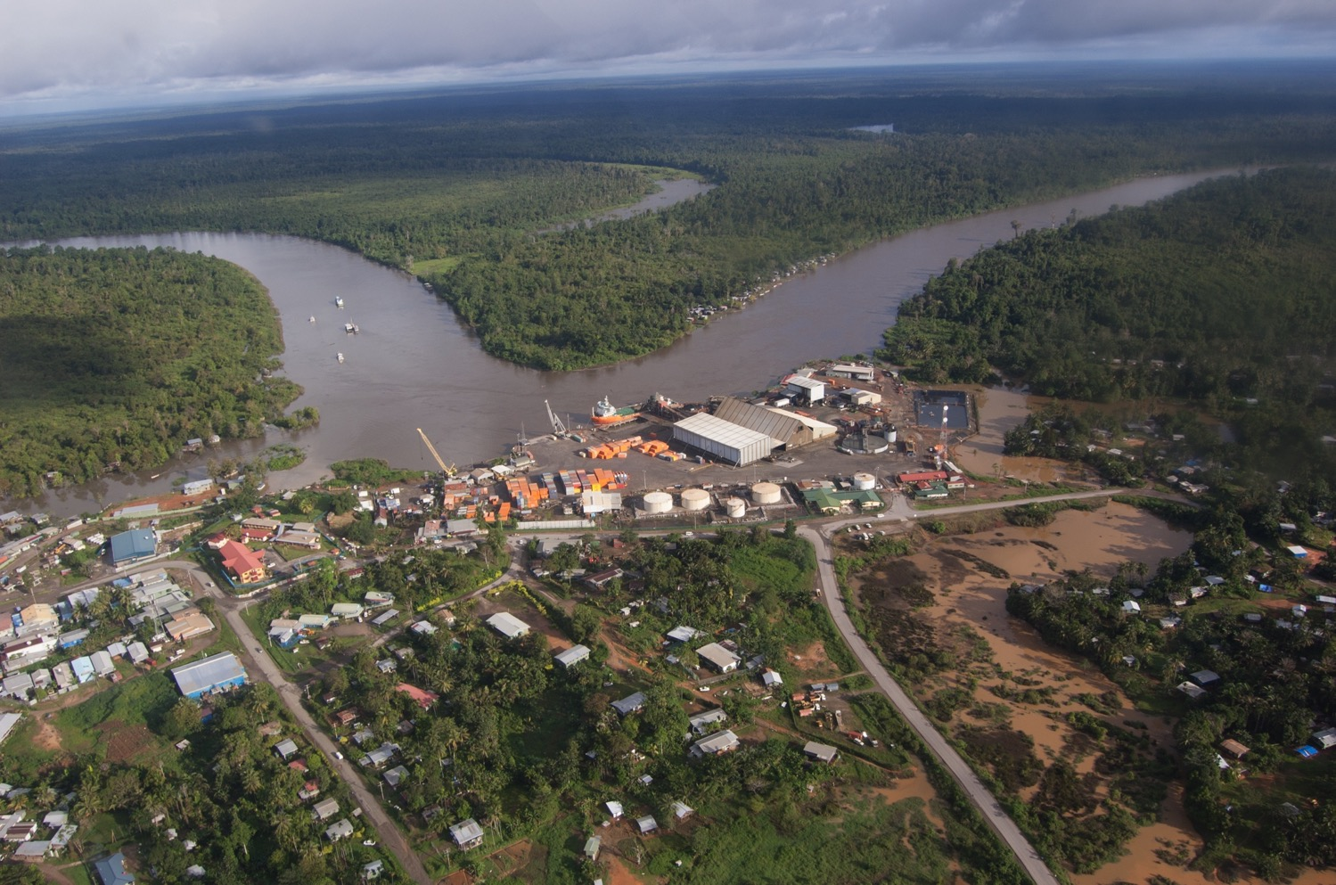

Slide 22
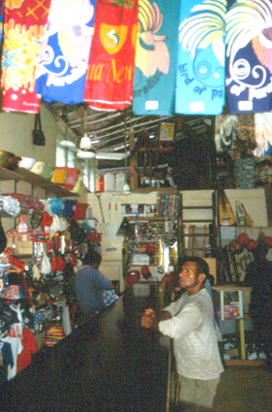

Slide 23
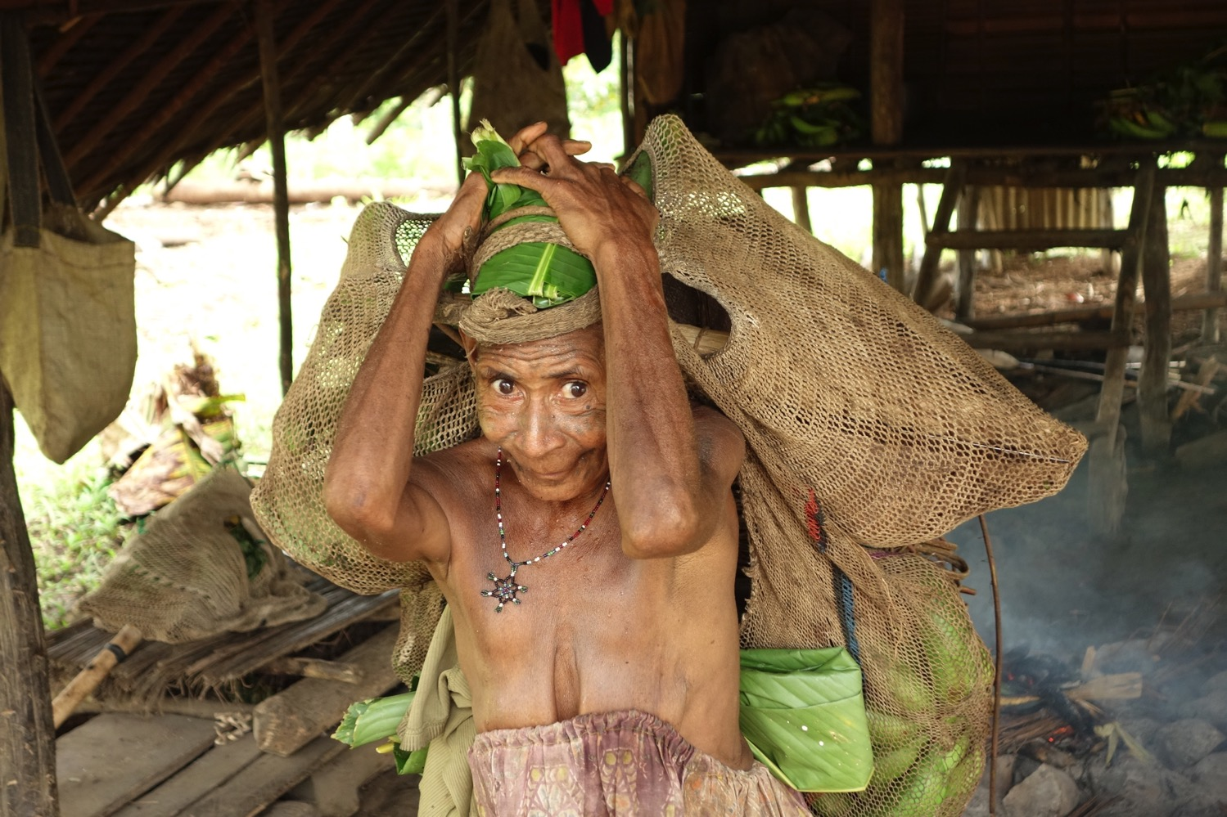

Slide 24
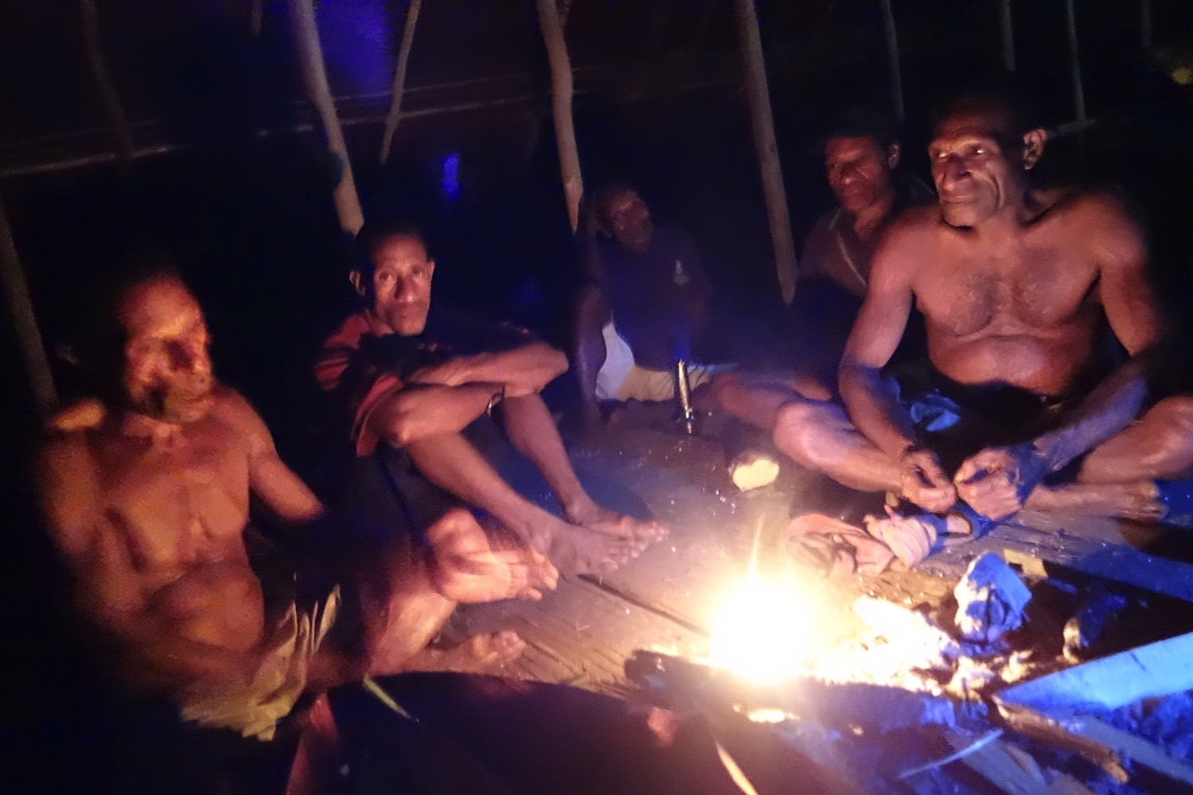

Slide 25
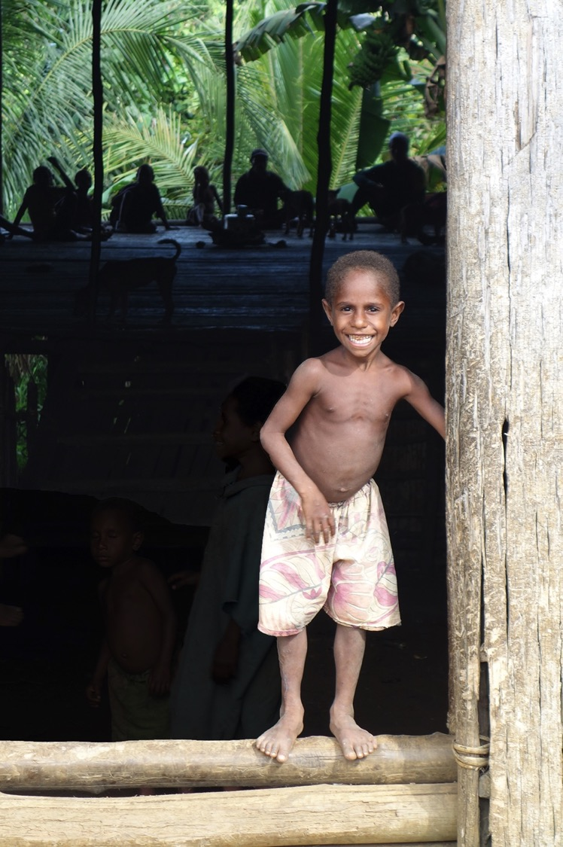

Slide 26
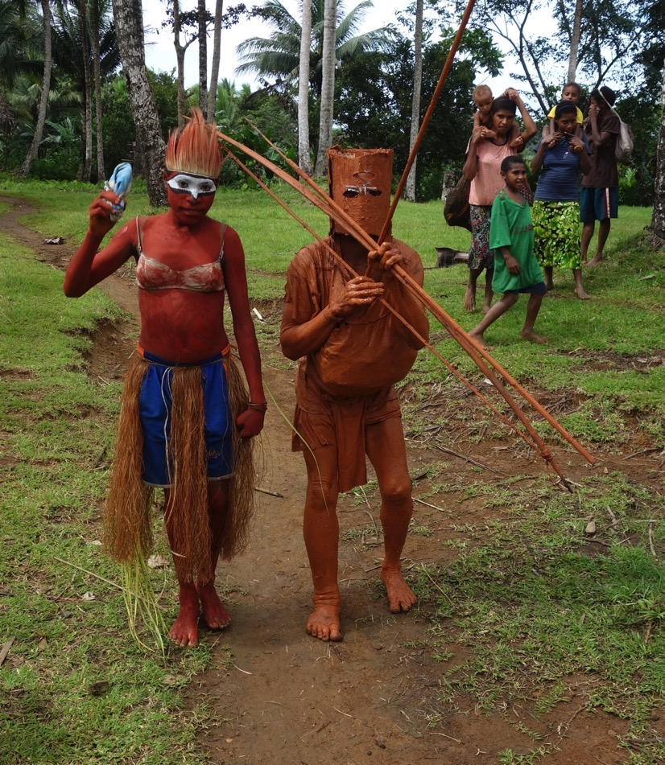

Slide 27
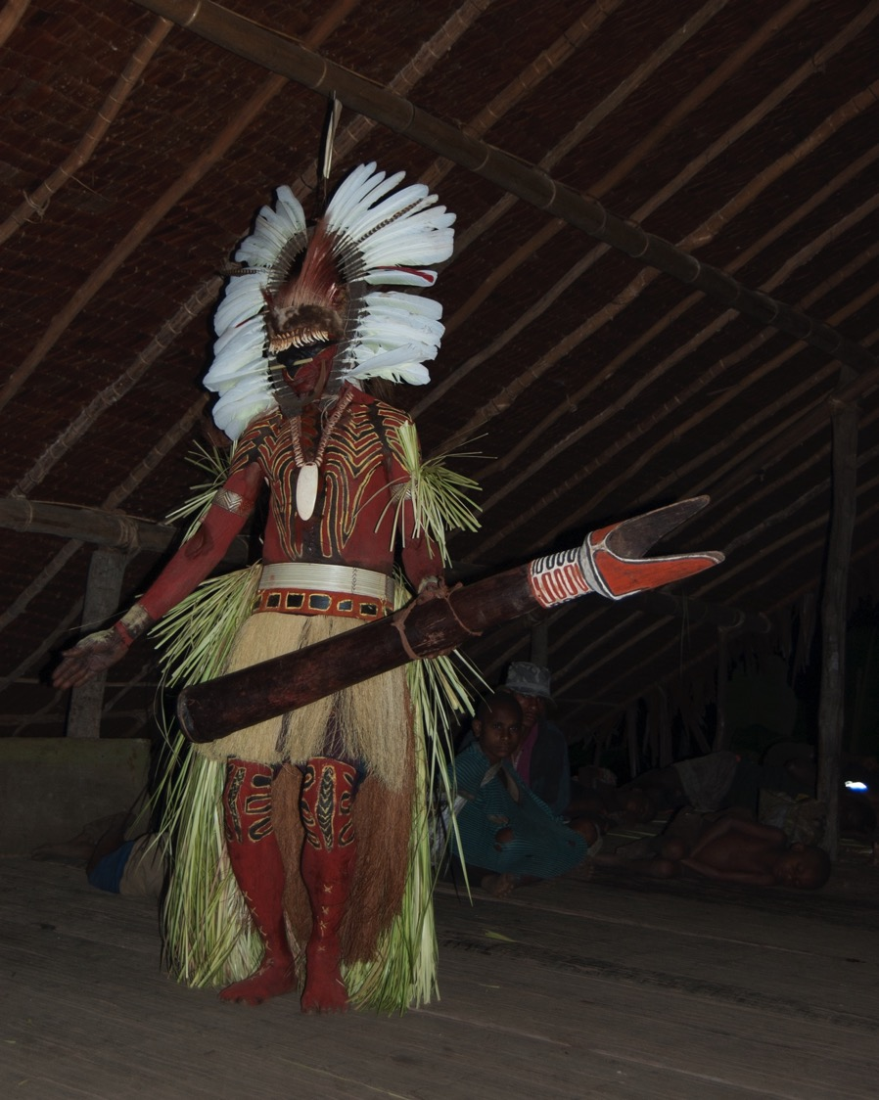

Slide 28
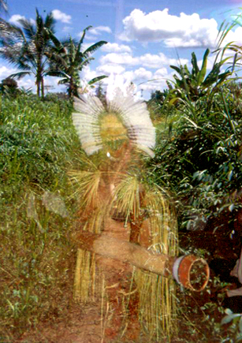

Slide 29
Martha McIntyre “The Changing Value of Women’s Work on Lahir” (2015:1)
“I asked a woman with whom I work: ‘What does money do?’ She replied ‘It makes men drunk and young women single mothers – money has spoiled this place.’”
“In 1994 Filer predicted various forms of ‘social disintegration’ for Lihir. Great economic inequalities that now exist, violent arguments, once rare, are commonplace. Millions of kina has been spent on beer. The simultaneous introduction of beer, roads, crimes and motor vehicles has its own devastating effect.”

Slide 30
Jerry Jacka Alchemy in the Rainforest (2015:231)
“In essence, I argue that Porgera is a massive development failure both socially and environmentally.
“[T]he costs of mining in human lives and the degradation of biodiversity far outweigh the benefits of development.”

Slide 31
Alex Golub Leviathans at the Gold Mine (2014:139-40)
Among those privileged few at Porgera who receive major compensation benefits and relocation housing, Golub (2016:139-40) suggests that their settlement was:
“considered dangerous, dirty, degraded, and squalid,” and so awash in drunkenness, gambling, prostitution, kept women, and unsavory and uncomfortable living conditions that many preferred to go and sleep in their traditional bush houses.

Slide 32
Colin Filer and Martha McIntyre ”Grass Roots and Deep Holes” (2006:216)
“In the minds of most Papua New Guinean ‘grassroots’ or village people, mining has become the way to gain wealth rapidly and to ensure that dreams of ‘development’ and ‘modernity’ come true.”
Though nongovernmental organizations “have tended to emphasize the negative impacts of mining, especially on indigenous communities and their environments,” the responses of Papua New Guineans themselves, “testify to the enthusiasm with which Melanesians welcome mining on their land” (ibid.:221).

Slide 33
Colin Filer and Martha McIntyre ”Grass Roots and Deep Holes” (2006:226)
“The experience of marginality in one project in no way dampen enthusiasm for yet further large-scale projects.”

Slide 34
Strickland-Bosavi Area: ‘Of Course it Might,’ OR Things in the mirror may be closer than they appear
Dwyer and Minnegal, “Waiting for Company” (1999)
Minnegal and Dwyer, Navigating the Future (2017)
Knauft, Exchanging the Past (2002)
____, The Gebusi, pt. III (2016)
____,“Finding the Good,” (TAJA, in press)
____, Fieldnotes, 2013 [w/ L. Wood] + 2016 & 2017 [w. A-S. Malbrancke]

Slide 35
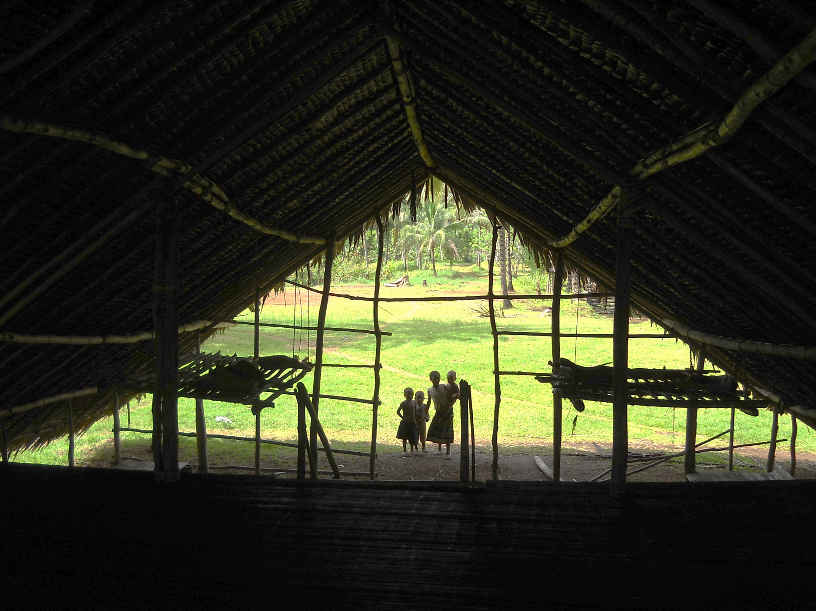

Slide 36
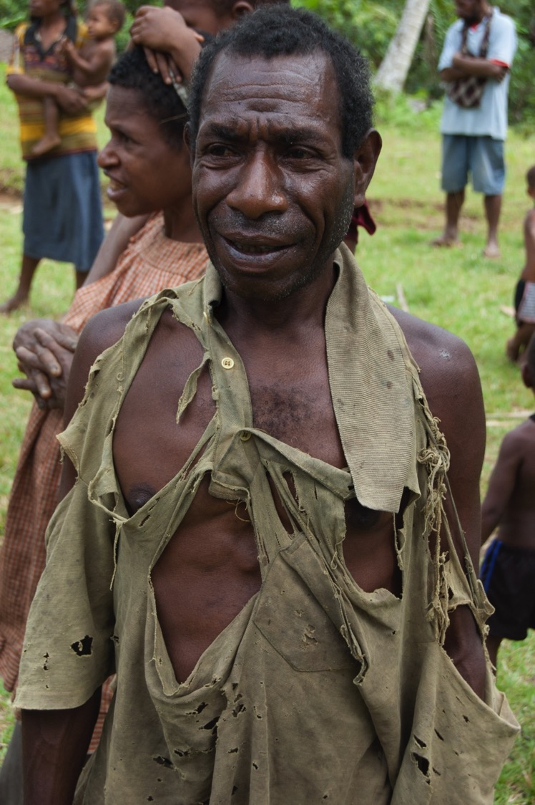

Slide 37
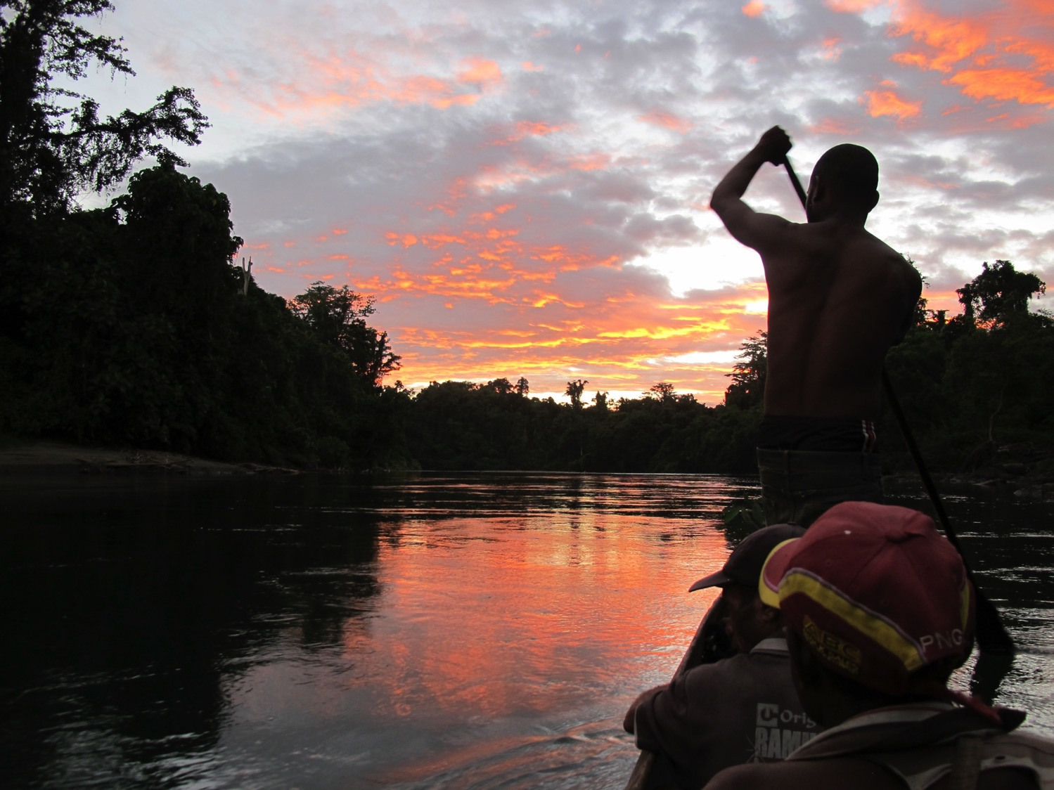

Slide 38
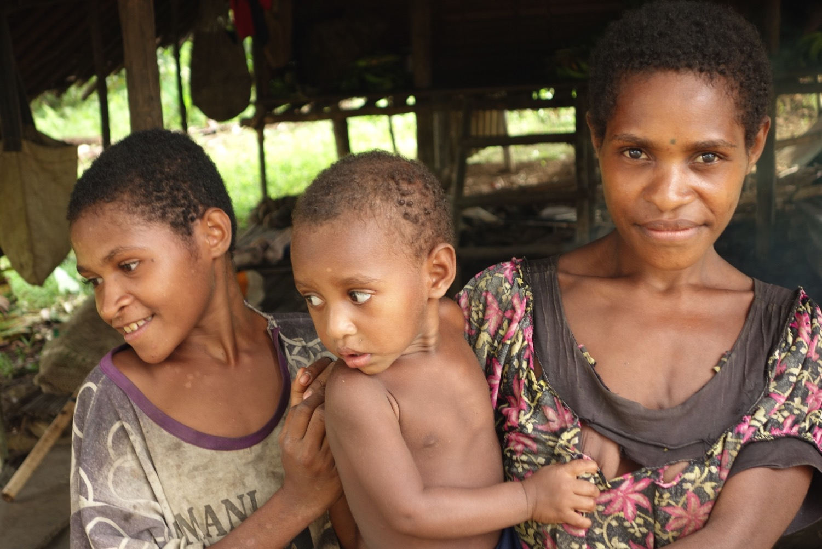

Slide 39


Slide 40
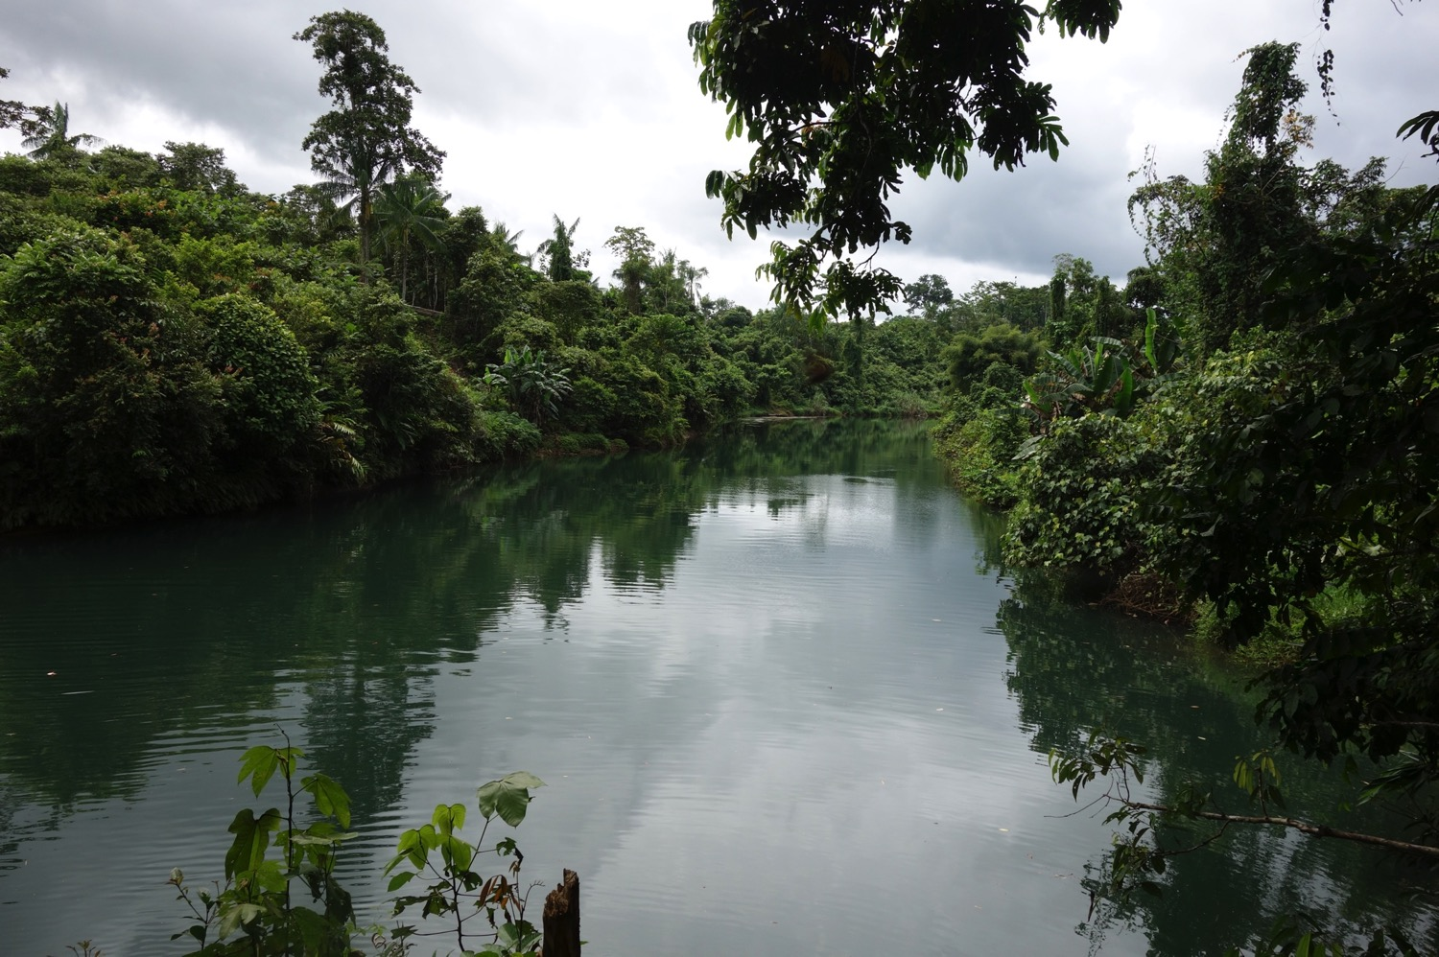

Slide 41
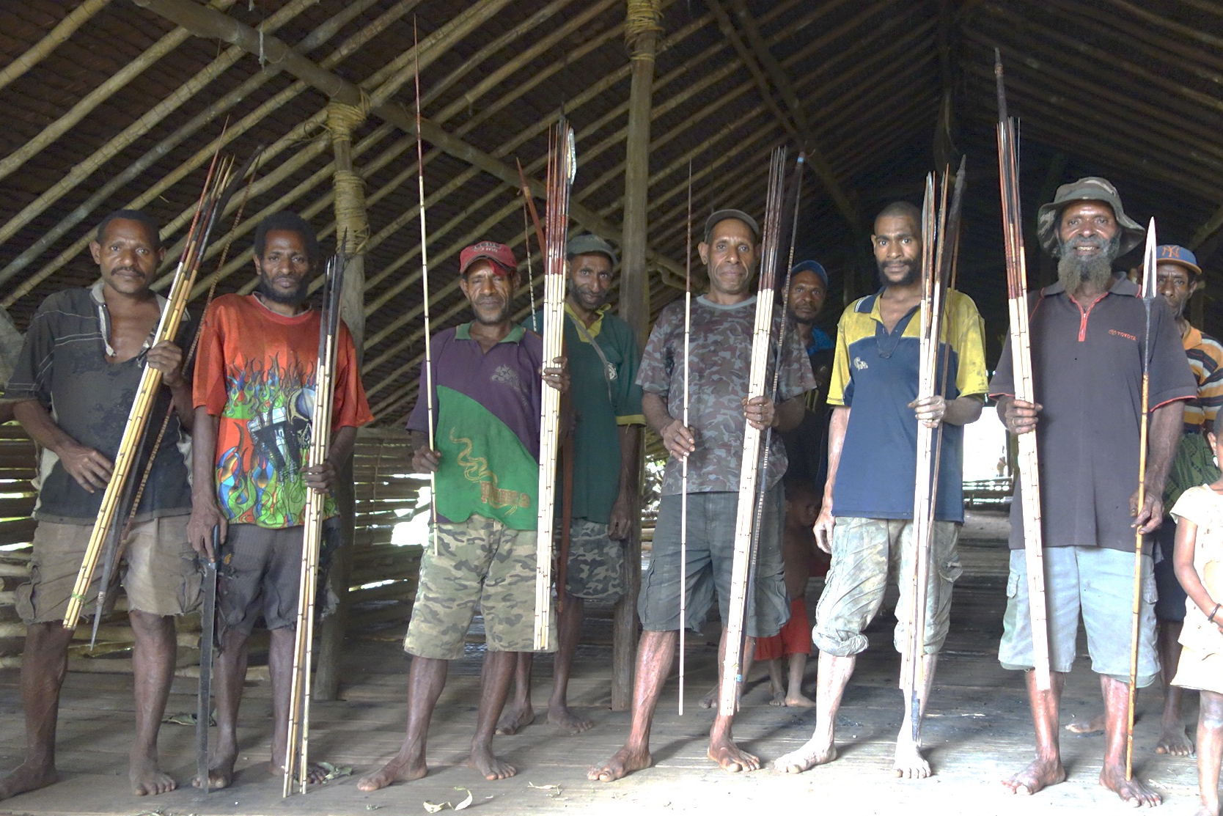

Slide 42
Conclusions
People fantasize, project, but more practically and immediately they yearn . . .
People fight with each other based on the hypothetical benefit that large-scale resource extraction might bring.
Absence of resource development does not forestall or efface such effects but can easily magnify a sense of inequality, of being left out and left behind.
This is a local inflection or incarnation of a sense of being a suffering subject, of left behind in the tidal development of modernity -- and precluded from benefit by others who stand in one’s rightful way (cf., Robbins 2013; see Knauft in press).

