Slide 1
The History of Us – White, Black and Together in the US

Slide 2
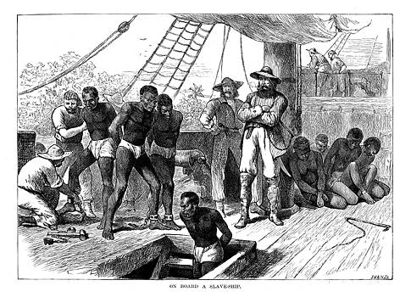
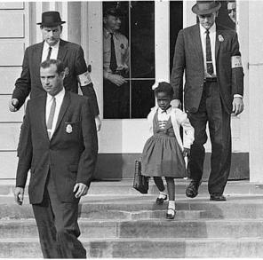
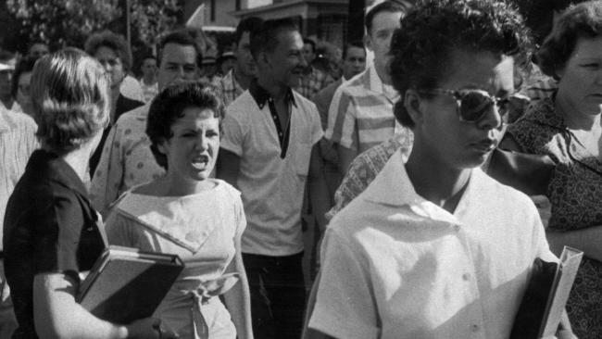
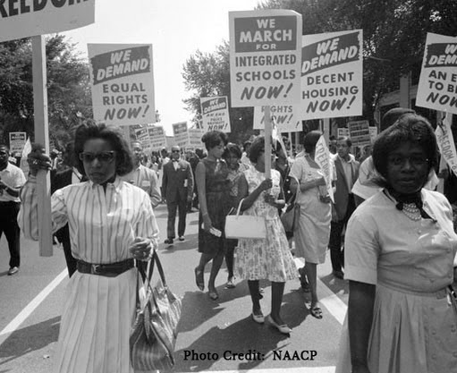
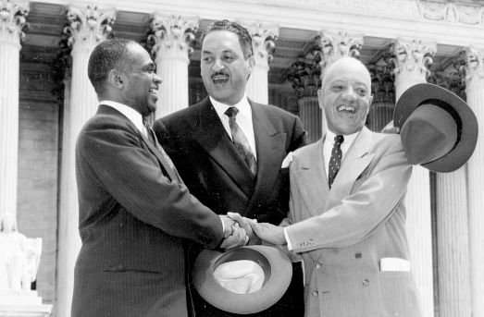
The History of Us

Slide 3
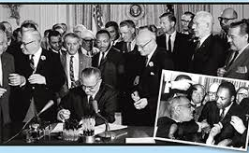

Slide 4
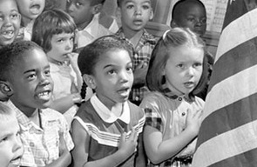
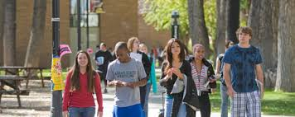
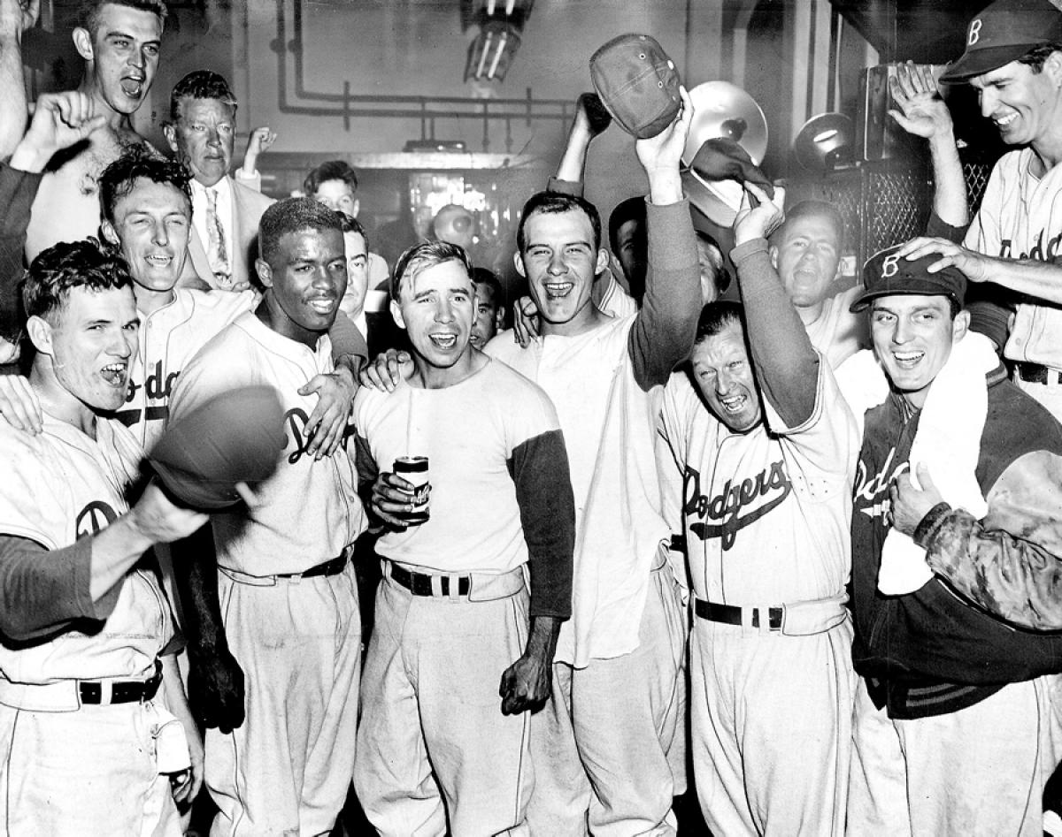
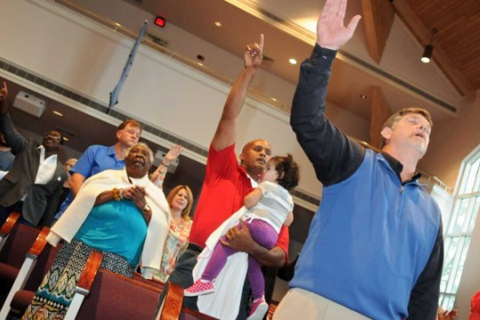

Slide 5
The first African slaves arrived at Jamestown in 1619…

Slide 6
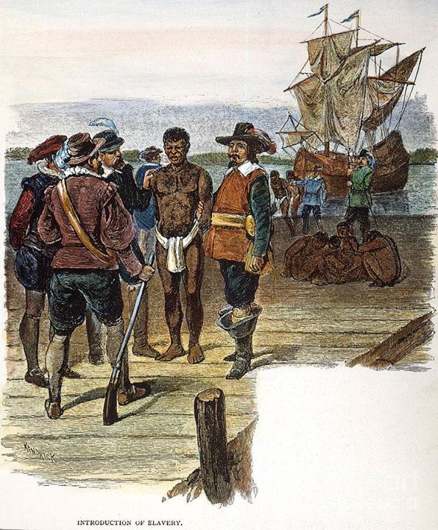
And trading in slaves became big business…

Slide 7
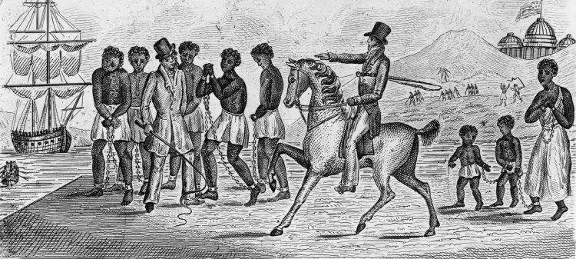
And owning slaves was not only a sign of wealth, but also a means to greater wealth…

Slide 8
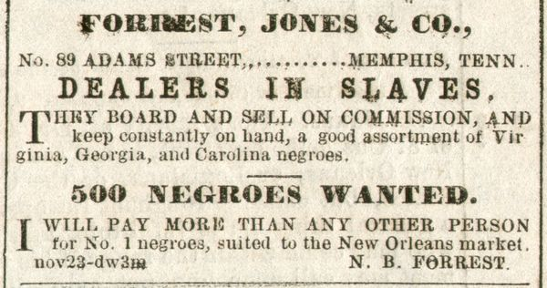
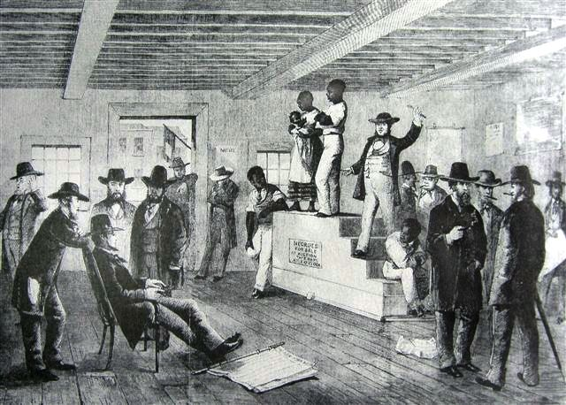
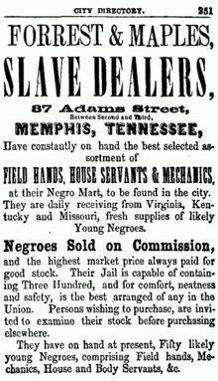

Slide 9
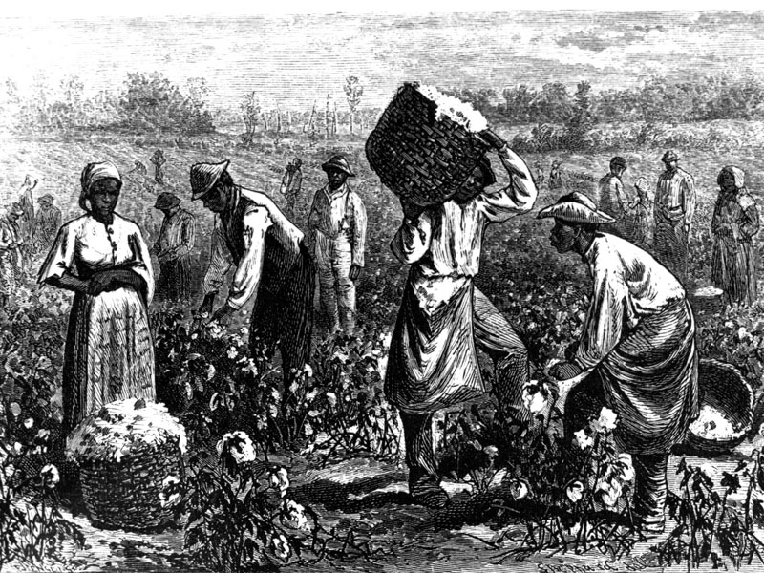

Slide 10
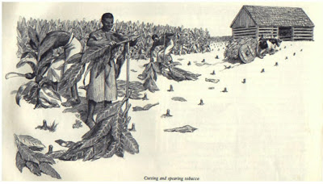

Slide 11
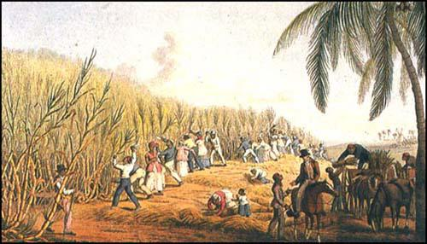

Slide 12
States with Highest Slave Populations in 1860
State | Total Pop. | Slave Pop. | % Slaves
S. Carolina | 703,708 | 402,406 | 57%
Mississippi | 791,305 | 436,631 | 55%
Louisiana | 708,002 | 331,726 | 47%
Alabama | 964,201 | 435,080 | 45%
Georgia | 1,057,286 | 462,198 | 44%
Florida | 140,424 | 61,745 | 44%
N. Carolina | 992,622 | 331,059 | 33%
Virginia | 1,596,318 | 490,865 | 31%
Texas | 604,215 | 182,566 | 30%
Arkansas | 435,450 | 111,115 | 26%
Tennessee | 1,109,801 | 275,719 | 25%
Kentucky | 1,155,684 | 225,483 | 20%

Slide 13
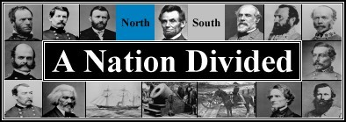
A nation divided…

Slide 14
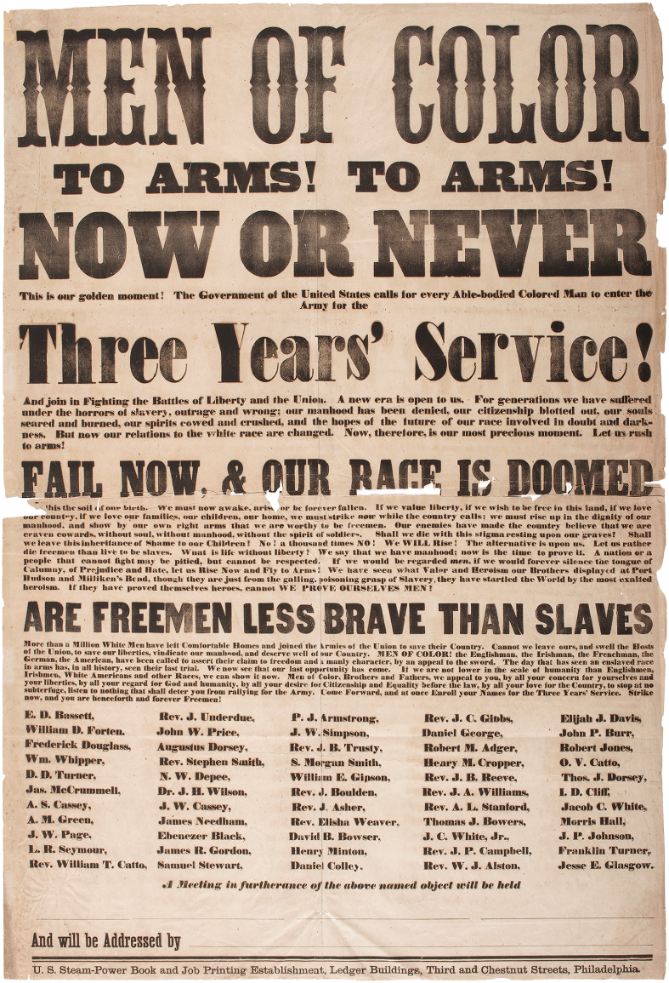
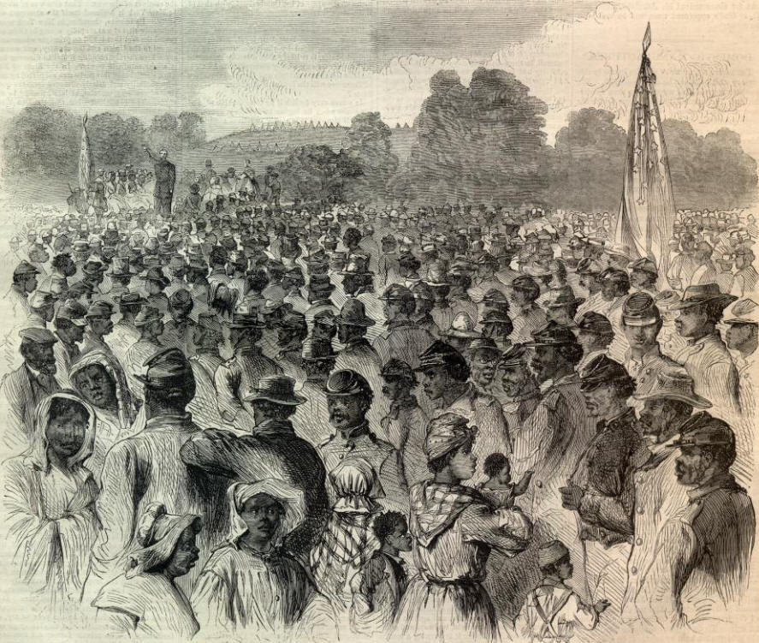
A nation at war…

Slide 15
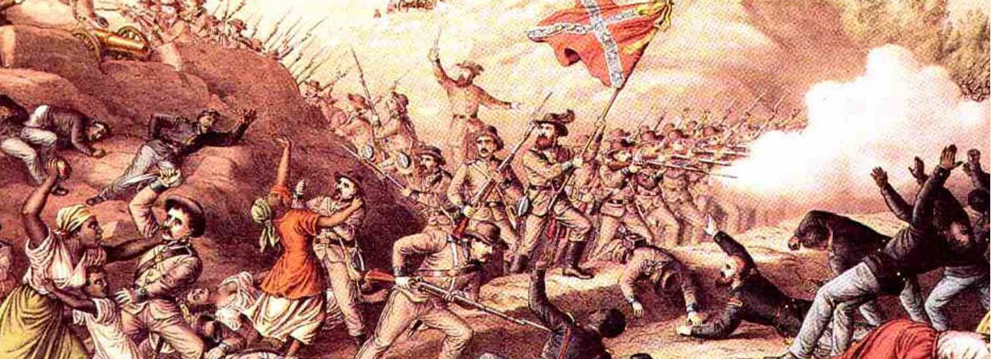
A nation at war…

Slide 16
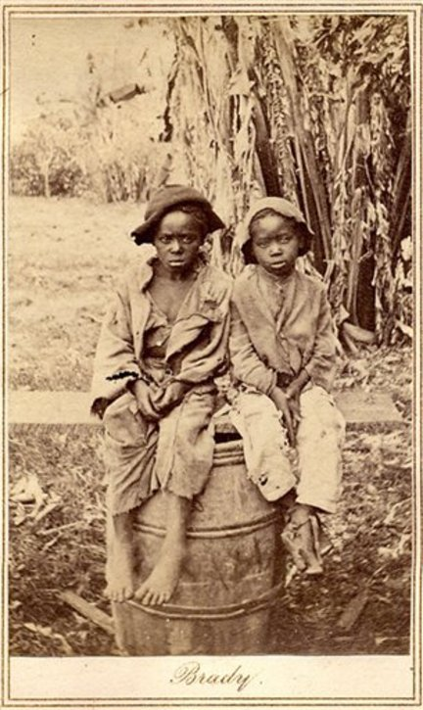
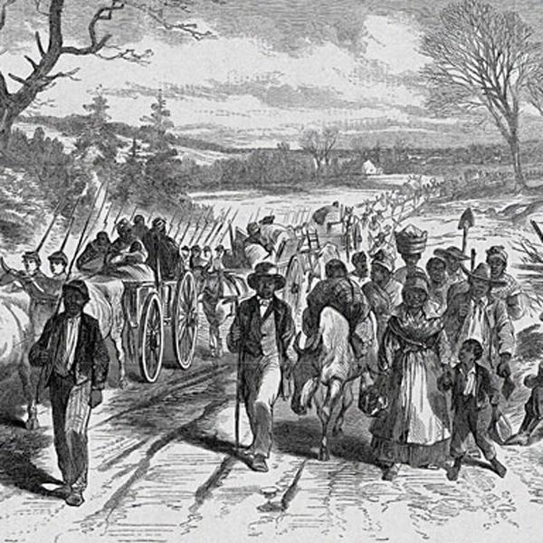
A declaration of freedom…but where do we go?

Slide 17
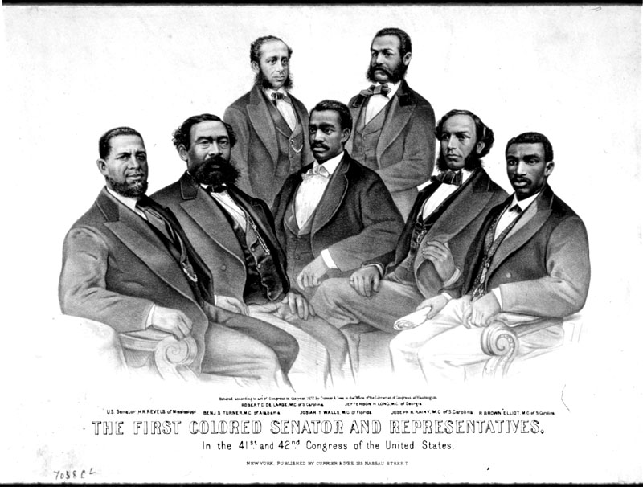
Reconstruction looked promising.

Slide 18
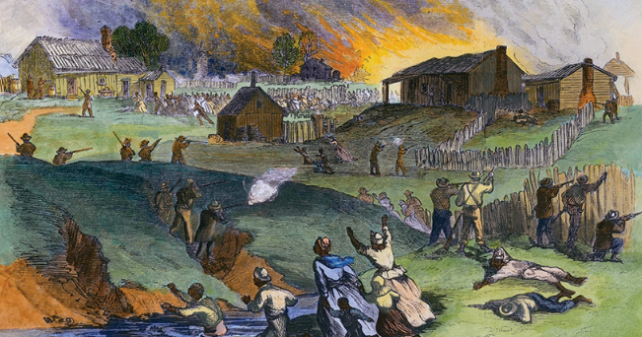
But our shared history has been a painful one.

Slide 19
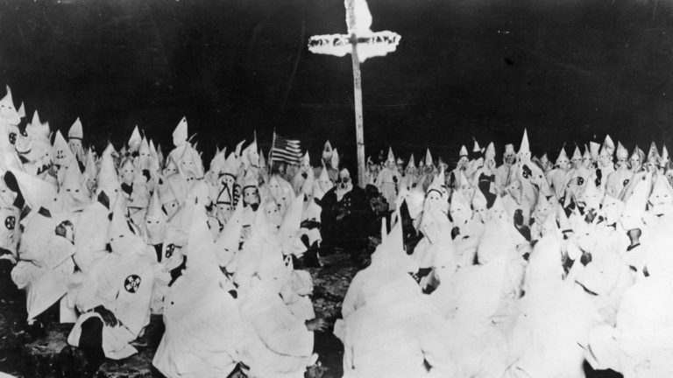
Our shared history has been a painful one.

Slide 20
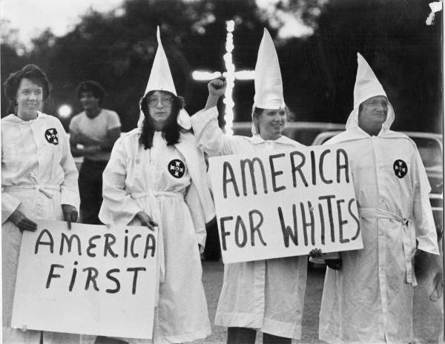
Our shared history has been a painful one.

Slide 21
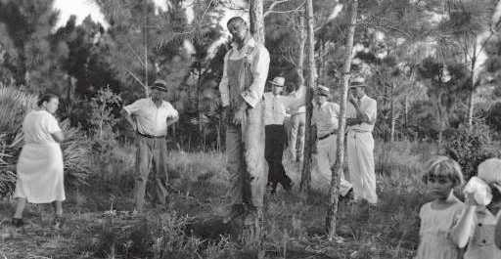
Our shared history has been a painful one.

Slide 22
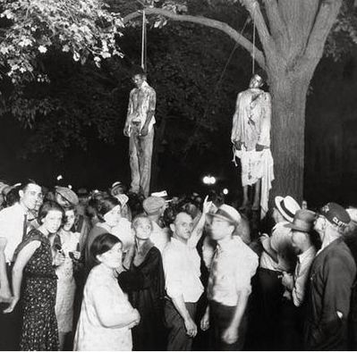
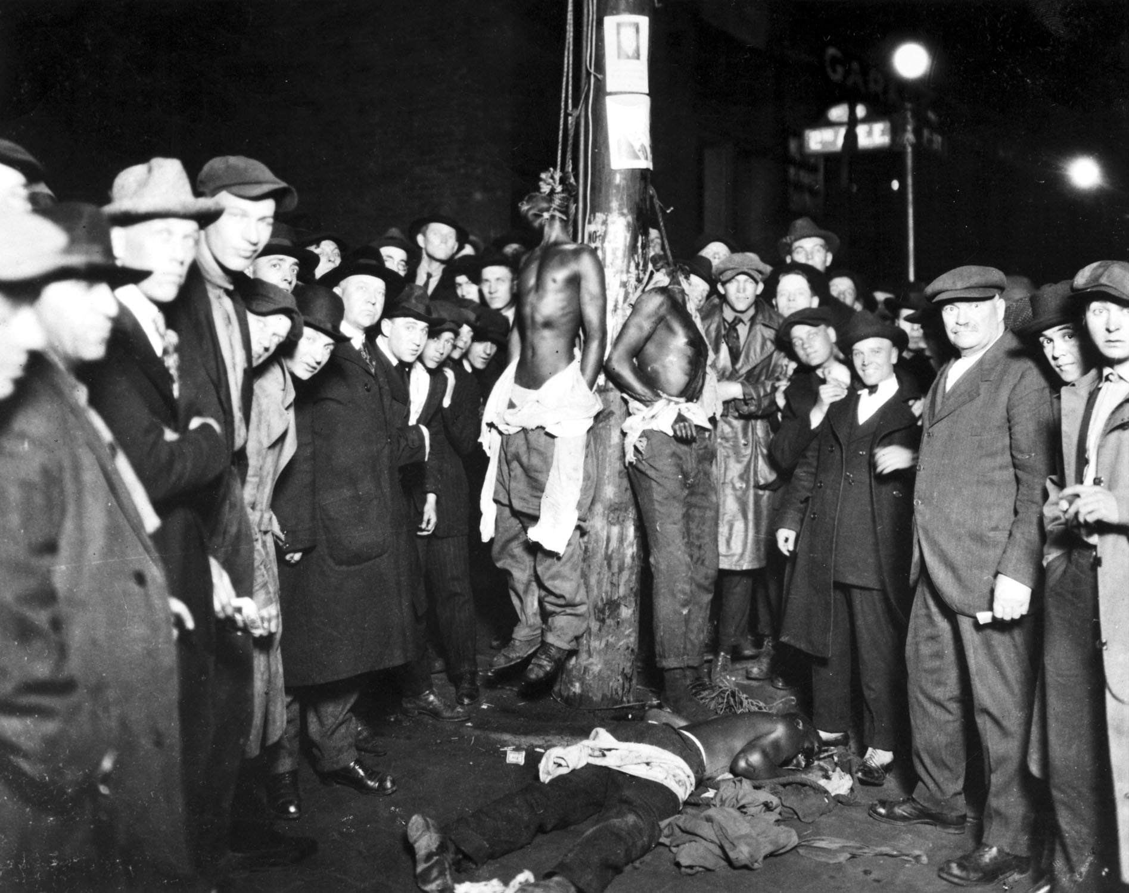
Our shared history has been a painful one.

Slide 23
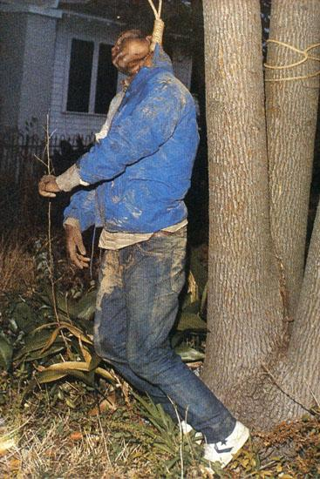
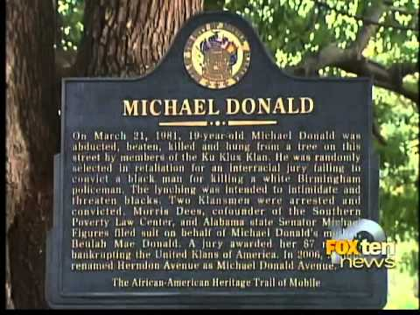
Our shared history has been a painful one.

Slide 24
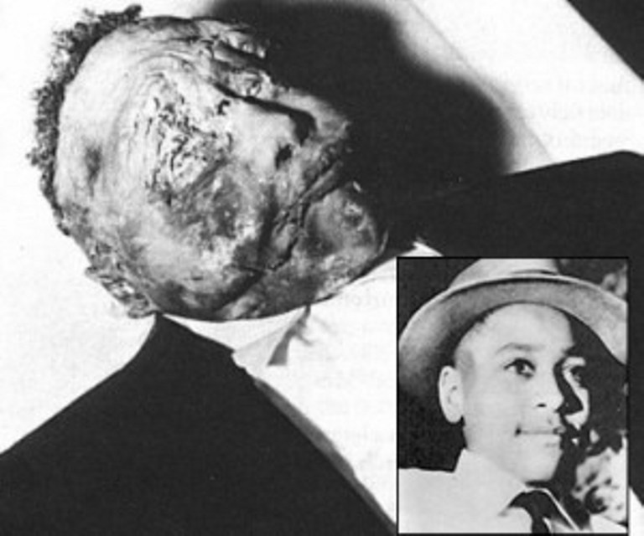
Our shared history has been a painful one.

Slide 25
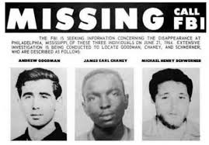
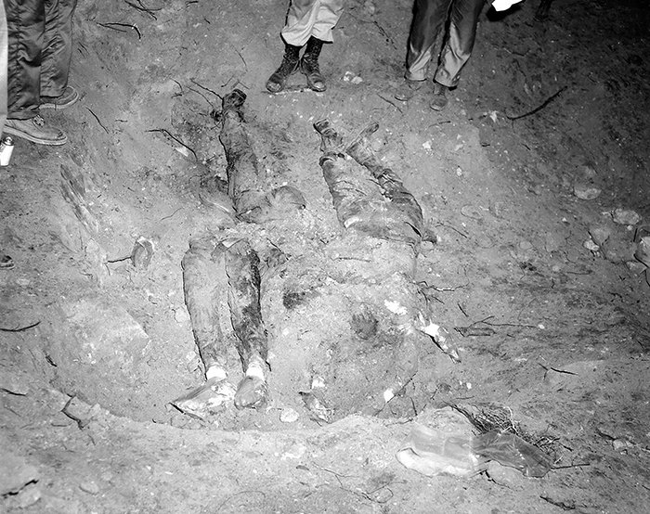
Our shared history has been a painful one.

Slide 26
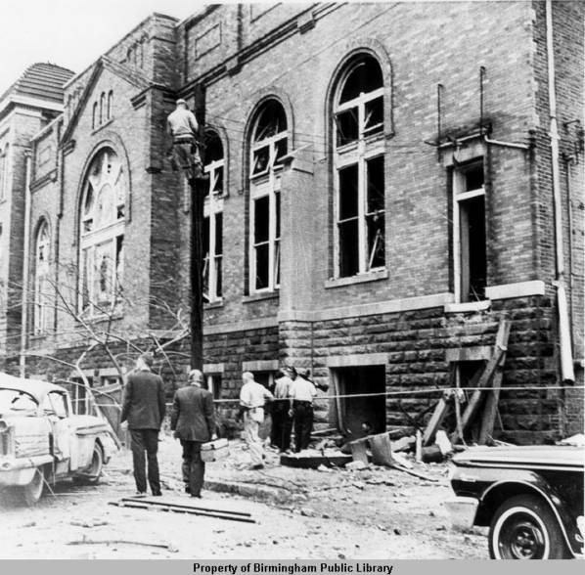
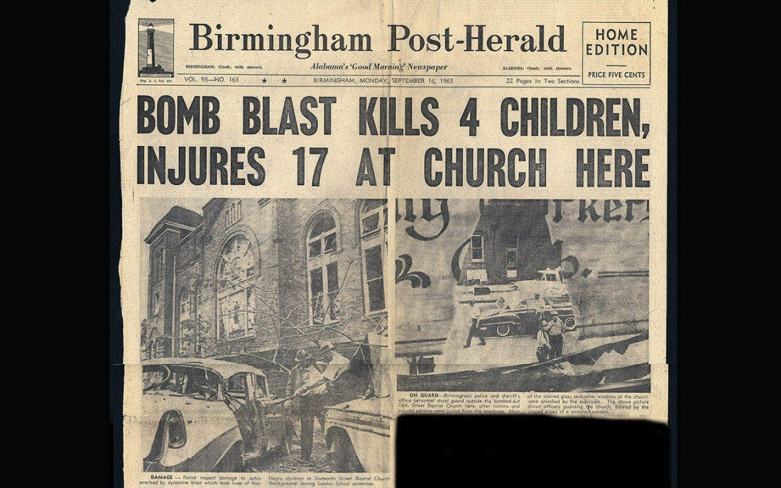
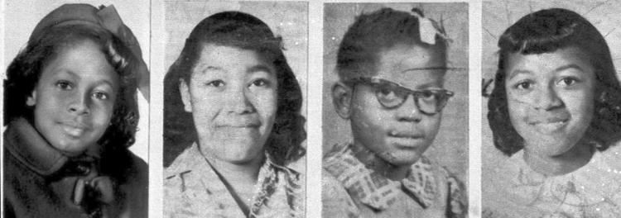
Our shared history has been a painful one.

Slide 27
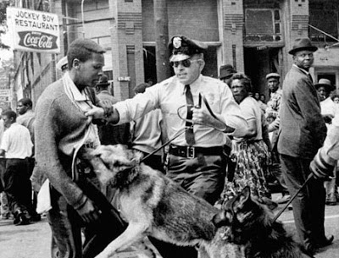
Our shared history has been a painful one.

Slide 28
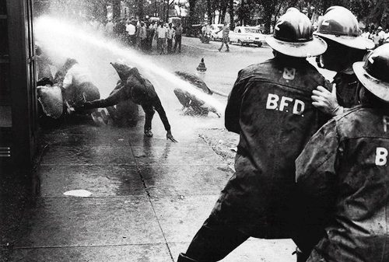
Our shared history has been a painful one.

Slide 29
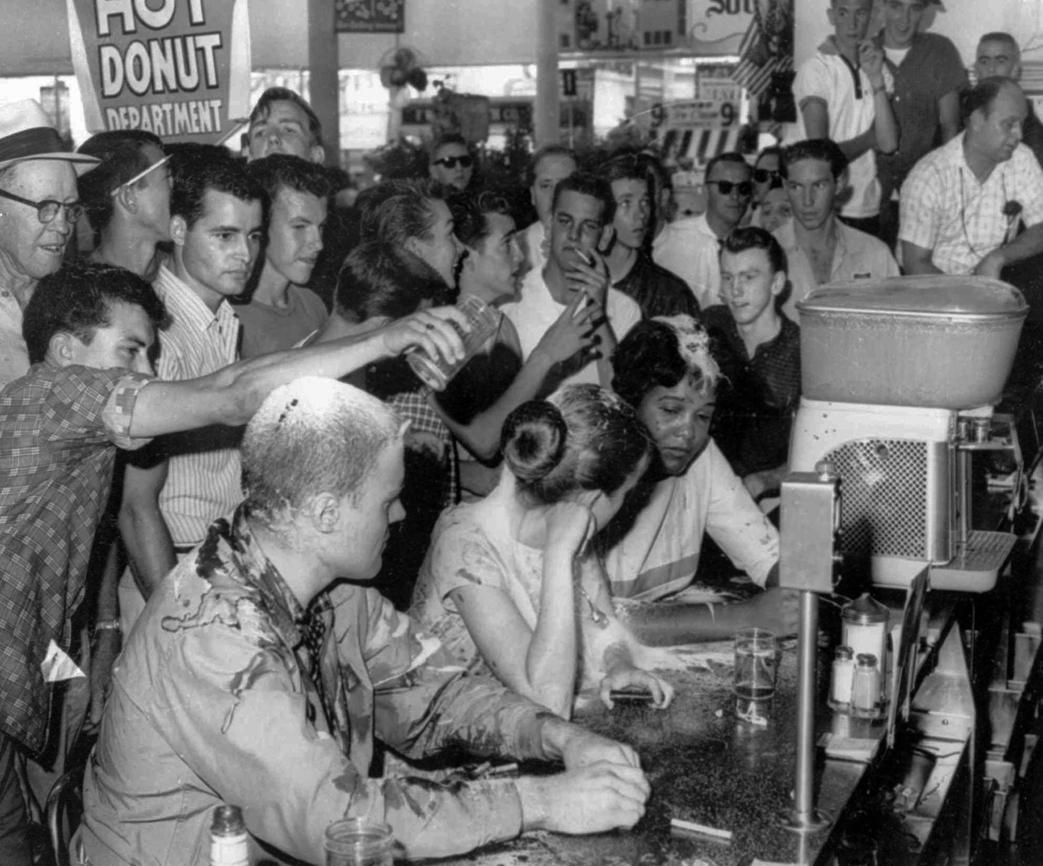
Our shared history has been a painful one.

Slide 30
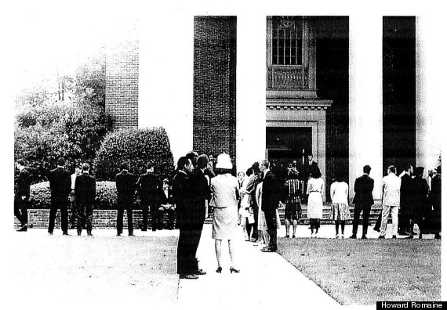
Our shared history has been a painful one.

Slide 31
Laws were passed…

Slide 32
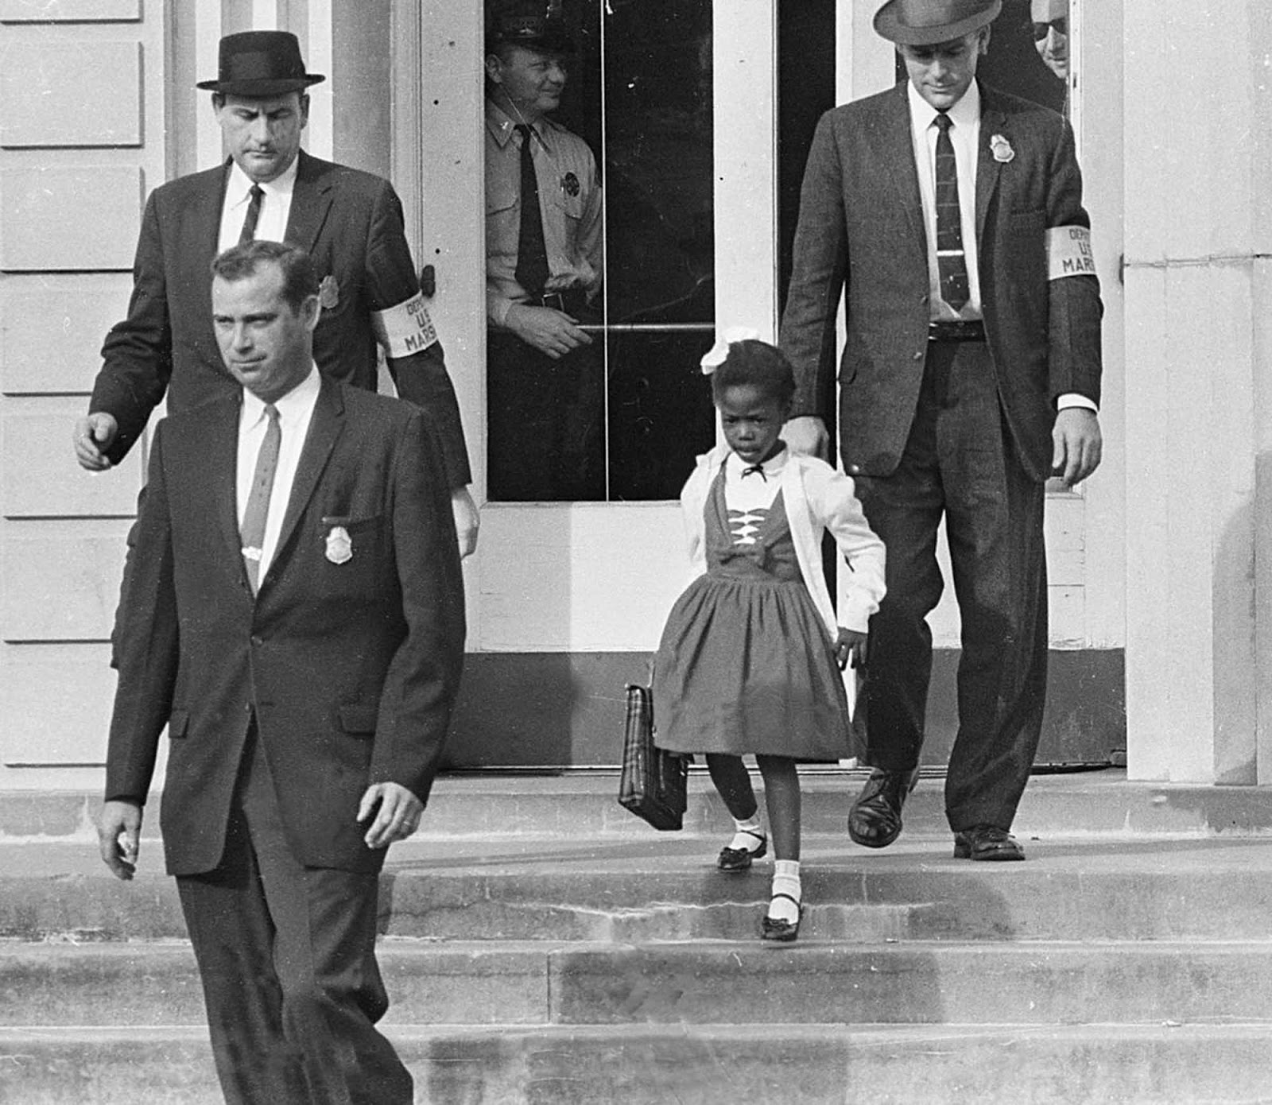
Schools were to be desegregated with all deliberate speed…

Slide 33
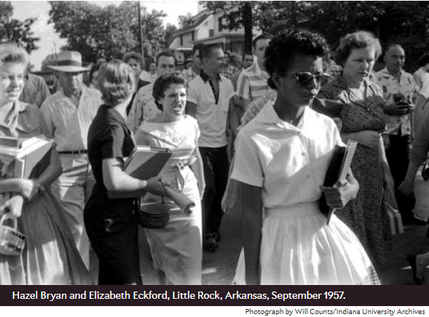
Schools were to be desegregated with all deliberate speed…

Slide 34
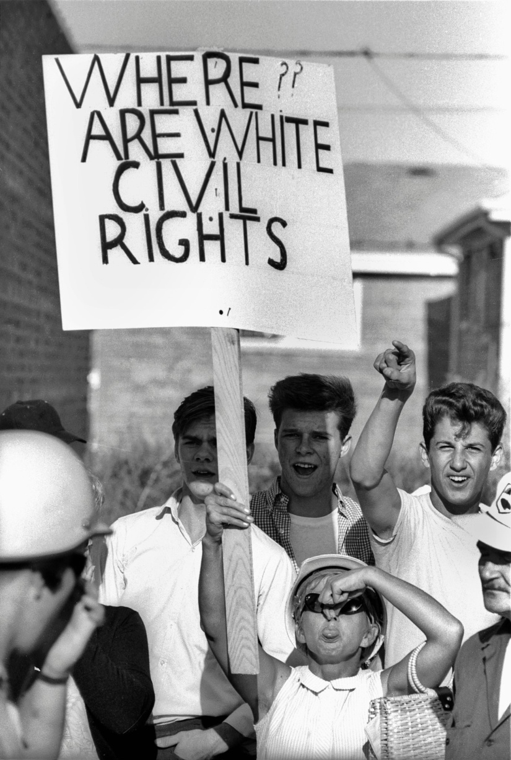
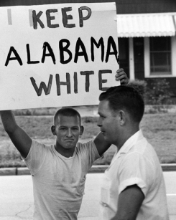
But we never came together as a nation.

Slide 35
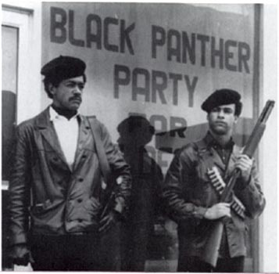
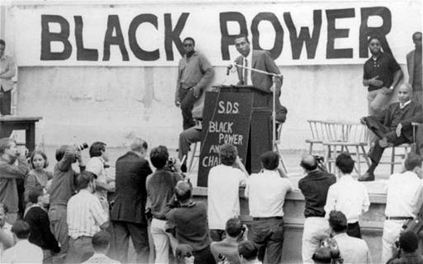
But we never came together as a nation.

Slide 36
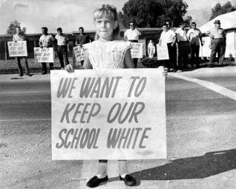
Perhaps we thought that resistance would just go away…

Slide 37
Perhaps we thought that resistance would just go away…

Slide 38
Schools after desegregation didn’t look very desegregated…

Slide 39
Neighborhoods after desegregation didn’t look very desegregated…

Slide 40
Churches after desegregation didn’t look very desegregated…

Slide 41
And perhaps the resistance really didn’t go away…

Slide 42
The lasting effect of disease, displacement and disparity in education and housing in some of our cities has become a legacy of poverty…

Slide 43
What do the scriptures say?

Slide 44
The Bible as justification for slavery…
Genesis 9:24-26
²⁴ When Noah awoke from his wine and knew what his youngest son had done to him, ²⁵ he said, “Cursed be Canaan; lowest of slaves shall he be to his brothers.” ²⁶ He also said, “Blessed by the LORD my God be Shem; and let Canaan be his slave.”

Slide 45
The Bible as justification for separation…
Nehemiah 13:24-27
²⁴and half of their children spoke the language of Ashdod, and they could not speak the language of Judah, but spoke the language of various peoples. ²⁵And I contended with them and cursed them and beat some of them and pulled out their hair; and I made them take an oath in the name of God, saying, ‘You shall not give your daughters to their sons, or take their daughters for your sons or for yourselves. ²⁶Did not King Solomon of Israel sin on account of such women? Among the many nations there was no king like him, and he was beloved by his God, and God made him king over all Israel; nevertheless, foreign women made even him to sin. ²⁷Shall we then listen to you and do all this great evil and act treacherously against our God by marrying foreign women?’

Slide 46
What else do the scriptures say?
Genesis 1
²⁷ So God created humankind in his image, in the image of God he created them; male and female he created them.

Slide 47
What else do the scriptures say?
Leviticus 19
¹⁷ You shall not hate in your heart anyone of your kin; you shall reprove your neighbor, or you will incur guilt yourself. ¹⁸ You shall not take vengeance or bear a grudge against any of your people, but you shall love your neighbor as yourself: I am the Lord.

Slide 48
What else do the scriptures say?
Galatians 3
²⁸There is no longer Jew or Greek, there is no longer slave or free, there is no longer male and female; for all of you are one in Christ Jesus. ²⁹And if you belong to Christ, then you are Abraham’s offspring, heirs according to the promise.

Slide 49
What else do the scriptures say?
Colossians 3
⁵ Put to death, therefore, whatever in you is earthly: fornication, impurity, passion, evil desire, and greed (which is idolatry). ⁶On account of these the wrath of God is coming on those who are disobedient. ⁷These are the ways you also once followed, when you were living that life. ⁸But now you must get rid of all such things—anger, wrath, malice, slander, and abusive language from your mouth.⁹Do not lie to one another, seeing that you have stripped off the old self with its practices ¹⁰and have clothed yourselves with the new self, which is being renewed in knowledge according to the image of its creator. ¹¹In that renewal there is no longer Greek and Jew, circumcised and uncircumcised, barbarian, Scythian, slave and free; but Christ is all and in all!

Slide 50
“When I am commanded to love, I am commanded to restore community, to resist injustice, and to meet the needs of my brothers.” (from Stride Toward Freedom, 1958)

