Slide 1
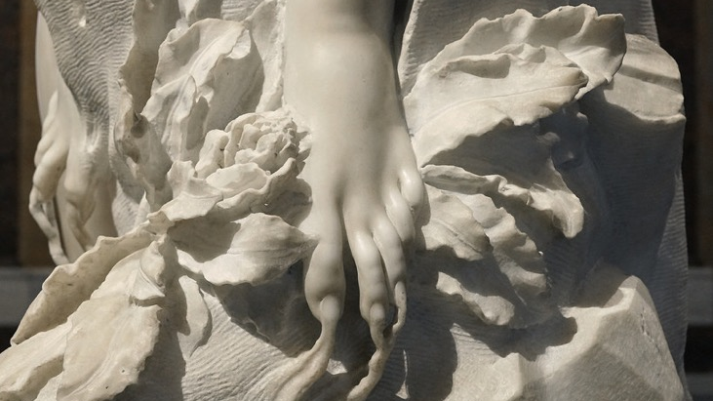
Defining the Baroque
Section 102.4
11 February 2021

Slide 2
Today’s Plan
Introduce Exhibition Assignment
Review of key terms from this past week
Defining the Baroque, Building Visual Analysis
3-2-1 Reflection

Slide 3
Today’s Learning Objectives
By the end of today’s section, you will understand the defining attributes of the Baroque Period
You will continue to build confidence in visual analysis
You will gain confidence in using key terms from lecture

Slide 4
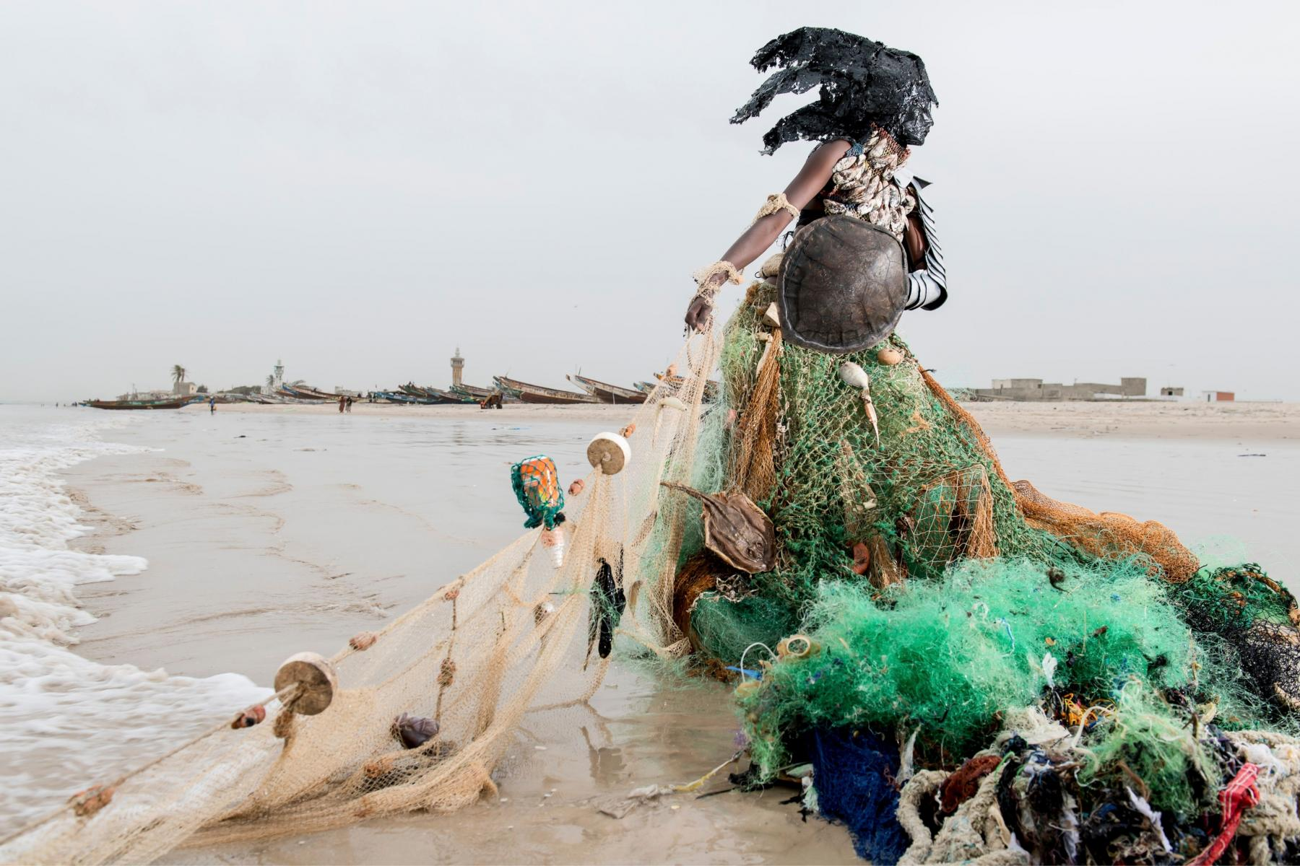
Exhibition Critique
https://emory.instructure.com/courses/97952/assignments/571542

Slide 5
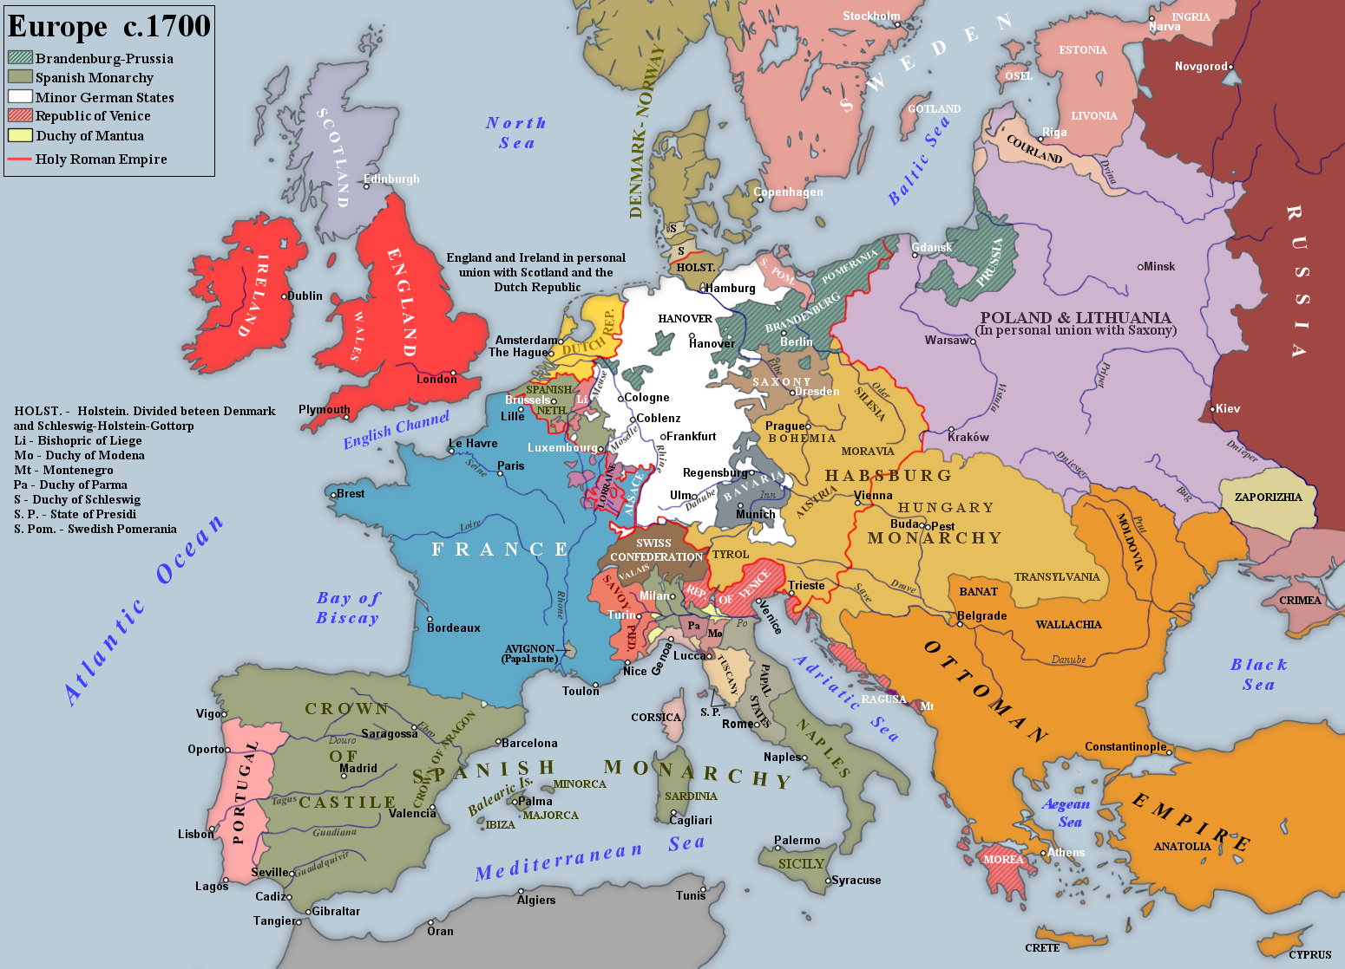
A note on Geography
In this course we will cover…
Italy, mainly Rome
Holland and Flanders
Spain
France

Slide 6
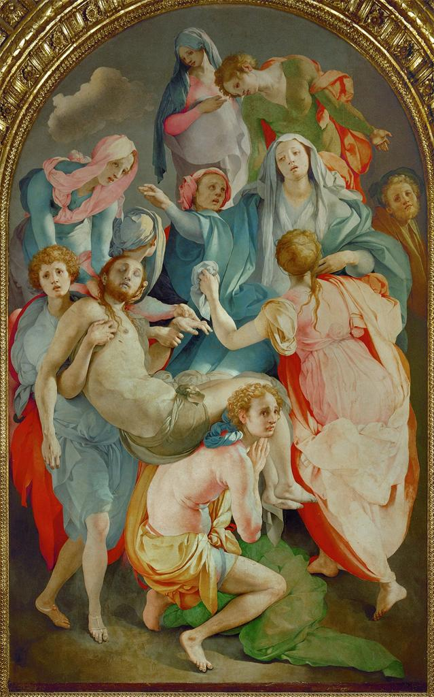
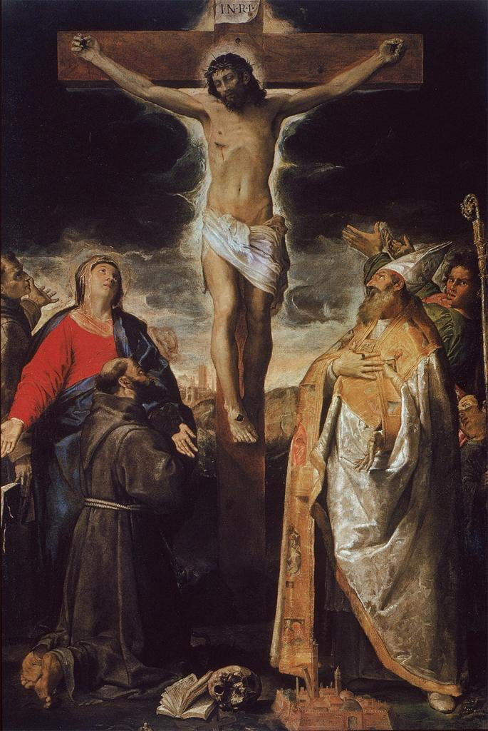
Key Terms
Naturalism
Idealism
Mannerism
Realism

Slide 7
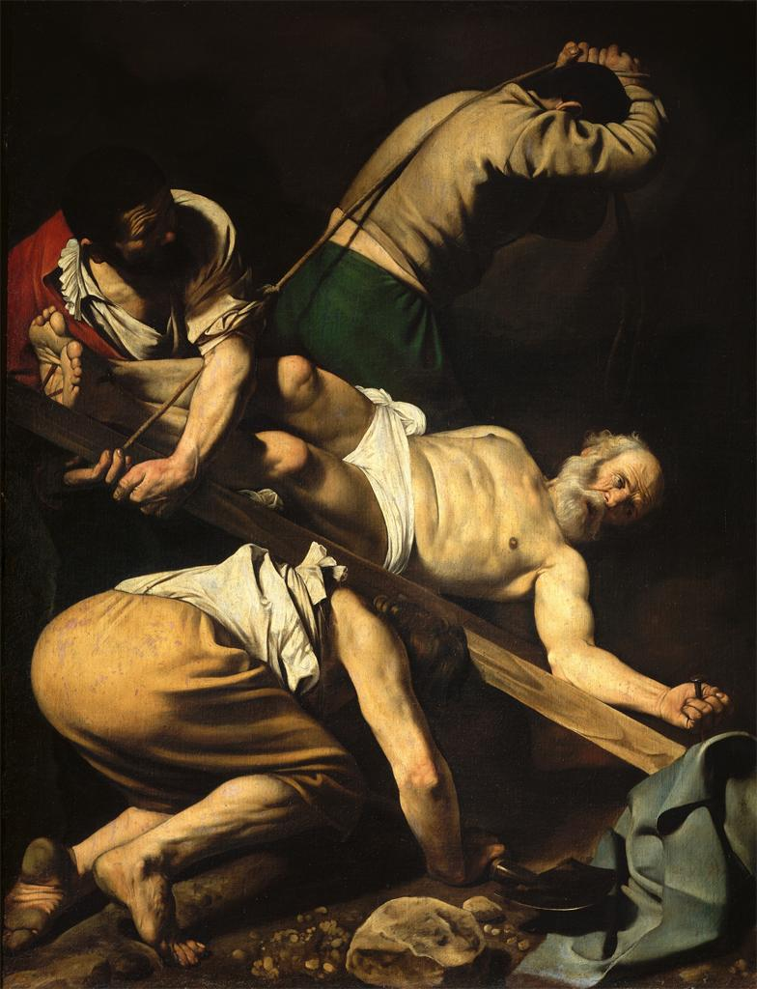
Naturalism: the attempt to imitate nature by observing nature
Caravaggio, Crucifixion of St. Peter, Cerasi Chapel, 1600-1

Slide 8
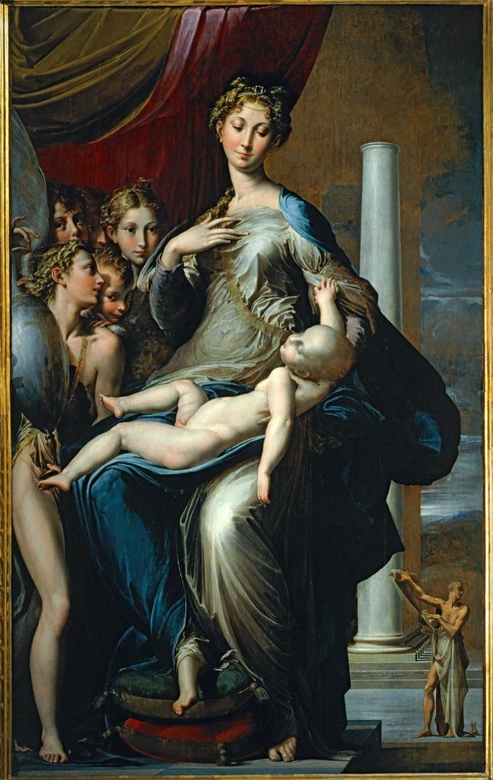
Mannerism: A 16th century style in which the figures are painted anti-naturalistically

Slide 9
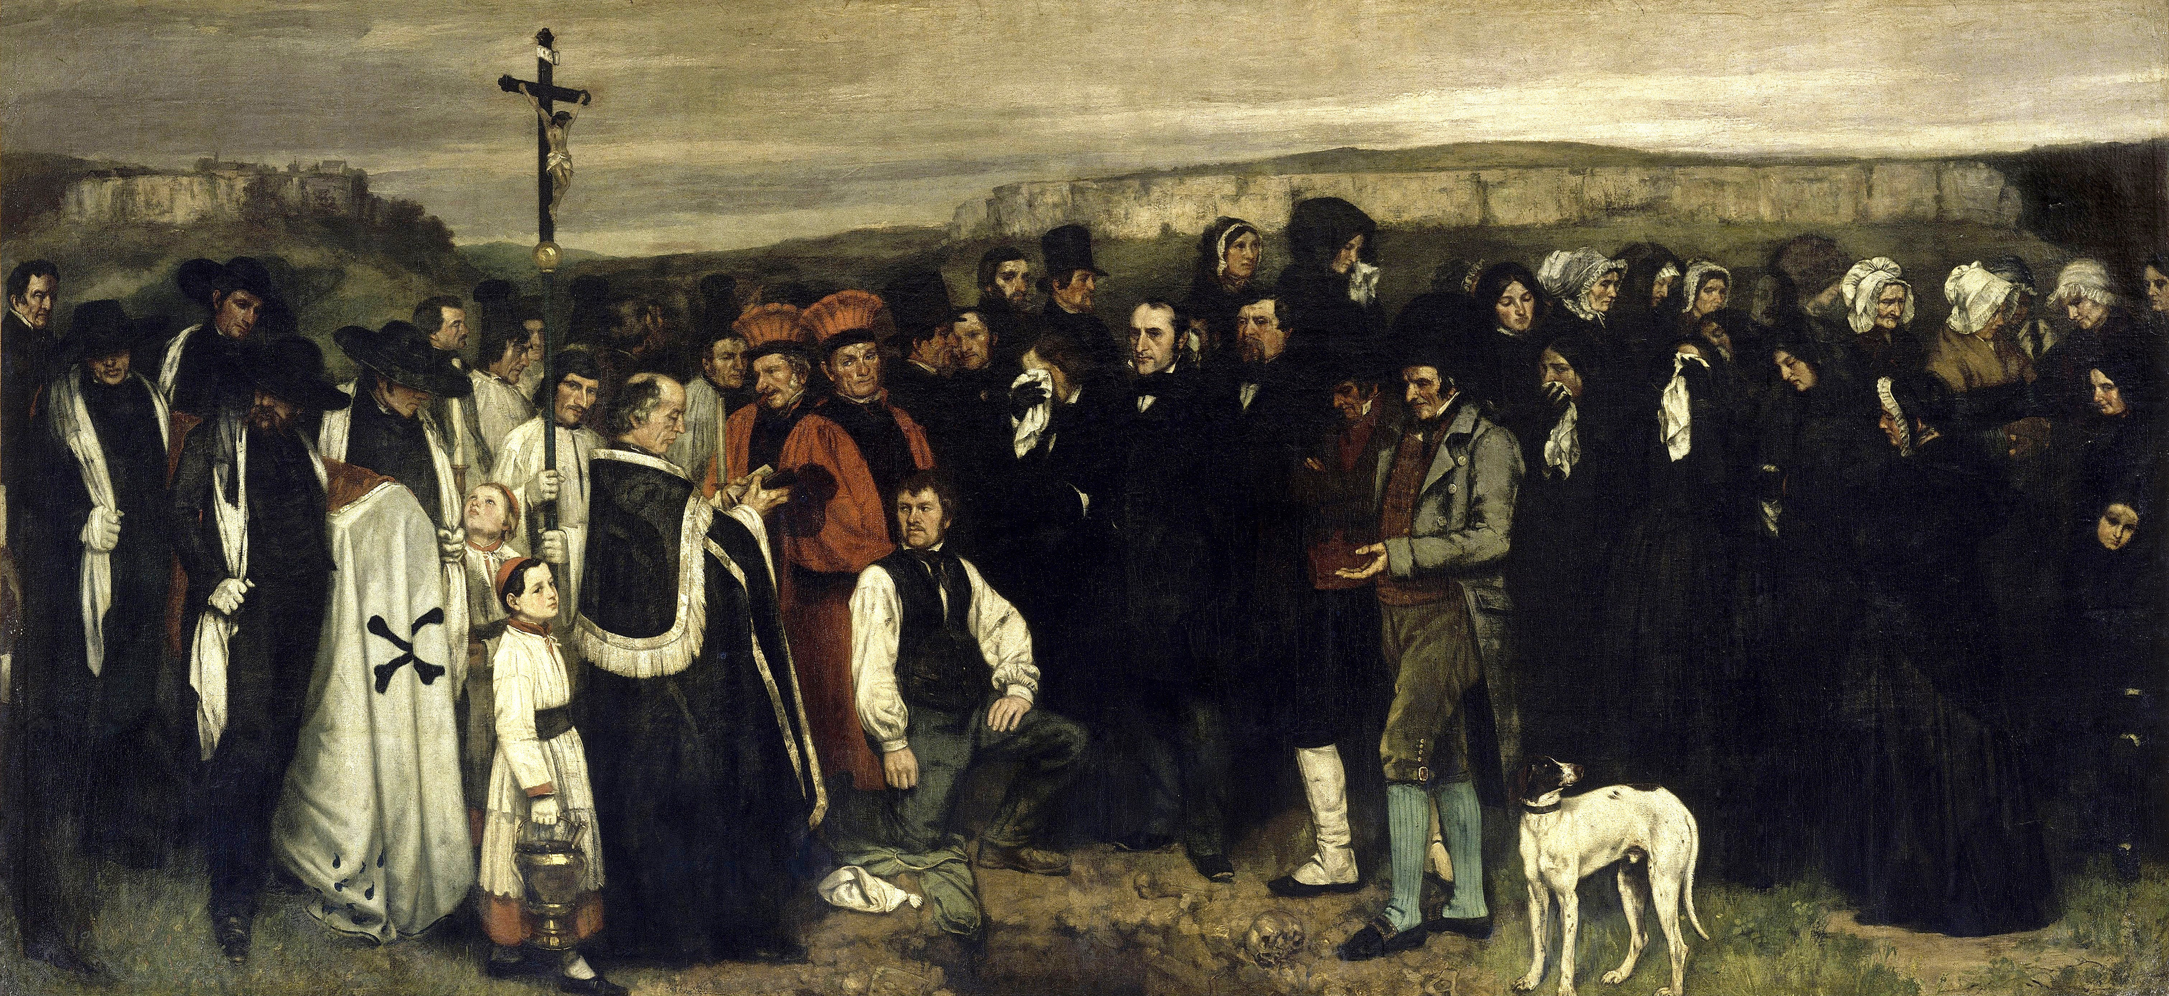
Key Terms
Realism (vs. realism) – a 19th century movement that sought to convey the truth of contemporary life
Notes:
Gustave Courbet, Funeral at Ornans, mid 19th century

Slide 10
Key Terms - Events
The Counter Reformation
The Council of Trent

Slide 11
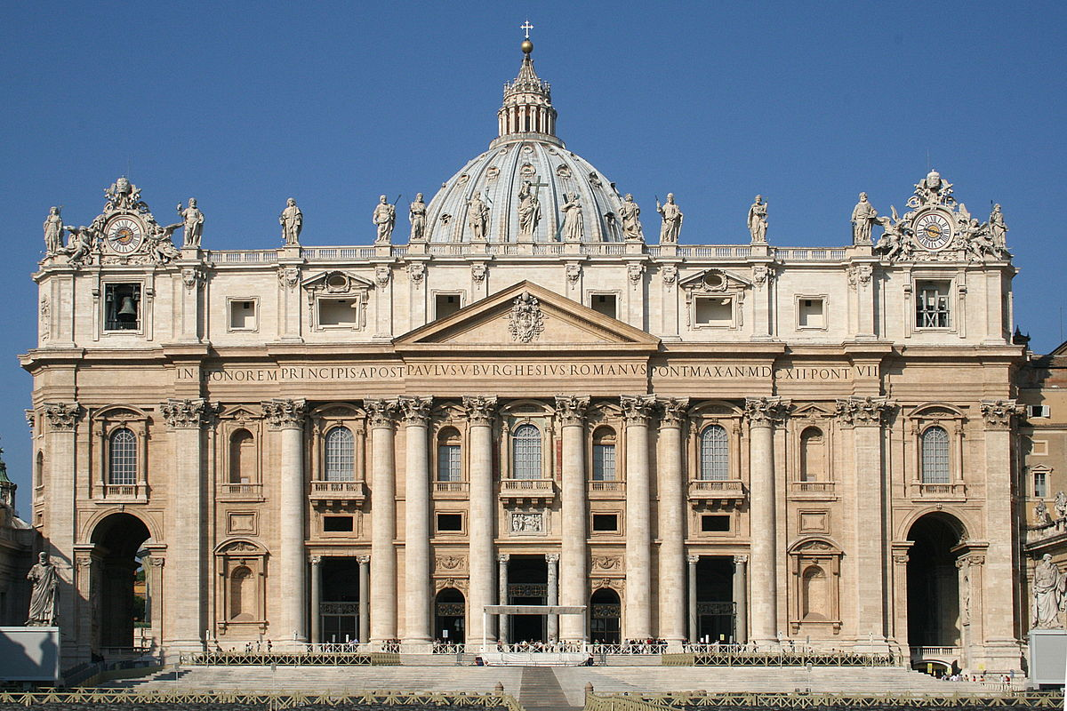
The Counter Reformation: Resurgence of the Catholic church after the Protestant challenge. Caused the extensive building and decoration that evolved into the Baroque.
Notes:
Carlo Moderno, New St. Peter’

Slide 12
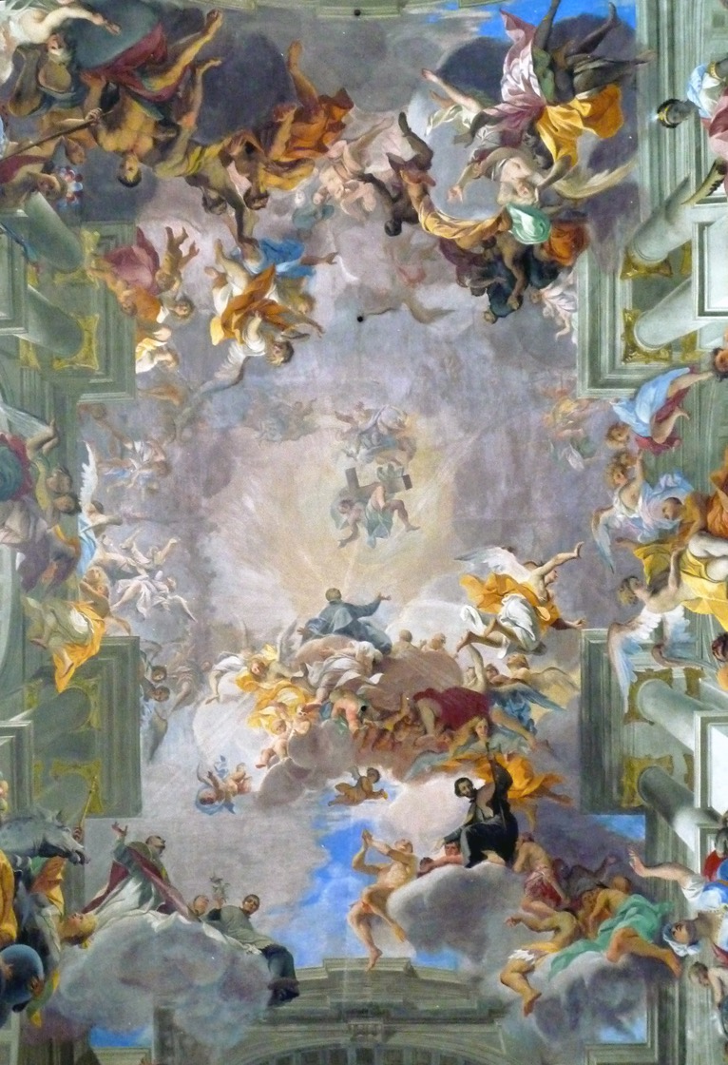
The Council of Trent: Great Church council of the mid-16th century, whose acts and decrees shaped the Roman Catholic Church in the 17th century

Slide 13

Key Terms - Painting
Chiaroscuro
Di sotto in s$\grave{u}$
Fresco
Quadratura
Quadro riportato

Slide 14
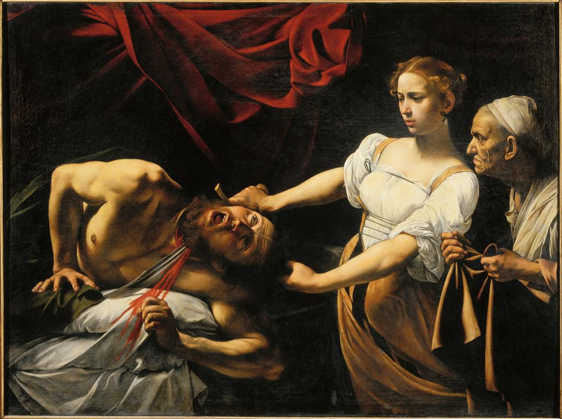
Chiaroscuro: Italian for “light and dark” : contrasts of light and shadow

Slide 15
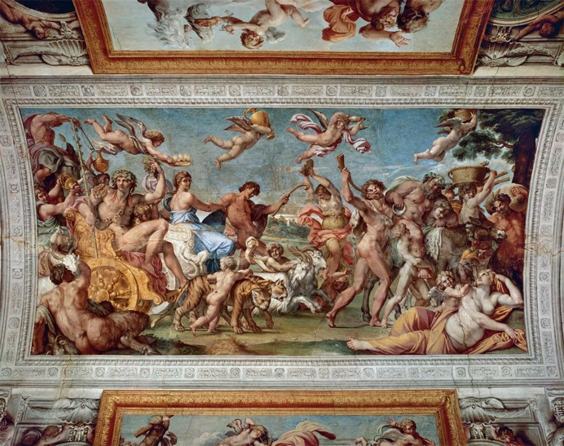
Quadro Riportato: Italian for “transported painting”: a ceiling painting intended to look like a framed painting
Annibale Caracci, Palazzo Farnese Ceiling, Rome, 1597-1601

Slide 16
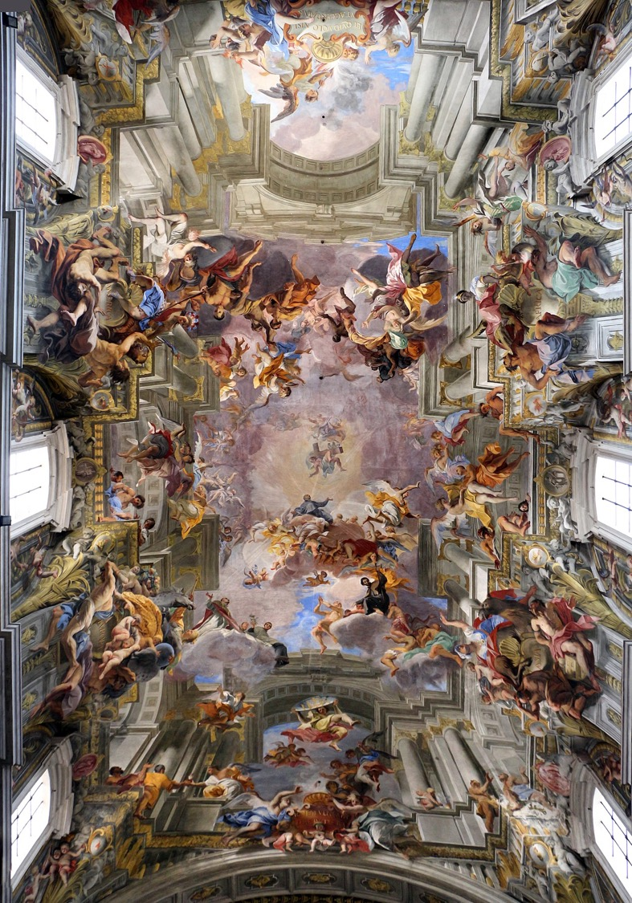
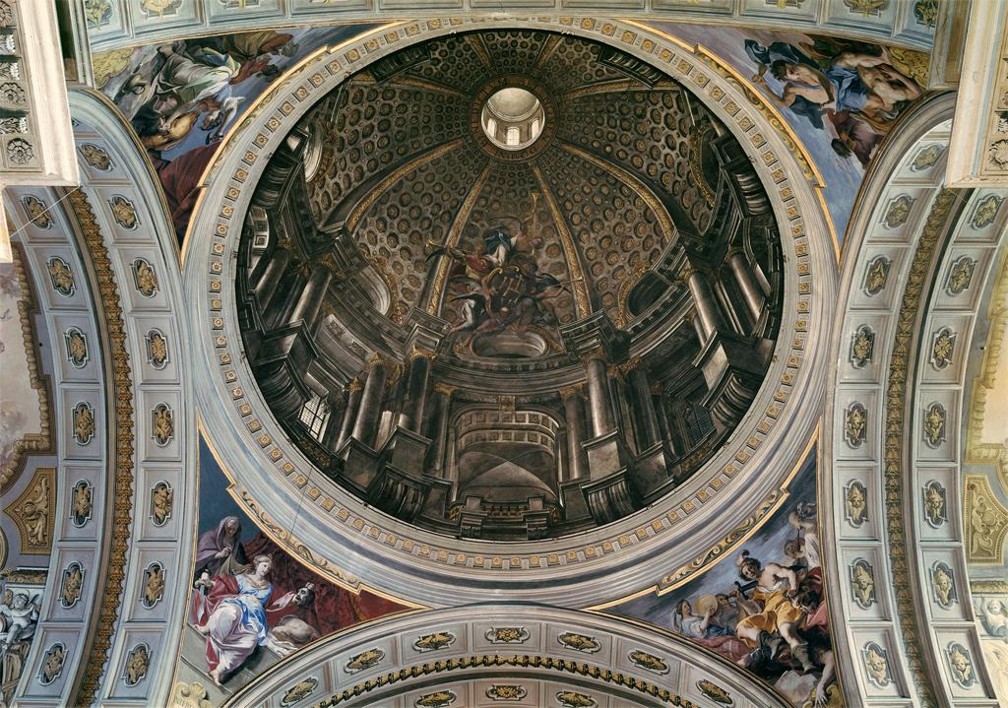
Quadratura: describes a type of ceiling painting in which illusionistic architectural features are painted in perfect perspective
Fresco: A technique in which paint is applied to wet plaster

Slide 17
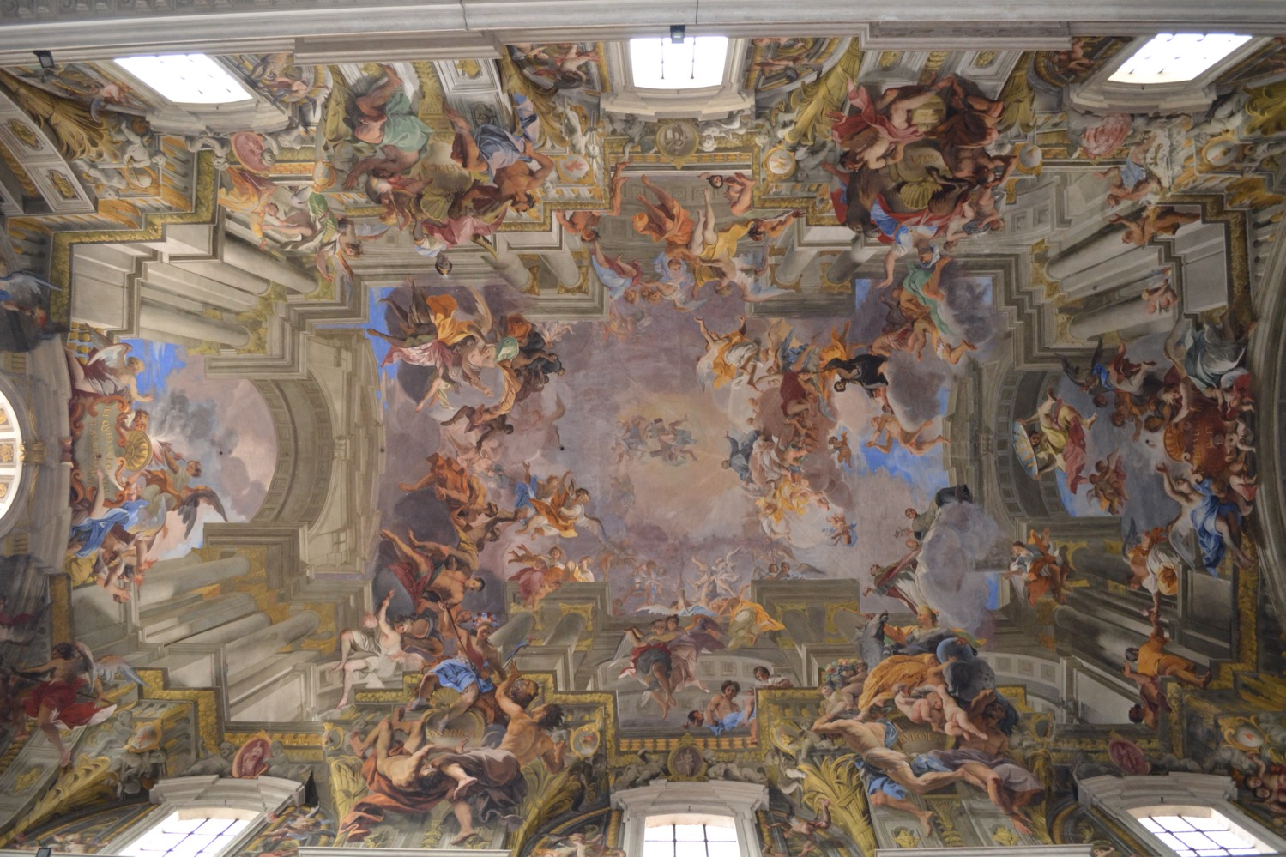
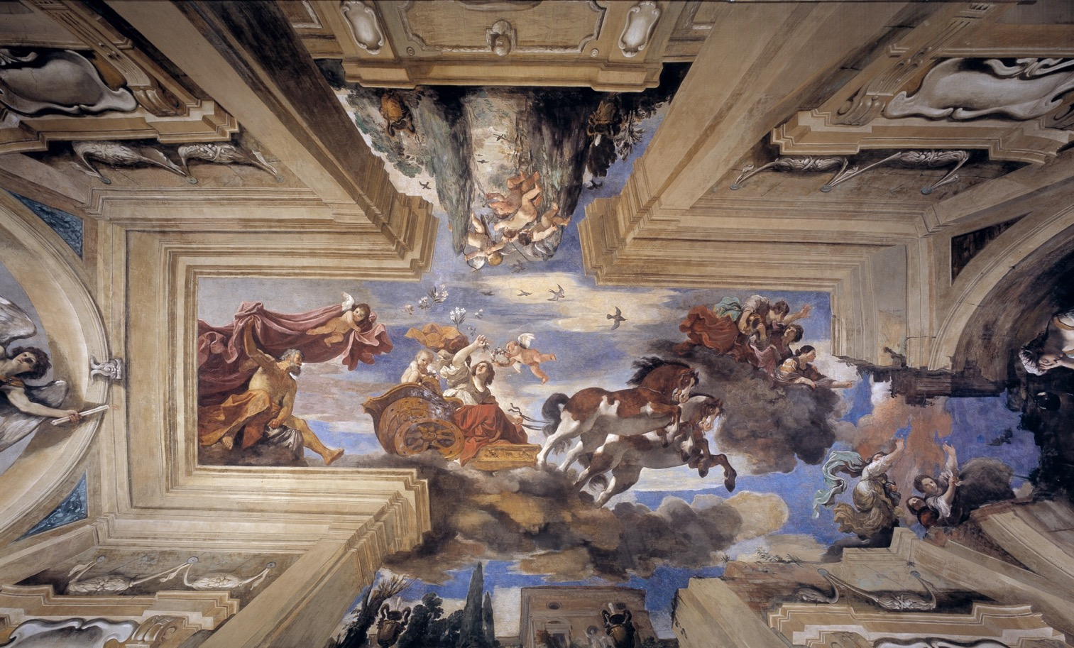
Di sotto in s$\grave{u}$: Italian for “from below upward” or “seen from below”:
Notes:
Guercino, Aurora

Slide 18
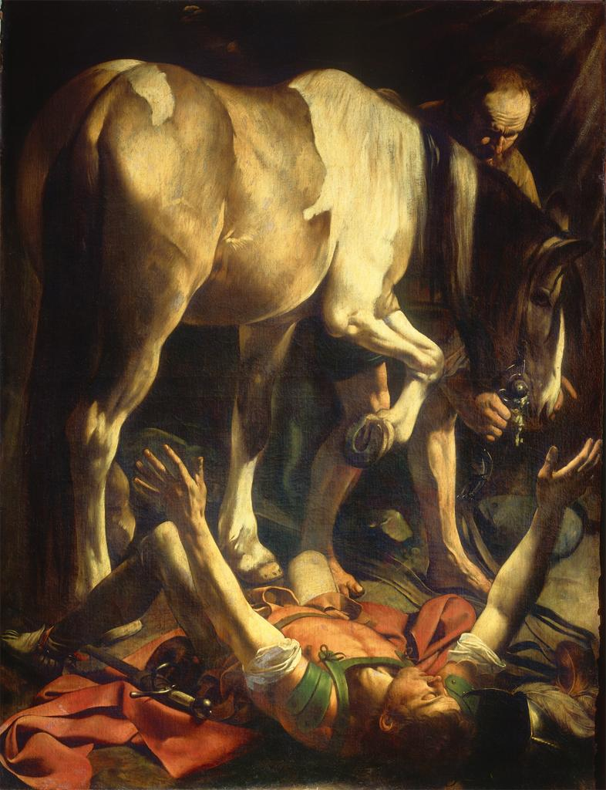
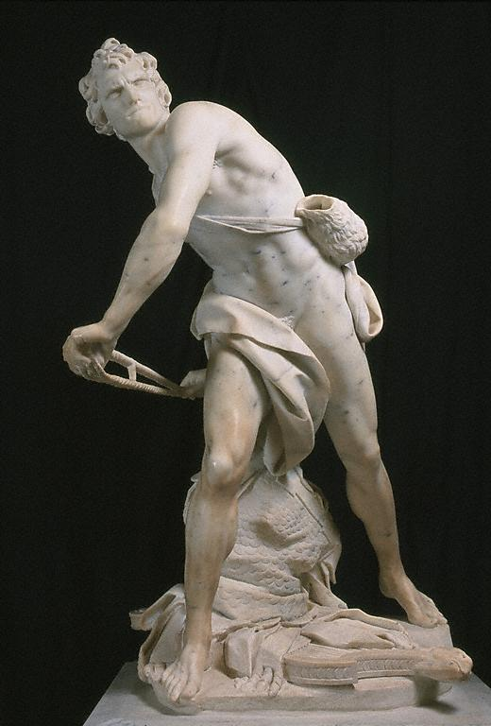
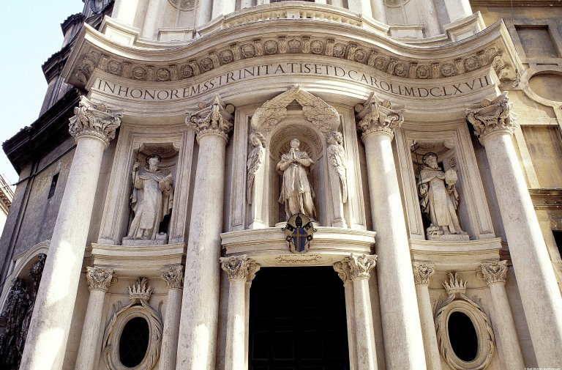
Defining the Baroque
Please take 2 minutes to think about what defines the Baroque Period before we begin our activity
Notes:
Bernini’s David
Cornaro Chapel, Boromini
Caravaggio, Conversion of St. Paul

Slide 19
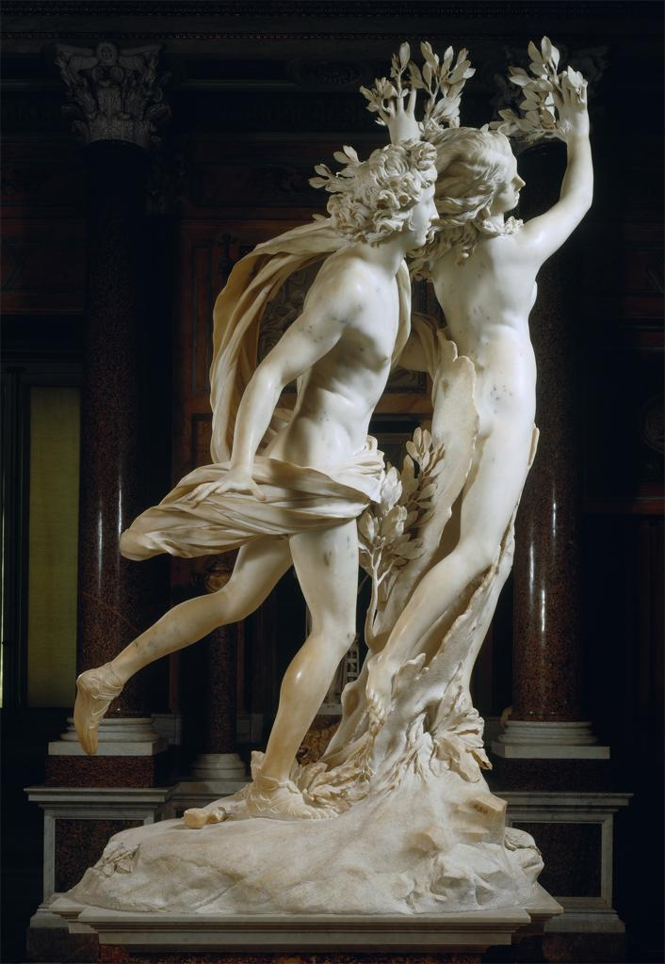
What attributes define this Sculpture as Baroque
Notes:
Bernini Apollo and Daphne

Slide 20
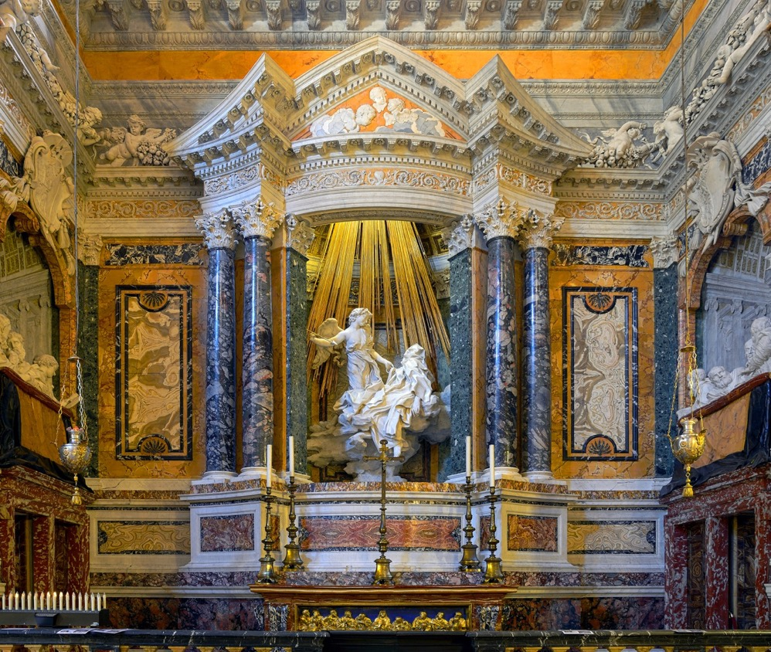
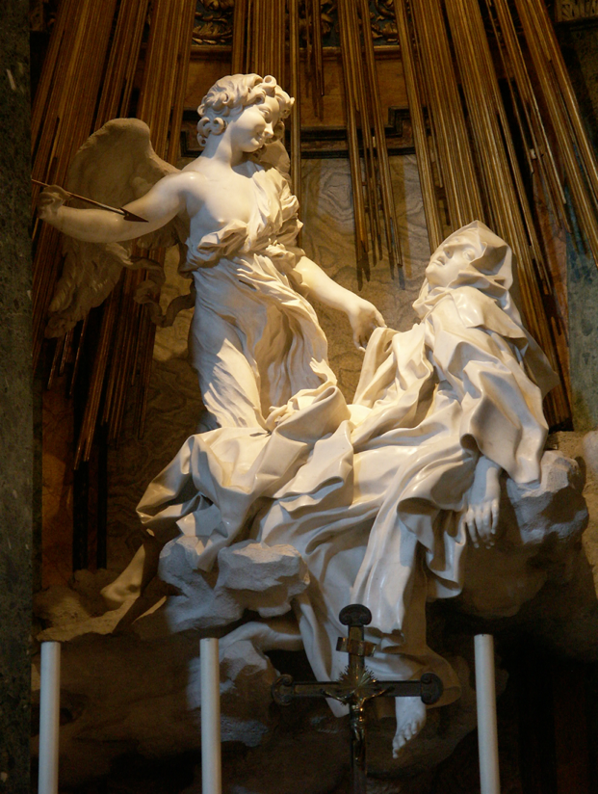
Bernini, Cornaro Chapel, 1642-52
Notes:
Antique and modern marble
Drama
Architecture is not standard or what we are used to

Slide 21
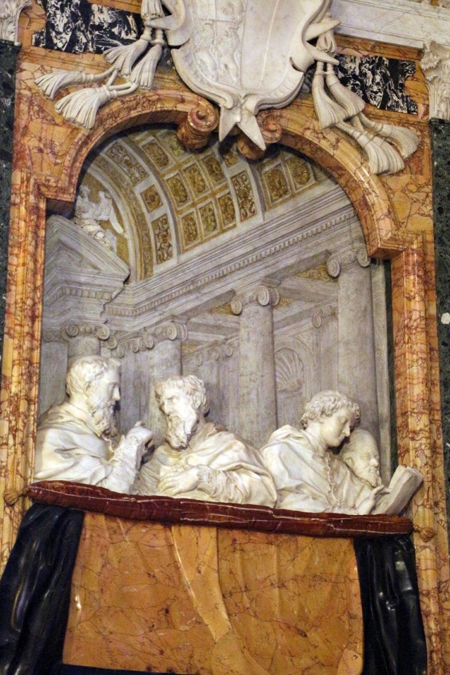
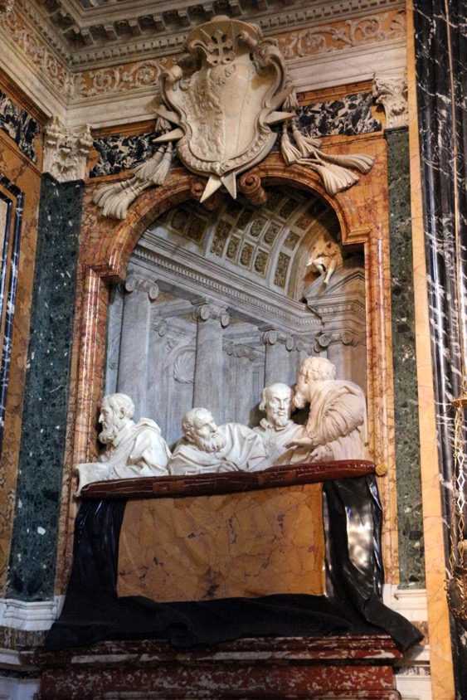
Who are these people? Why are they important?
Notes:
The importance of the patron
Illusionism
Family members

Slide 23
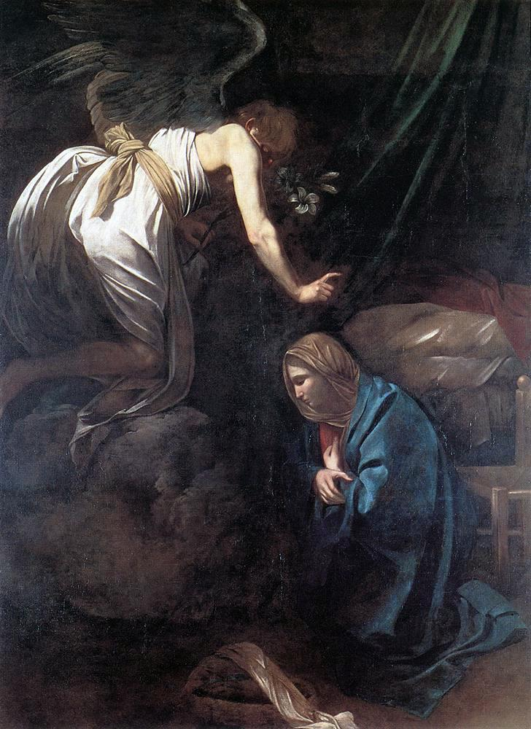
Notes:
Caravaggio, The Annunciation, 1608–10. Musée des Beaux-Arts de Nancy
Fra Carnavale, Annunciation, Italian, ca. 1448, Washington, D.C., National Gallery of Art

Slide 24
Which work of art comes from the Baroque period? Why do you think so?

Slide 25
Group 1: Line and Shape
Group 2: Color (Hue)
Group 3: Composition
Group 4: Effect
Group 5: Context
Caravaggio, The Annunciation, 1608–10

Slide 26
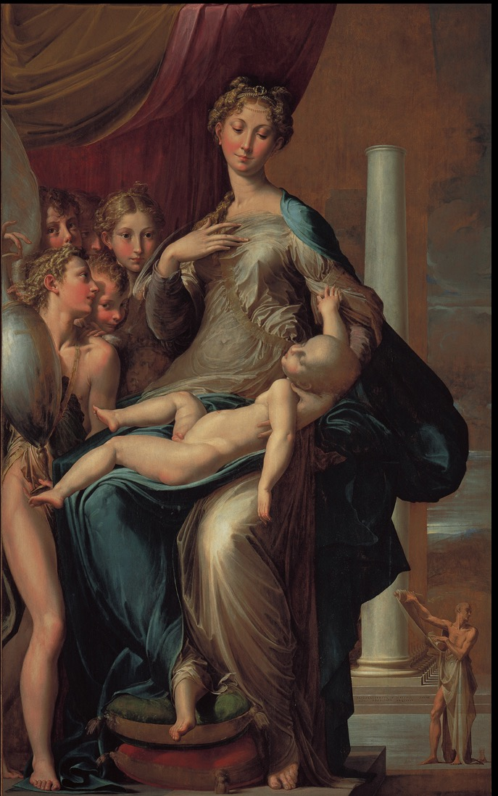
Notes:
Caravaggio, The Loreto Madonna, 1604-5. Sant’ Agostino, Rome.
Parmigianino, Madonna of the Long Neck, 1534-50. Uffizi, Florence

Slide 27
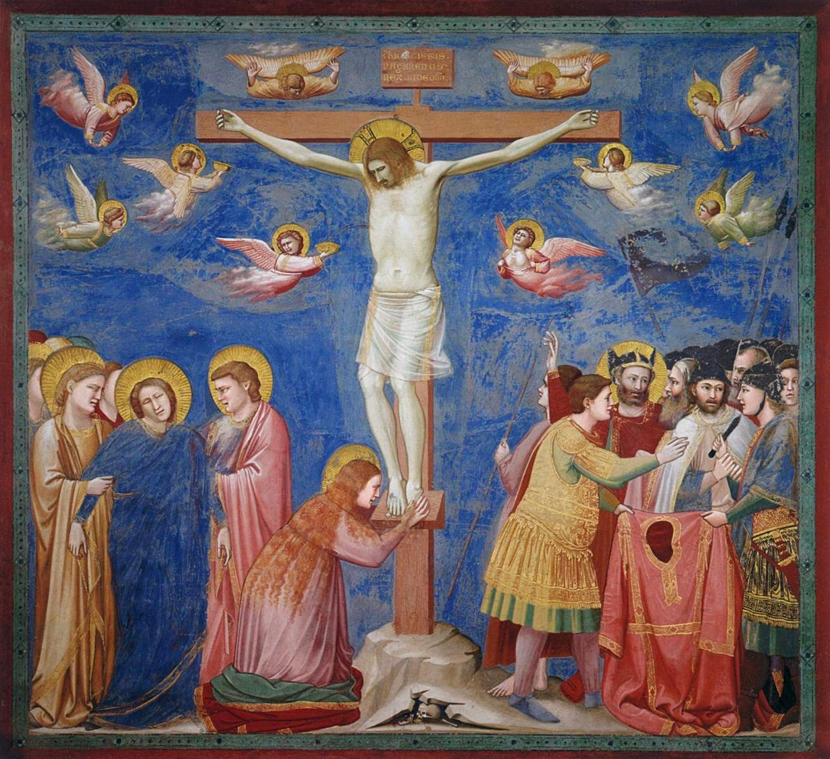
Notes:
Francisco de Zurbarán - La Crucifixión, c. 1630. Art Institute of Chicago
Giotto, Crucifixion, 1304-6. Arena Chapel, Padua

Slide 28
3-2-1 Reflection
On your note-card, please write –
3 things that you learned in this class this week
2 questions that you still have
1 challenge that you faced

Slide 29
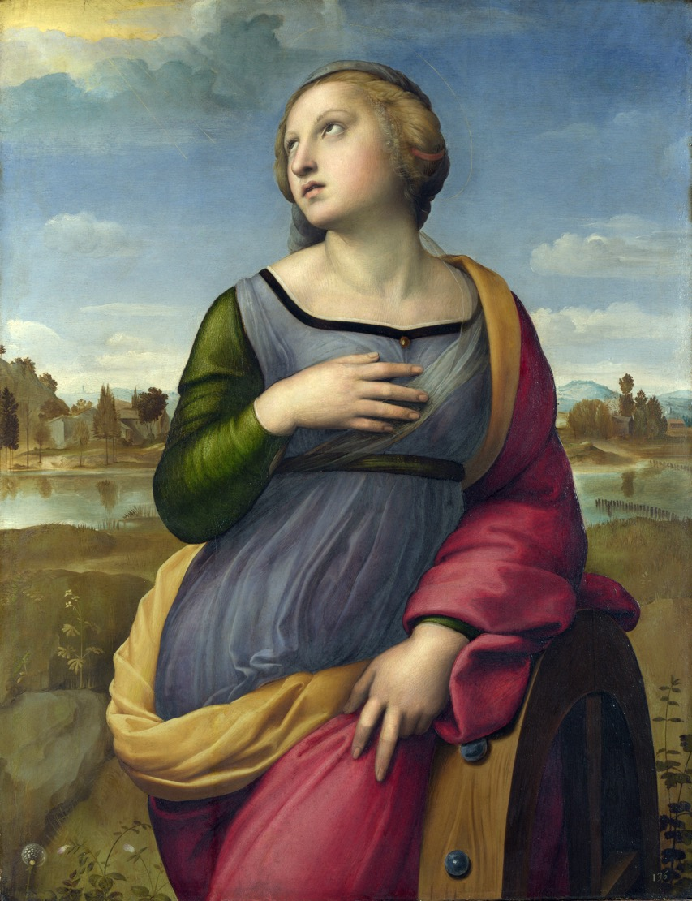
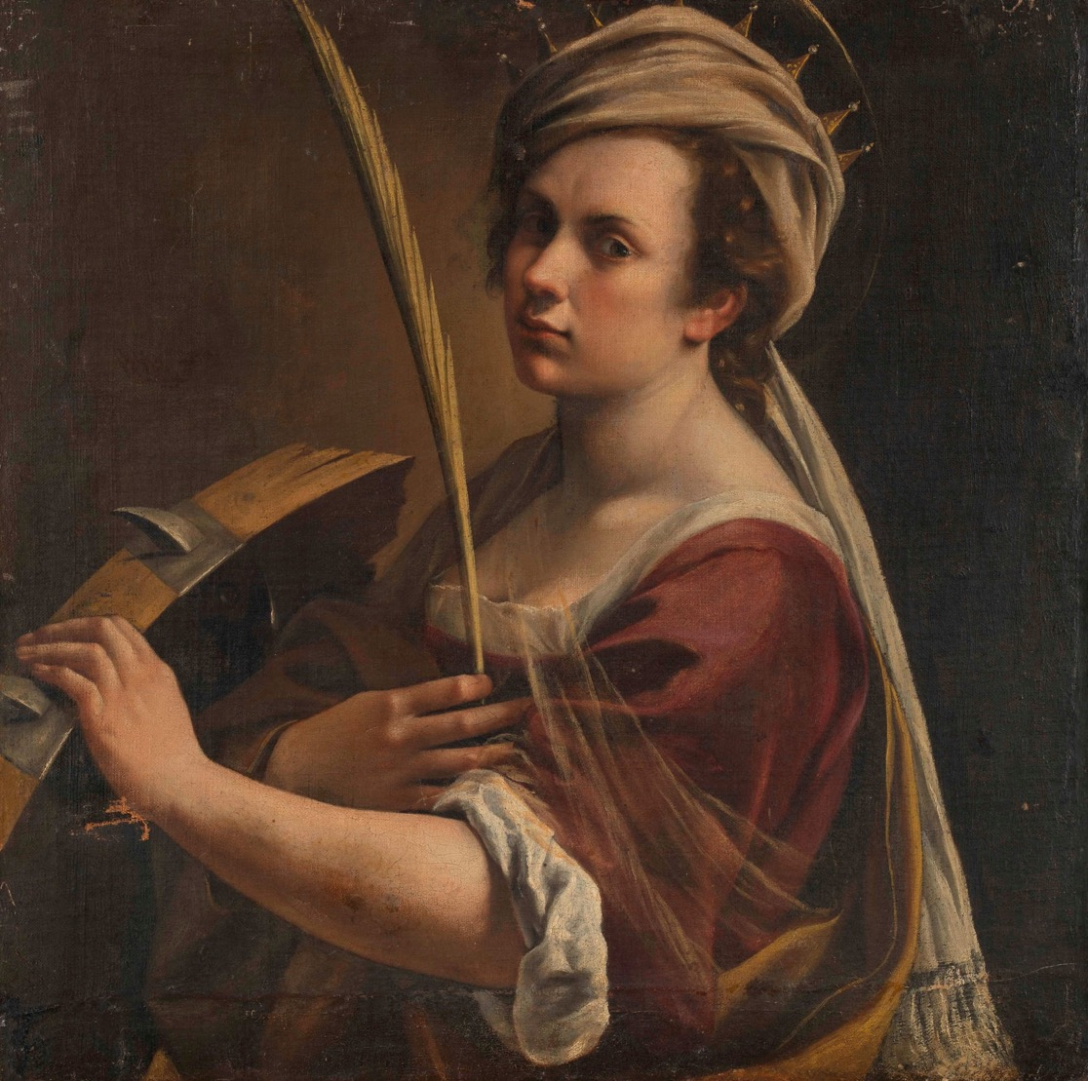
Notes:
Raphael, St. Catherine of Alexandria, c. 1507. National Gallery, London
Artemisia Gentileschi, Self-Portrait as Saint Catherine of Alexandria, 1615–17. National Gallery, London

Slide 30
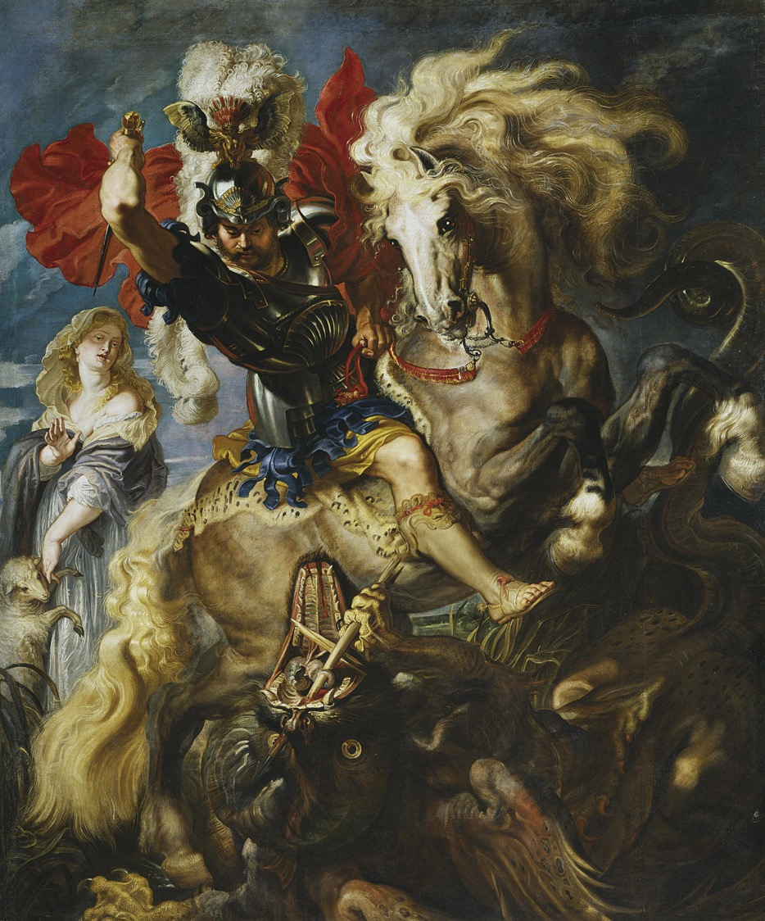
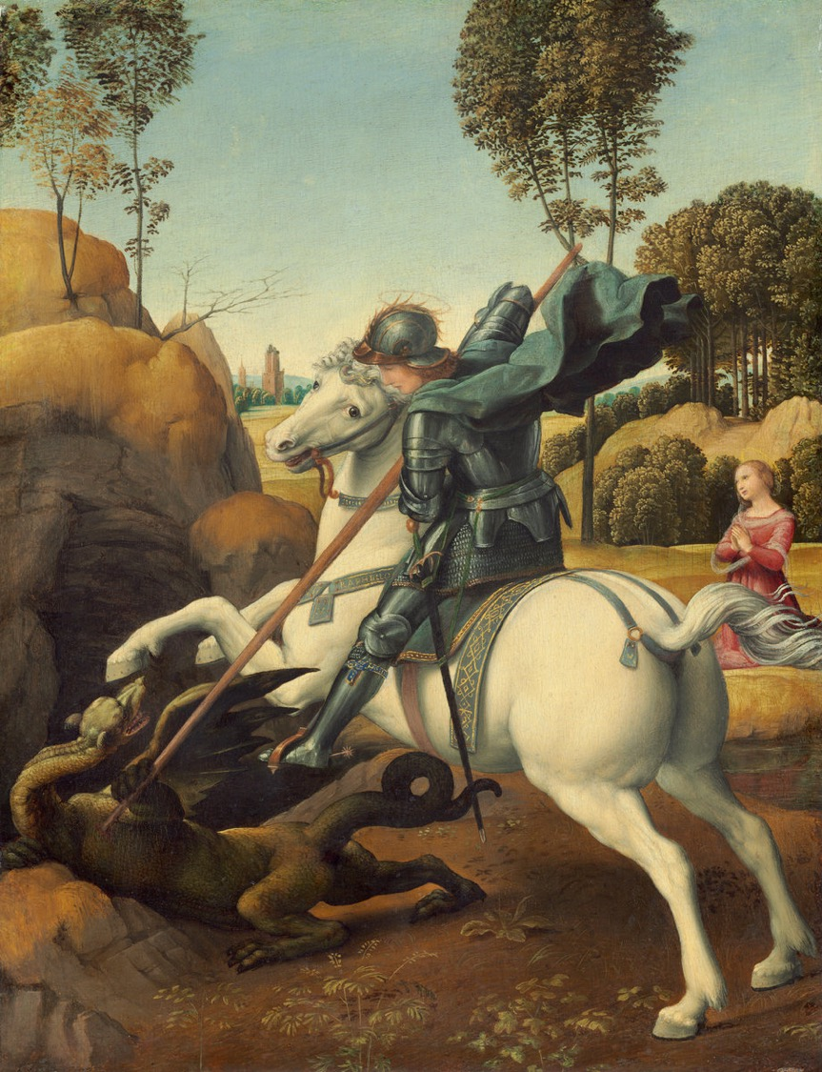
Notes:
Rubens, Saint George and the Dragon, 1605, Prado, Madrid
Raphael, Saint George and the Dragon, c. 1506. National Gallery of Art, Washington

Slide 31
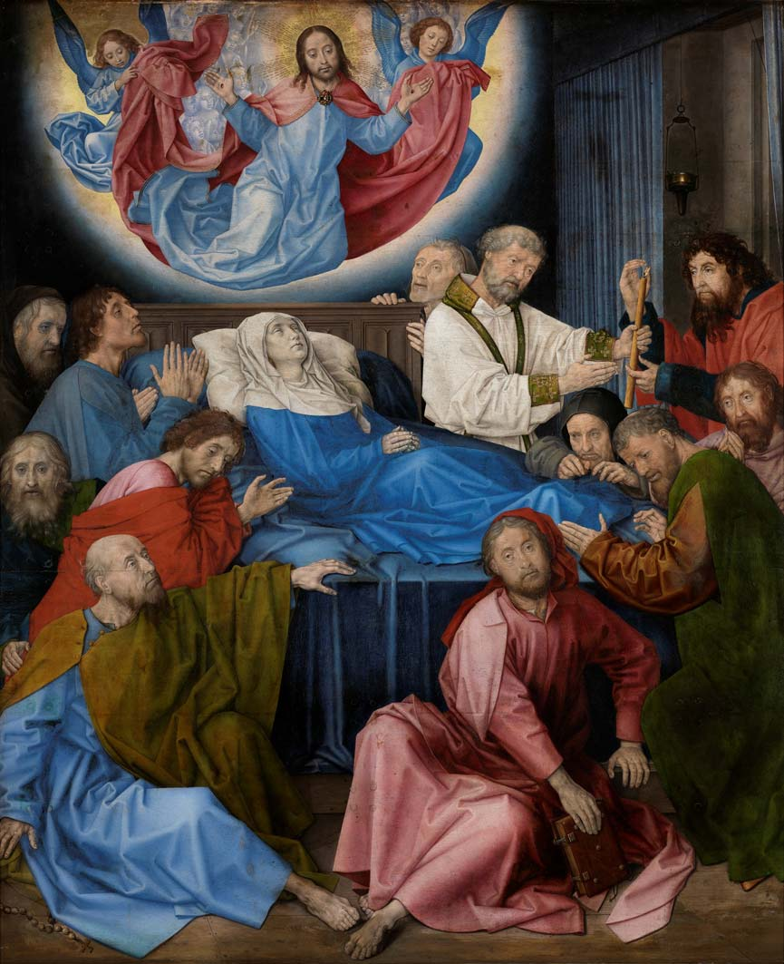
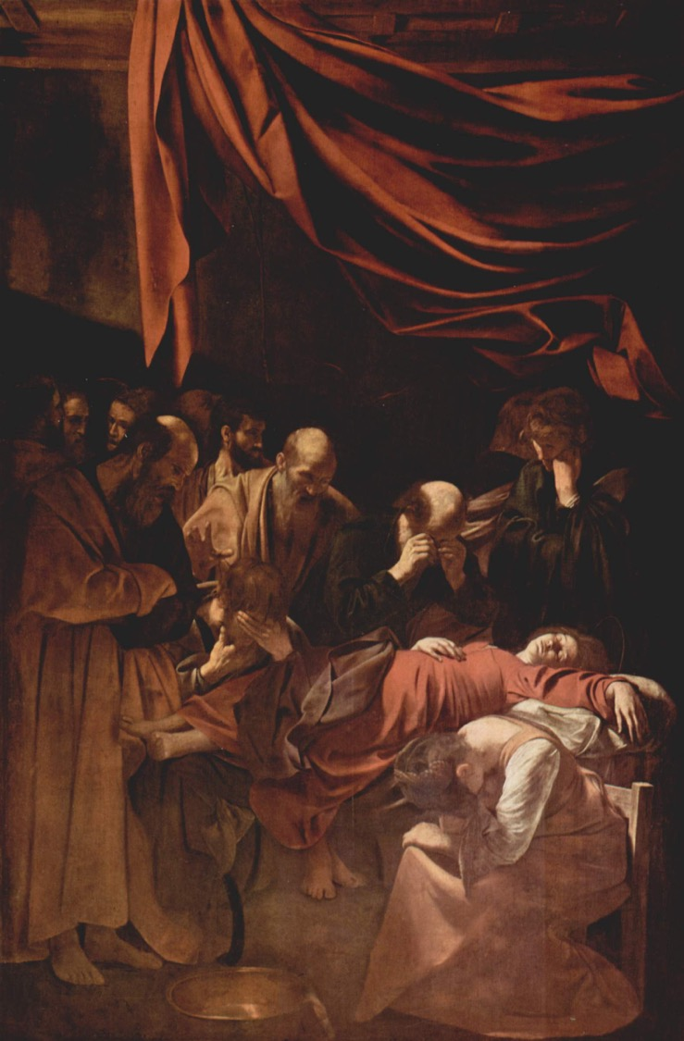
Notes:
Hugo Van der Goes, Death of the Virgin, c. 1472-80. Groeningemuseum, Bruges
Caravaggio, Death of the Virgin, 1606 . Louvre

Slide 32
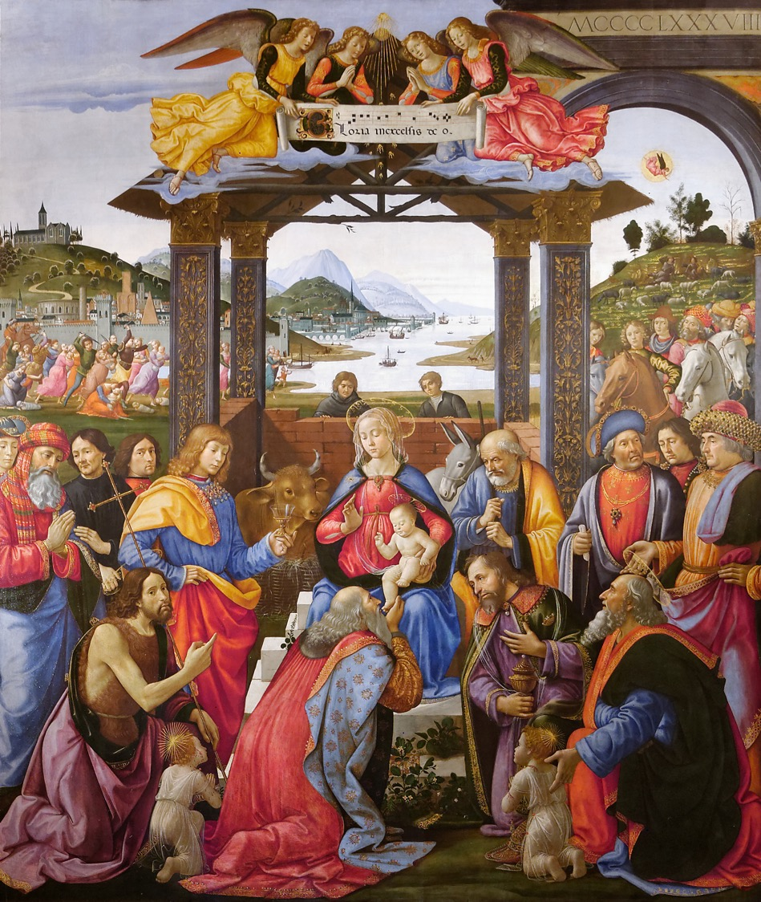
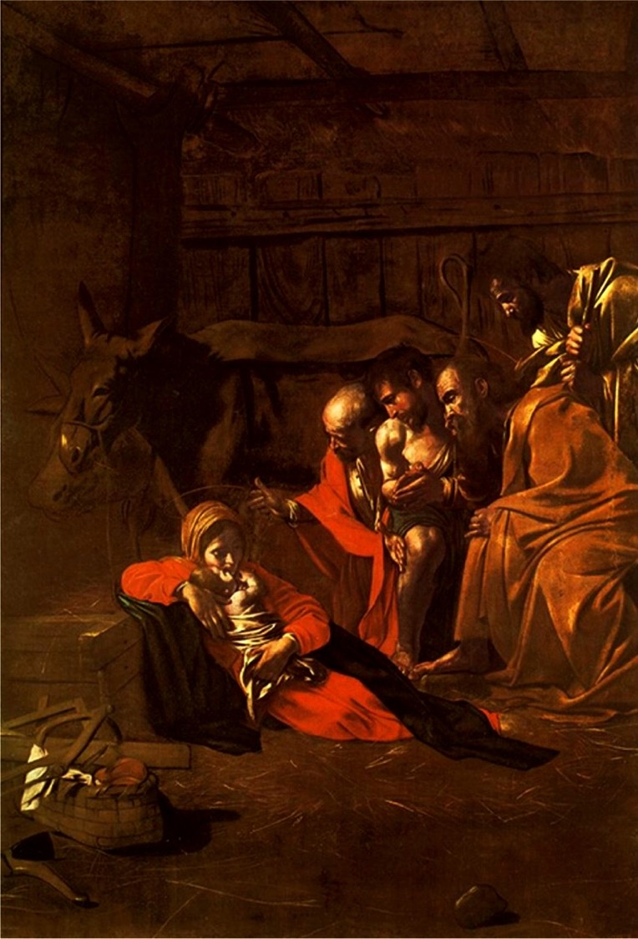
Notes:
Domenico di Ghirlandaio, Adoration of the Magi for the Ospedale degli Innocenti (1488)
Caravaggio, Adoration of the Shepherds, 1609. Museo Regionale, Messina

Slide 33
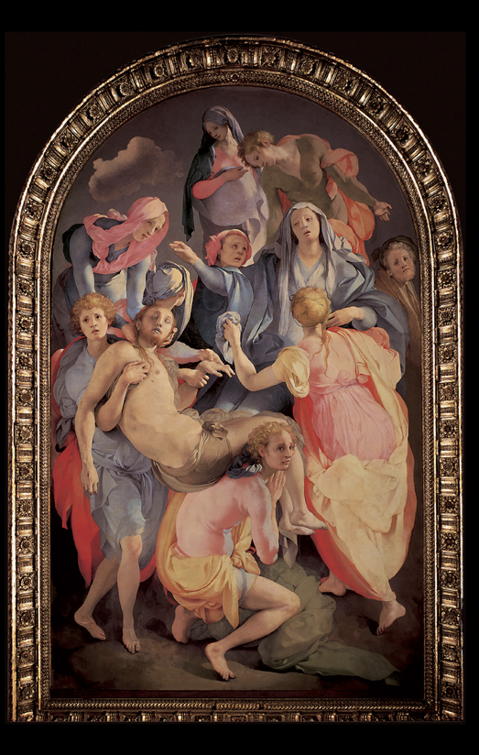
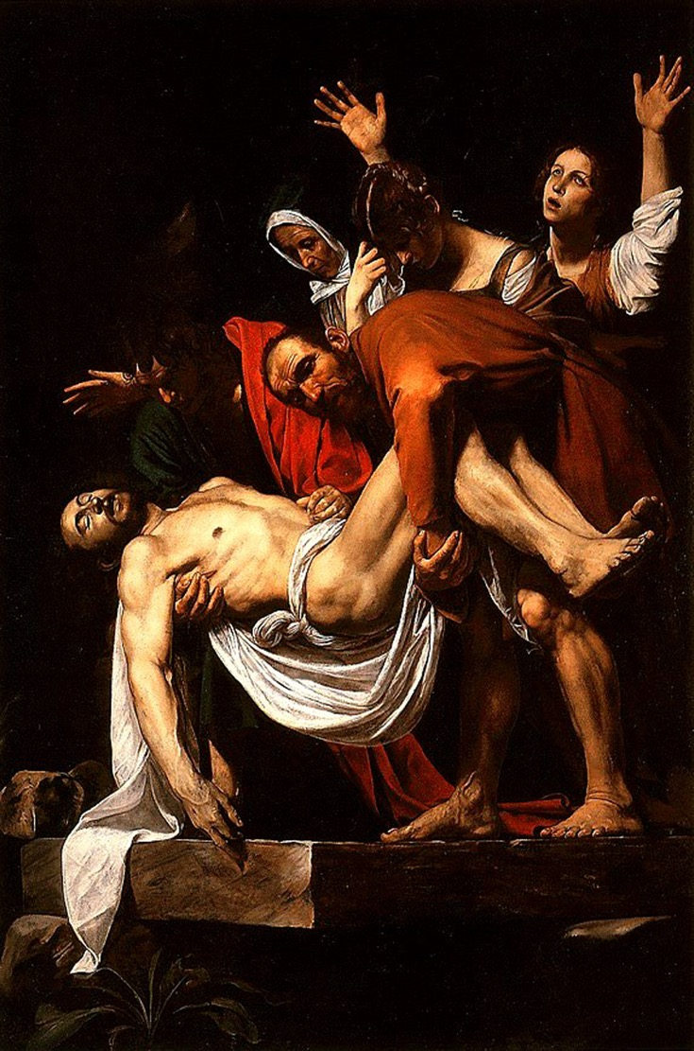
Notes:
Pontormo, Deposition, 1525-8. Church of Santa Felicita, Florence
Caravaggio, The Entombment of Christ, 1603. Pinacoteca Vaticana, Vatican City

Slide 34
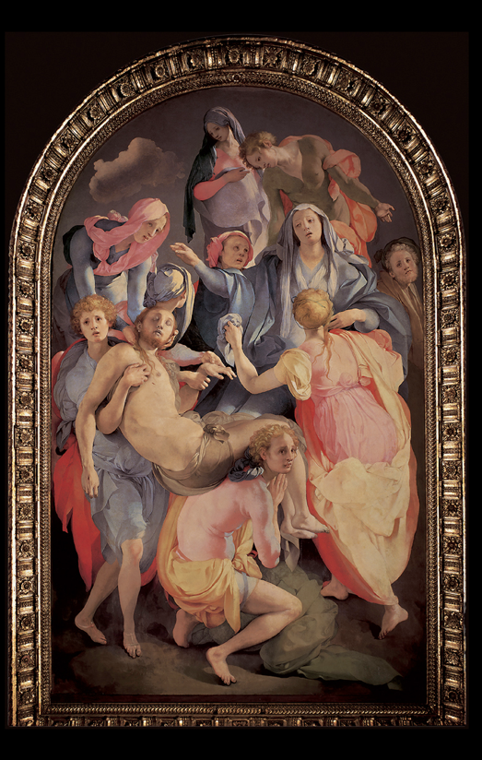
Notes:
Pontormo, Deposition, 1525-8
Rubens, Descent from the Cross, 1614

Slide 35
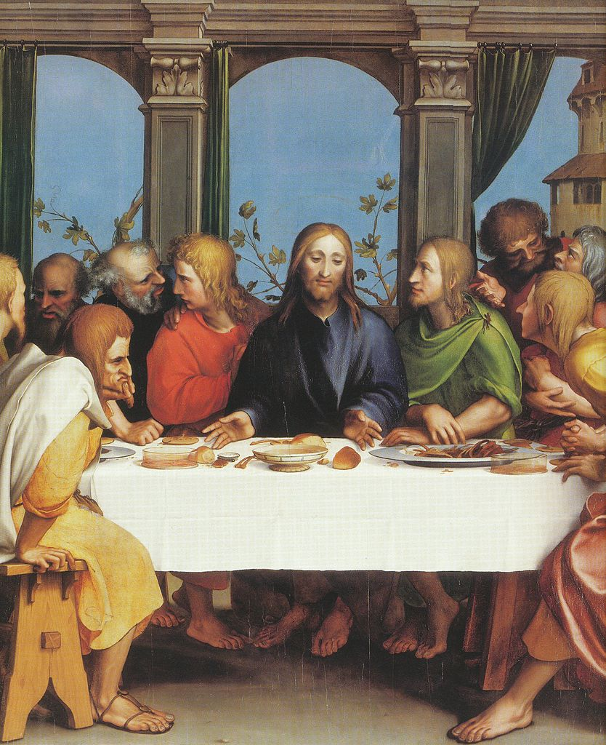
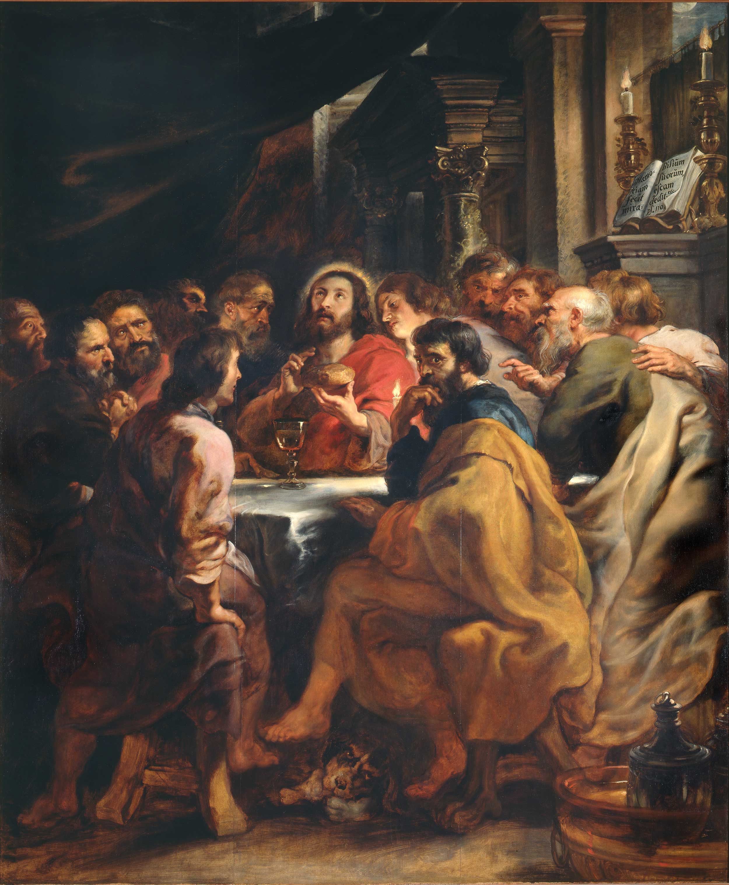
Notes:
Hans Holbein the Younger, The Last Supper, 1524-25. Kunstmuseum, Öffentliche Kunstsammlung, Basel
Rubens, Last Supper, 1630–31, Milan

