Slide 1
PepDriver
Controlling Liberty1
Notes:
This presentation clarifies the instrument configurations which are available for the new Mars family of microwave digestion / extraction. As well as the new sequential Discover SPD.
This is a story about technology improvements – led by CEM. Vessel technology and control technology, combined, have led to the development of superior instruments which are actually easier to use.

Slide 2
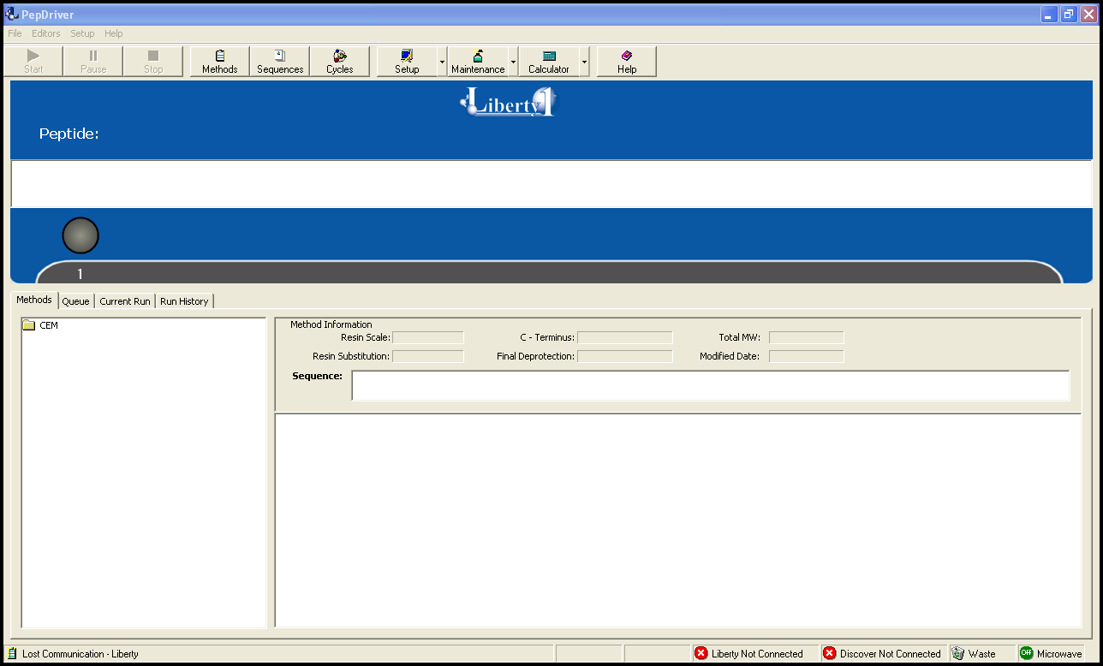
PepDrive
The application software package is the user interface to the CEM Automated Microwave Peptide Synthesizer, Model Liberty1.
Notes:
This presentation is intended to provide an overview of the PepDriver application software used to control operation of the CEM Liberty 1 System. It provides
Complete operational control over the Liberty 1
Calculators – Provide information for reagents needed for a specific sequence and how to prepare reagents used by the system
Maintenance – Walks you through routine maintenance procedures.
We will review each of these 3 sections using screen shots from the application software and also discuss the optional UV Monitoring feature.

Slide 3
Editors – Liberty1 Operation
The operation of the Liberty1 is controlled by four (4) ‘editors’
Microwave Editor – Provides control for the microwave assisted deprotection and coupling steps of a cycle.
Cycle Editor – Provides control and customization for any step in the residue addition cycle (deprotection, washing, coupling and washing steps).
Sequence Editor – Provides the ability to create sequences to be synthesized on the Liberty 1
Method Editor – Provides the ability to synthesize a defined sequence on the Liberty 1

Slide 4
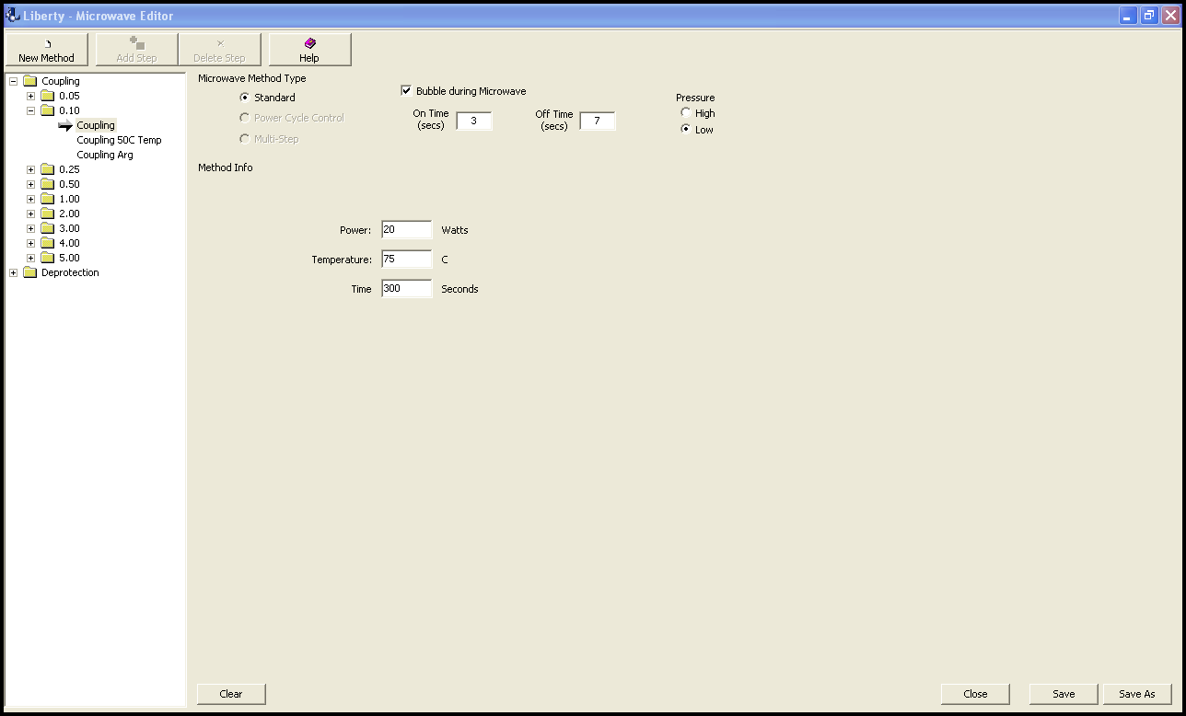
Microwave Editor
Provides control for the microwave assisted deprotection and coupling steps of a cycle.
Notes:
The microwave editor is accessed from the Setup tab on the top menu bar. The microwave editor Provides control for the microwave assisted deprotection and coupling steps of a cycle. Under each step is a folder for the differing scales and within each scale you have different microwave programs. You have the ability to control the maximum input power selection (you want an input power selection to bring you to the control temperature within 75-90 seconds of the total time). Note the section on ‘Bubble during Microwave’ - this provides nitrogen bubbling from the bottom of the reaction vessel. In this example you have 3 seconds on followed by 7 seconds off during the microwave program. You are using the low pressure nitrogen supply.

Slide 5
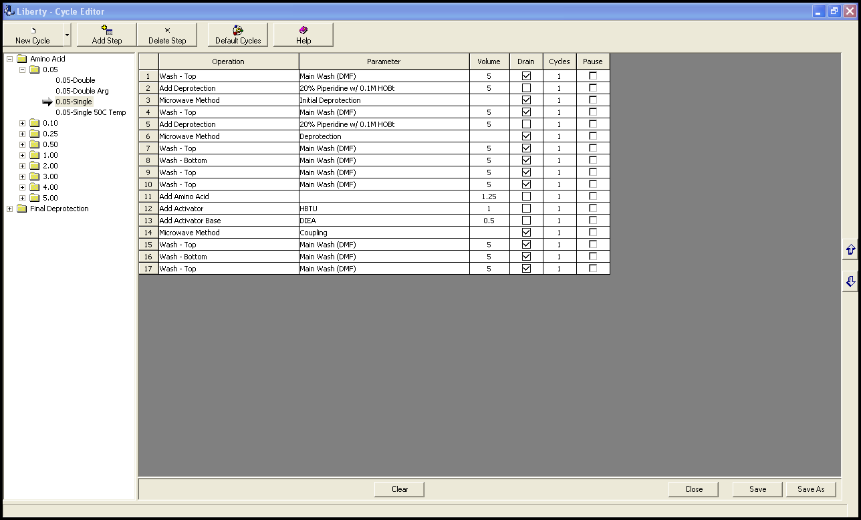
Cycle Editor
Provides control and customization for any step in the residue addition cycle and final deprotection step.
Notes:
The Cycle Editor provides control and customization for any step in the residue addition cycle (deprotection, washing, coupling and washing steps). The cycle editor contains preprogrammed cycles for a range of scales (0.05 – 5.0 mmol) and for standard amino acid addition, cysteine and histidine(use a lower coupling temperature to prevent racemization) and for arginine (to prevent aspartamide formation). These cycles can be easily edited to create custom cycles or you can create new cycles from ‘scratch’.
In addition to the residue addition cycle, you have control over the final deprotection step.

Slide 6
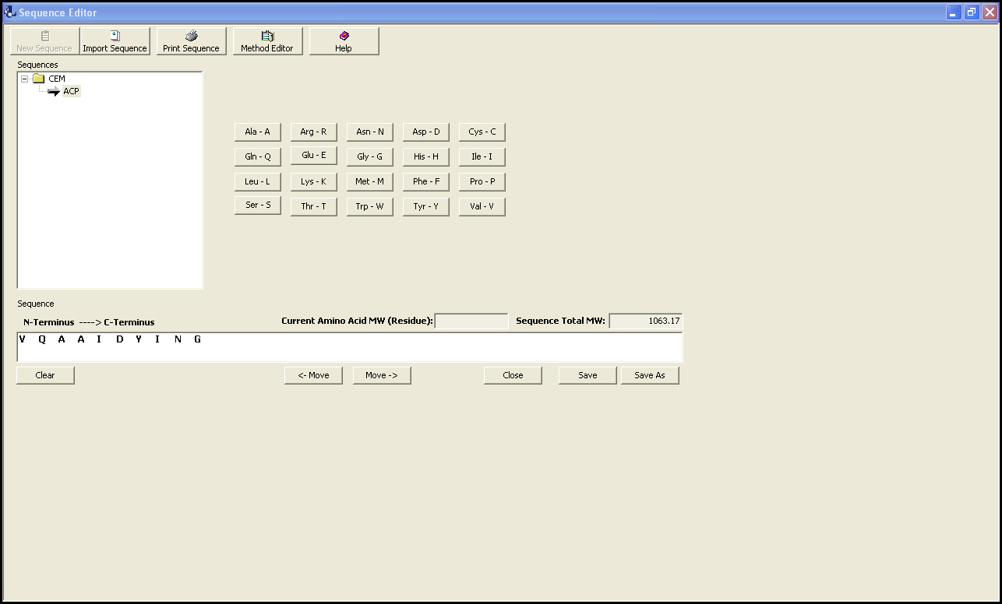
Sequence Editor
The sequence editor provides the ability to create sequences to be synthesized on the Liberty1.
Notes:
The sequence editor provides the ability to create sequences to be synthesized on the Liberty 1. You can import sequences or edit existing sequences. The sequence molecular weight is displayed.
The sequence information is what the Liberty 1 will use to synthesize the desired sequence. Note the method editor button on the top of the screen which will take you to the method editor to run the Liberty 1

Slide 7
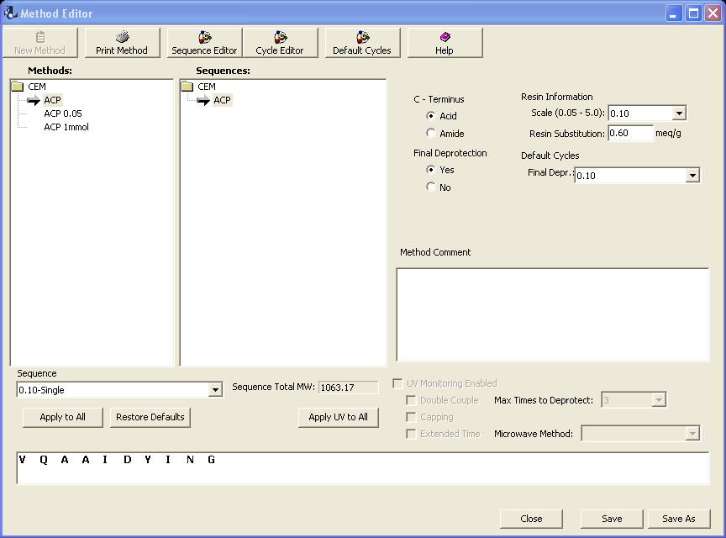
Method Editor
Provides the specific conditions to synthesize a defined sequence on the Liberty1.
Notes:
The method editor provides the specific conditions to synthesize a defined sequence on the Liberty 1. You will define
Sequence (that is why the sequence window opens)
Scale
C-terminus
Resin Substitution
Whether or not you want the system to perform final deprotection and the conditions for the deprotection
The conditions for each cycle (in the sequence drop down menu you will define the residue addition conditions). Note that you have the option of applying one set of conditions to each residue.
If you have the UV Monitor Option and it has been enabled in the options tab (see slide 16 for details) , this is where you could alter the defaults conditions for a specific coupling cycle. You will define the maximum number of times to run the deprotection before the system continues on and what action the system will take if the deprotection fails (run an extended coupling step and/or double couple and/or cap <if you have that feature on the Liberty 1>).

Slide 8
Calculators
Reagent - how to prepare all reagents to be loaded on the system at the correct concentrations.
Usage - to determine the amount of each reagent needed for a given method.

Slide 9
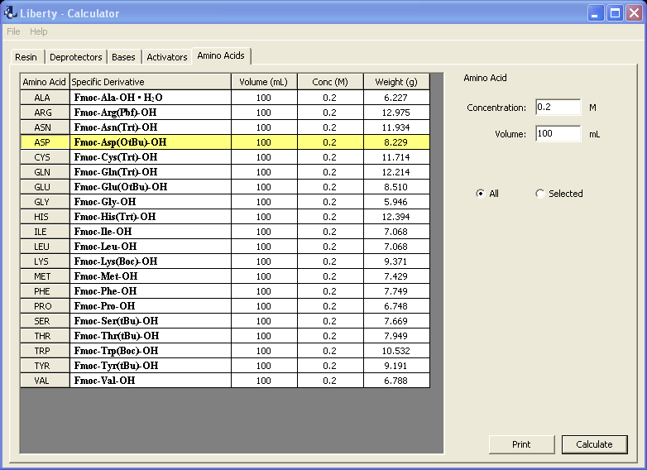
Calculator – Reagents
Amino Acids
The weight of the Fmoc protected amino acid required for a user defined volume and concentration
Notes:
The amino acid calculator shows the weight of the Fmoc protected amino acid required for a user defined volume and concentration. In this case the total volume is 100 mL at a concentration of 0.2 M.

Slide 10
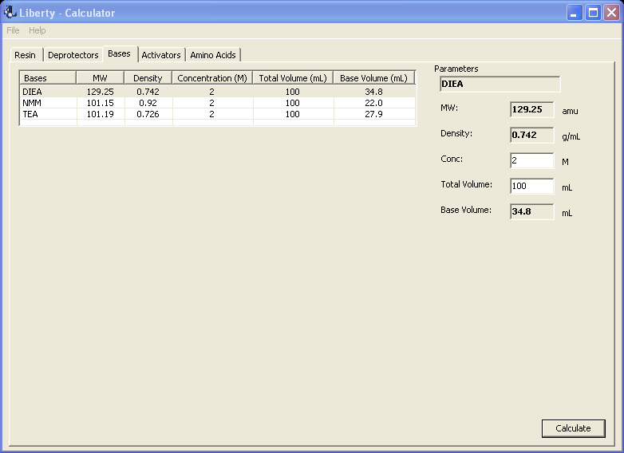
Calculator- Reagents
Bases
The volume of the selected base required for a user defined final volume and concentration.
Notes:
The base reagents calculator shows the volume of the selected base required for a user defined final volume and concentration. In this case the total volume is 100 mL at a concentration of 2 M for DIEA.

Slide 11
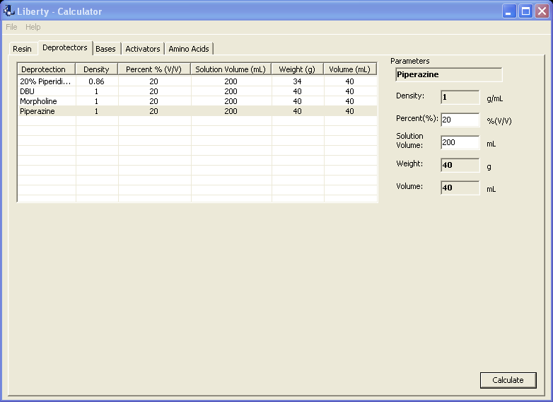
Calculator- Reagents
Deprotectors
The volume of the selected deprotector required for a user defined final volume and concentration
Notes:
The deprotectors reagents calculator shows the volume of the selected deprotector required for a user defined final volume and concentration. In this case the total volume is 200 mL at a concentration of 20% for Piperazine.

Slide 12
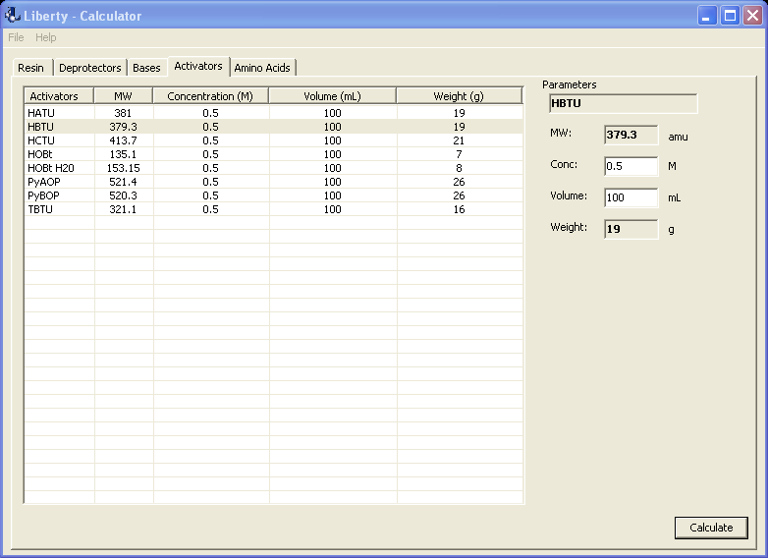
Calculator Reagents
Activators
The weight of the activator required for a user defined volume and concentration.
Notes:
The activator calculator shows the weight of the activator required for a user defined volume and concentration. In this case the total volume is 100 mL at a concentration of 0.5 M for HBTU.

Slide 13
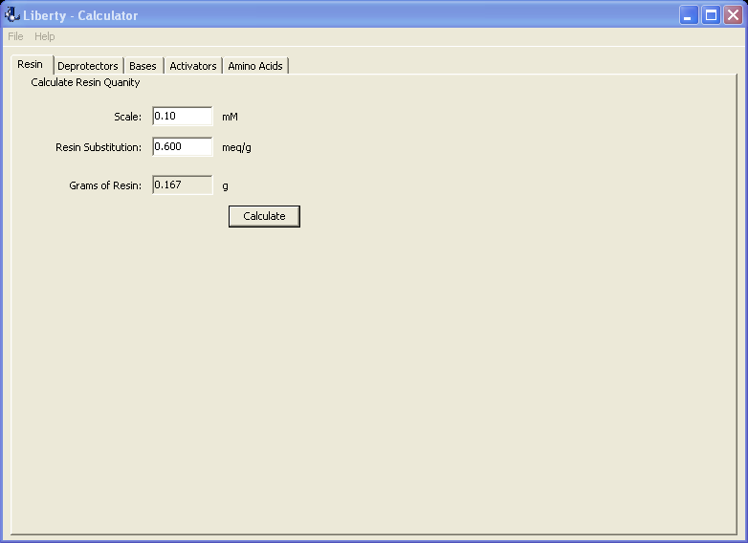
Calculator - Reagents
Resin
Weight of resin required based upon sequence scale and the resin substitution.
Notes:
The resin calculator shows the weight of resin required based upon sequence scale and the resin substitution.

Slide 14
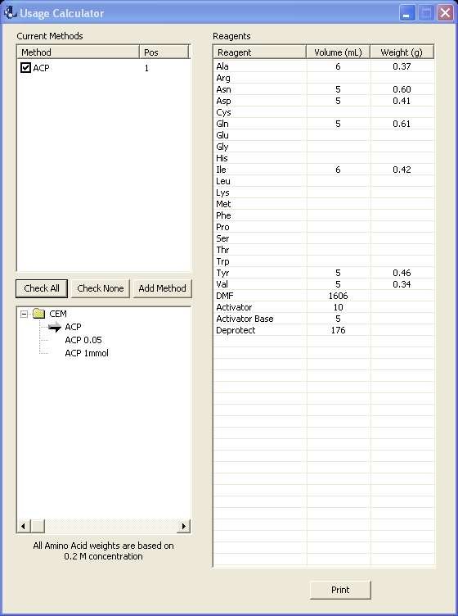
Calculator Usage
Determines the amount of each reagent needed for a given method.
Notes:
The usage calculator determines the amount of each reagent needed for a given method. You will open up the method folder, then highlight a method and it will appear in the top portion of the current methods window. Check the box next to the method and the reagents area will populate with the amount of each reagent required.

Slide 15
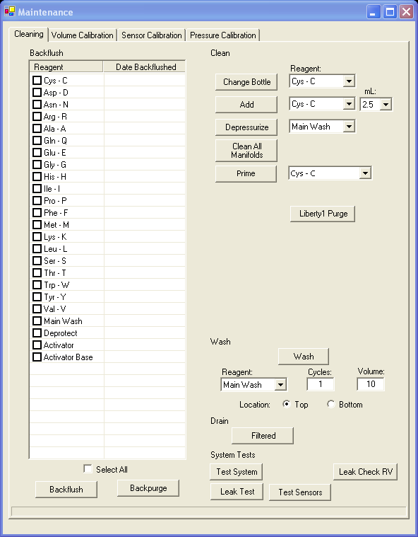
Maintenance
Walks you through the routine
maintenance procedures.
Notes:
The maintenance screen has four (4) windows with the most utilized one being Cleaning . You can
Backflush all reagent addition lines
Change reagent bottle (this is under the ‘clean’ area of the window)
Wash the reaction vessel from the top of bottom
Drain the reaction vessel
Perform system tests for sections of the Liberty 1
The other three (3) windows deal with reagent delivery volume calibration, amino acid sample loop sensor calibration and nitrogen pressure calibration.
NOTE: There is a diagnostics option under the Maintenance tab. However this feature should only be used in conjunction with a trained CEM representative. The diagnostics screens help troubleshoot operational issues if they should occur.

Slide 16
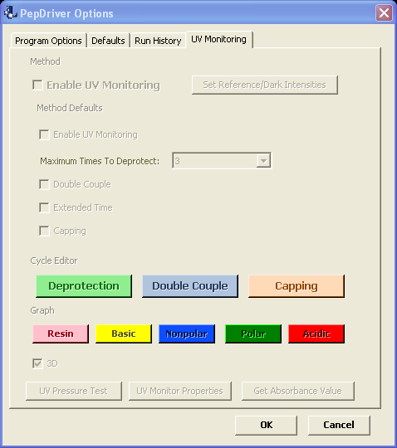
UV Monitor (Optional)
monitors the waste stream after the two deprotection steps to determine if the deprotection has gone to completion.
Notes:
This is a screen shot of the UV monitor setup screen. It is accessed from the setup drop down menu/options. This window has four (4) with the last being UV Monitoring. On the UV Monitor screen you will enable the UV Monitor feature. The UV monitor is an optional feature that monitors the waste stream after the two deprotection steps to determine if the deprotection has gone to completion. You can define the maximum number of deprotection cycles until the system continues on to the coupling step and the Liberty 1 system actions if there is a deprotection failure (extended coupling time, double coupling and/or capping (if option is available)). You can also have a graphical representation of the degree of deprotection for each cycle.

Slide 17
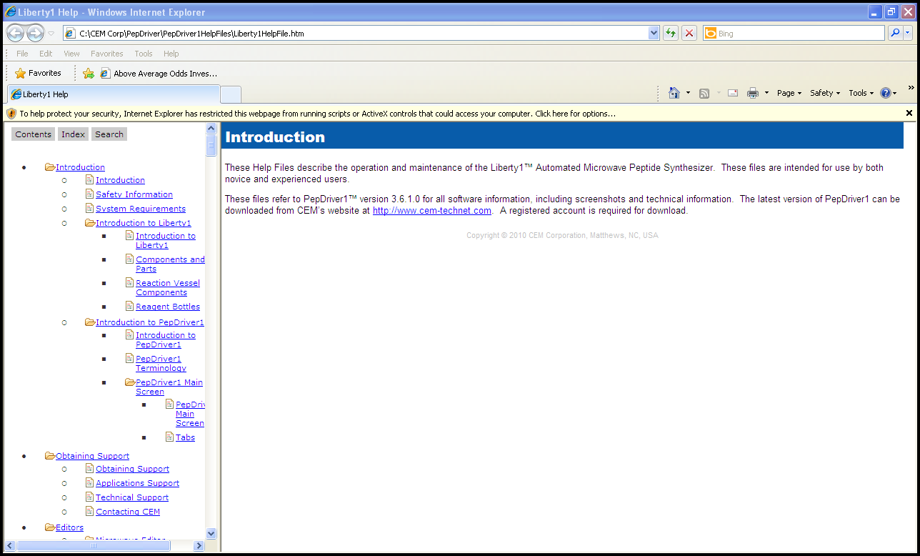
Help!!
The goal
The Help tab will provide answers to all your questions on the use of PepDriver.
Notes:
The goal of this presentation was to provide an overview via screenshots of the PepDriver appliction software that provides control over the Liberty 1 System. An in case you have any questions about further details, we provide an in depth review at the Help tab. This covers the PepDriver from soups to nuts.

