Slide 1

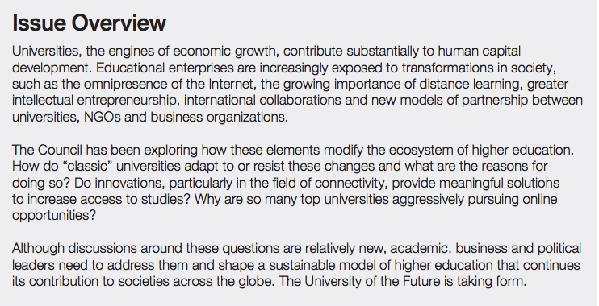
2012

Slide 2
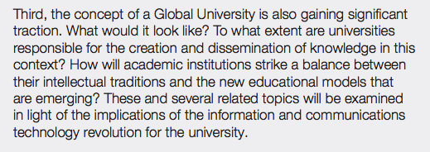

Slide 3
Appeal of Online Education/
Digital Scholarship
as a means to harness and stay abreast of rapidly changing environment: technology relating to global connectivity, “global university”
as it gratifies the “calling “ of teaching, education as a right for all.
as it offers possible solutions to the increasingly vexing economics of education
as it challenges universities to remain relevant, creators and curators of ideas always in touch with students’ needs and “market” demands

Slide 4
more than Esperanto ever achieved, digital language is the one universal language, a successful lingua franca, that we cannot afford to not learn. Current events are current, and information is in real-time
- effective
- fun to learn
- come with all sorts of fun “toys”
- renders common platforms through which to share culture: music, art, film…….

Slide 5


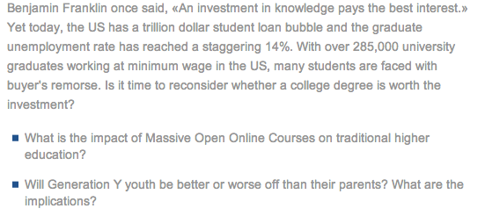

Slide 6
Daphne Koller, Co-Founder and Co-Chief Executive Officer, Coursera. Professor
in Artificial Intelligence, Stanford University.
http://www.openforumdavos.ch/en/higher-education-investment-or-waste.html
The university of the future? Socialstructing Higher Ed, “meet Andy…”
http://www.iftf.org/iftf-you/programs/future-of-learning/
Nomad University, the college of your choice
http://www.nomaduniversity.com/
COURSERA: HISTORY AND FUTURE OF (MOSTLY) HIGHER EDUCATION
Spring 2014 course, taught by Prof. Cathy Davidson of Duke University
http://www.hastac.org/future-higher-ed

Slide 7
FACOE: faculty advisory committee on online education, 2013-14
Charge to Faculty Advisory Committee on Online Education:
The Faculty Advisory Committee on Online Education, with representation from across the university, will be responsible for advising the Provost on issues around online education.
The near term responsibilities will include:
establishing standards and proposal guidelines for university-wide online course offerings from Emory, initially focused on a process for future Coursera courses; and
(2) reviewing course proposals and selecting courses to be developed for Coursera for the coming year.
The longer term responsibilities, to be addressed in Fall/Spring 2013/2014, include:
(3) considering policy issues such as licensing, intellectual property, faculty workload and compensation issues;
(4) shaping Emory’s short and long term goals and vision for online education.

Slide 8
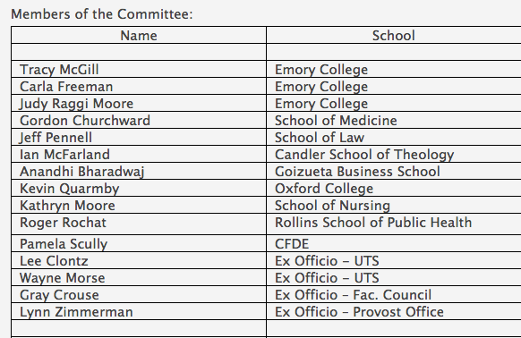

Slide 9
KEY DRIVERS OF CHANGE
What do we believe are the key drivers of change in higher education? Is it simply technology that is driving the change or are there other demographic/cultural shifts that are perhaps complementary to the technology change that together drive changes in higher ed?
There is no question that technology has created very significant possibilities for the delivery of higher education. It is also important to recognize that this is not the first time that has been considerable hype surrounding the effects that new technology will have on higher education. Correspondence courses in the nineteenth century, radio and television in the twentieth, and, most recently, the first wave of online technology during the dot.com bubble were all accompanied by predictions of radical change in higher education that were not realized. Nevertheless, it would be foolish to ignore the ways in which the ever-increasing capacity of hardware, software, and wifi infrastructure have the potential to change higher education.
In addition to technological factors, however, it is important to recognize larger structural changes that affect higher education. In the immediate postwar era, it was possible to earn a significant portion of one’s tuition and expenses even for private colleges through summer employment; public universities were even less financially taxing while also providing quality education (especially in flagship programs like the UC system). An undergraduate degree was virtually a guarantee of a job capable of sustaining a middle-class lifestyle (at least for white men).
The landscape of higher education has changed drastically. Even public institutions are now far too costly for students to be able to work their way through college, while the total year-to-year cost of attending elite private schools can exceed the median annual U.S. household income. It is therefore increasingly (indeed, save for the very wealthy, almost universally) necessary for students to resort to loans to fund their education, leading to ever-rising levels of student debt upon graduation. Furthermore, while median income still varies directly with educational attainment, a bachelor’s degree is no longer perceived as guaranteeing a stable career.
Two factors can be identified as influencing this last fact. First, the structure of corporate life is no longer one that facilitates the kind of smooth career path within a single organization that was common in decades past. Second, there has emerged within higher education a sharp stratification of institutions quite different from the traditional split between state and private schools. For-profit schools have emerged as a significant factor in what had been an almost exclusively non-profit universe. And within the non-profit sphere the gap between elite institutions (including top-tier private institutions as well as leading public research universities) on the one hand, and less prestigious schools (small, underfunded private schools, and state and community colleges) on the other has widened significantly. This stratification has created quite different profiles within higher education that make it difficult to speak generically of “undergraduate education” or “the baccalaureate degree,” since at the lower end of the scale schools (including the for-profit sector) have shaped their degree programs away from the liberal arts and sciences toward narrowly defined vocational degrees, while the schools at the other end have tended to maintain a more traditional profile.

Slide 10
WHAT DOES THIS MEAN FOR EMORY?
Online Education changing the role of Higher Ed institutions: emerging options
2) Online Education creating a different interpretation of teaching and of student-faculty relation and dialogue
3) Online Education creating a different interpretation of "campus", "academic calendar", "classroom", "academic time", physical or virtual presence on campus.
4) Credentialing: “Credentialing helps to pay some of the bills for educating… what MOOCs may force us to consider is whether a particular credential, a diploma, is necessary to demonstrate learning, as well as who gets to decide the relative value of the possible alternatives.
5) Assessing Universities
Traditionally, schools have been judged by how many prospective students they turn away, not by how many competent graduates they churn out. The Online Education changes will make it easier to measure what students actually learn. This additional assessment access will "make universities more accountable for what they produce.
6) Online Education, Intellectual Property and the Value of ‘free’ courses
Who “owns” online content? Who is compensated?

Slide 11
How should Emory prepare for the future?

Slide 12
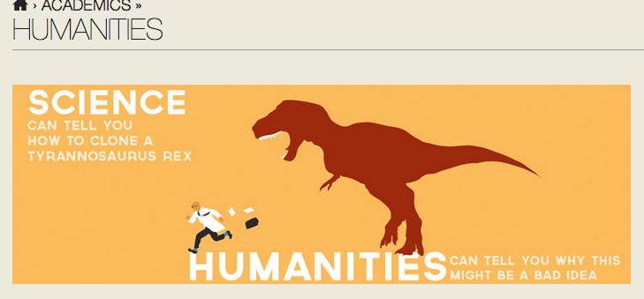
a Liberal Arts degree….. is it worth defending??

