Slide 1
Exploring Health Careers Presented by: Pre-Health Advising (PHA) at Emory University Kim Molee, PhD Director of Pre-Health Advising
Spring 2024

Slide 2
Agenda Items
What does it mean to be Pre-Health at Emory?
What is holistic development?
What are Pre-Health competencies?
How do I explore more health careers?
What programs exist for Emory Pre-Health students?
Where can I get more information?

Slide 3
What does it mean to be a Pre-Health student at Emory?
At Emory, Pre-Health is a pathway you self-select…
This means you are not “locked in” to a Pre-Health pathway, and this can occur at any point in time during your four years
You have at least two years to explore, and you should
You can major in ANYTHING & you can change your mind too, nothing goes to waste
You can meet the PHA (Pre-Health Advising) team across all four years at Emory, in the summer, and after graduation too
The PHA team is specifically trained to help you meet your academic, personal, and professional goals
We are here to support you and connect you to valid sources of information such as professionals in healthcare, alumni, and other Pre-Health students

Slide 4
Holistic Development for Pre-Health students at Emory
Academics
Community Service
Leadership
Clinical
Research
Other
Notes:
DANI
Today should hopefully not be the first time you are seeing this term holistic development, and these are the categories which encompass you and your unique individual experiences and make up your full picture, of who you are.
These categories are the overarching umbrella of your experiences as an undergraduate student and everyone’s experiences in these categories are different and that’s ok, they should be unique to you!
Your experiences SHOW how you informed your decision, developed various skill and competencies that will make you a successful applicant and healthcare professional.
Kim is going to talk through each category in a little more depth in a few minutes, you might have more than you think! Students often ask how many hours do I need and is this # of shadowing hours enough? This is where the reflection piece comes in…you could have 20 hours or you could have 200 hours, but can you tell us what you learned about the profession/yourself…
ALL of your experiences.
Consider your readiness in the holistic development categories, consider feedback from your MCU 1:1 Follow-Up. You have heard about these holistic development categories from the beginning. The thread continues from your MCU to the Composite Letter, and we take your experiences in all of these categories to put together your CL and tell your story.

Slide 5
How does the Emory Liberal Arts foundation integrate with Pre-Health?
Critical thinking is an essential healthcare competency; the profession requires you to be culturally sensitive, resilient and adaptable when faced with complex clinical issues. These competencies are emphasized in the Liberal Arts foundation during the first two years at Emory.
Research experience in any discipline can strengthen your healthcare skills as you learn the essentials of data collection, analysis, and problem-solving strategies.

Slide 6
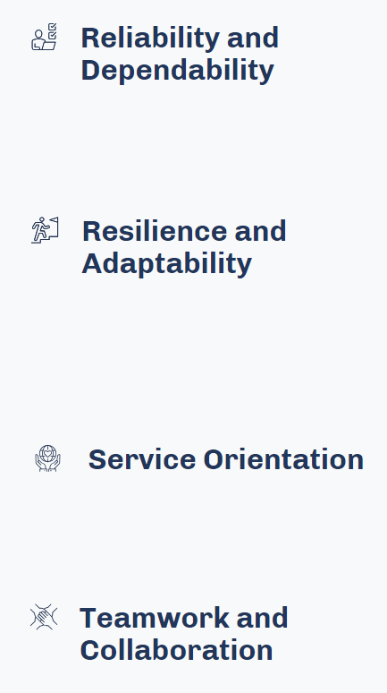
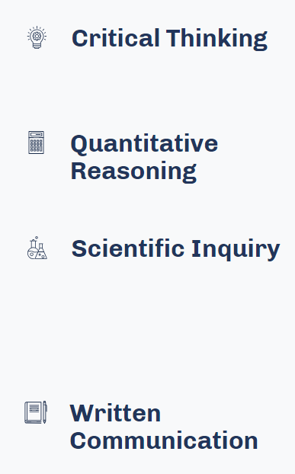
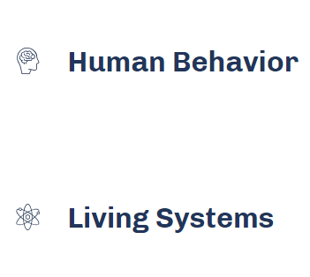
Selection of Pre-Health competencies
Science, thinking, and professionalism
These apply to all healthcare professions
Source: https://students-residents.aamc.org/real-stories-demonstrating-premed-competencies/premed-competencies-entering-medical-students
Notes:
DANI
Another component to testing and communicating your why, is taking these competencies, set forth by the Association for American Medical Colleges, as key competencies to being a successful healthcare professionals (while it’s from AAMC—applicable to all). Take the time to reflect on how you have developed and demonstrated these skills through your experiences.
In the QR code at the end, we will share some resources that will help you reflect on these competencies including various worksheets from the AAMC and the University of MD, that help you list out your experiences and how you have demonstrated these!
Our Director, Kim Molee, is also presenting on competencies in our next Am I Ready presentation as part of this series.

Slide 7
How Do I Explore Health Careers?
Volunteering in a clinical setting-- most hospitals and clinics have volunteer programs for students
Paid clinical positions– medical scribe, medical assistant or office assistant
Summer research or internships
Shadowing/Observing

Slide 8
What programs exist for Emory Pre-Health students?
Academic planning
Four-year planning from day one!
Access to Pre-Health Juniors and Seniors for advice on course selection
Support for time management skills and tutoring
Study Abroad & summer programs
Access to opportunities
Hospitals and clinics on campus
Research labs in the Emory School of Medicine, Rollins School of Public Health, Woodruff School of Nursing & the CDC
Faculty members in the Emory School of Medicine partner with Pre-Health Advising, across multiple healthcare disciplines
Application assistance
Population-specific support on writing essays, personal statements, test prep material & timeline planning at Emory and during gap years

Slide 9
Services Summary
Academic Advising Services | Application Advising Services
Composite Letter Services | Faculty & Healthcare Advisory boards
First year and second year small group advising | Peer Mentor Program
Pre-Health Events & Partnerships | Alumni Mentors

Slide 10
Resources for more information
Want to get connected? View PHA opportunities:
https://prehealth.emory.edu/prepare/clinical.html
https://emoryprehealth.blogspot.com/
https://www.instagram.com/emorypha
Want to learn more? Start here:
https://pathways.emory.edu/about/contact.html
http://explorehealthcareers.org/

Slide 11
Questions?

