Slide 1
Content & Design
Kevin Glover, Emory University

Slide 2
Design is not just what it looks like and feels like.
Design is how it works.

Slide 3
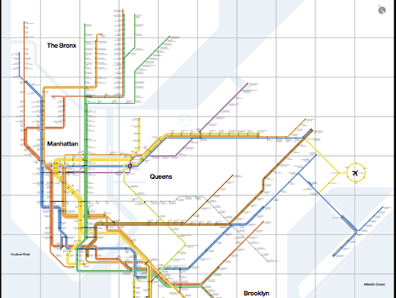
“
God is in
the details.
”

Slide 4
Design is One
The design of a product is one with the whole as much as it is an individual piece.

Slide 5
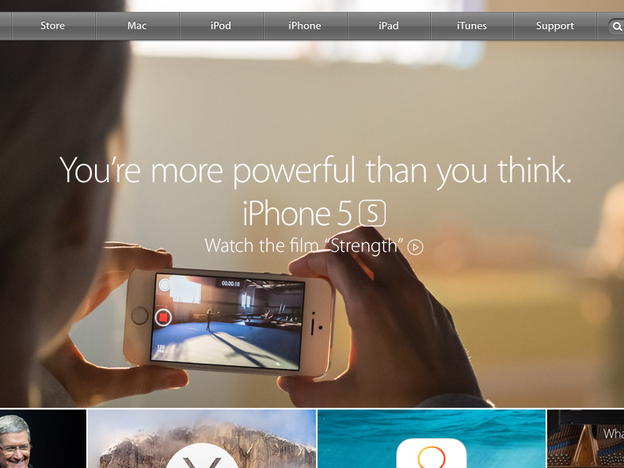
Why?

Slide 6
Three Style Principles
Semantics
Syntactics
Pragmatics
Notes:
Semantics, in design, means to understand the subject in all its aspects; to relate the subject to the sender and the receiver in such a way that it makes sense to both. It means to design something that has a meaning, that is not arbitrary, that has a reason for being, something in which every detail carries the meaning or has a precise purpose aimed at a precise target.

Slide 7
Determine Right Structure From The Start
What is the purpose
Why are people coming here
How are people accessing this
Where are they and what are they doing
What are the budget and resources available

Slide 8
A Few Web Design Tips

Slide 9
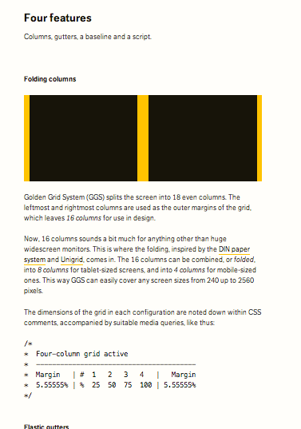
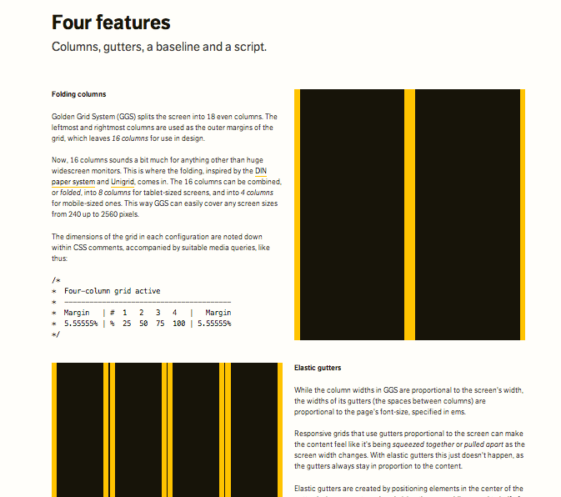
Use a Responsive Grid

Slide 10
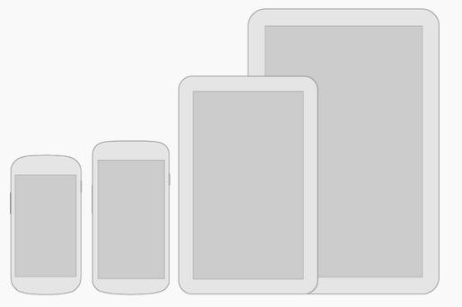
Think Mobile First

Slide 11
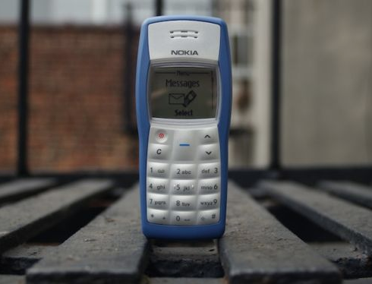
#1 Phone in the World

Slide 12
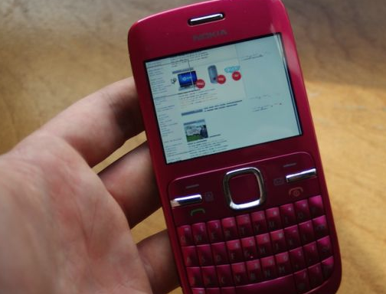

Slide 13
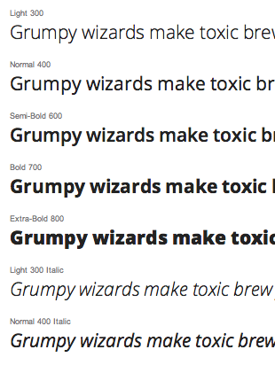
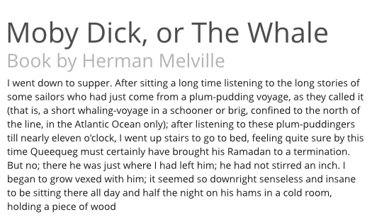
Use Web Fonts Responsibly
Google.com/Fonts

Slide 14
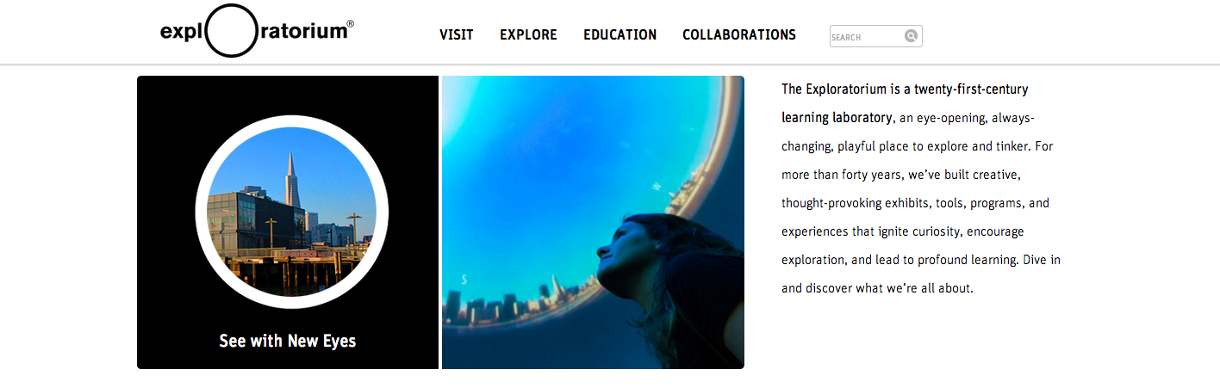
Use concise Language
Exploratorium.edu

Slide 15
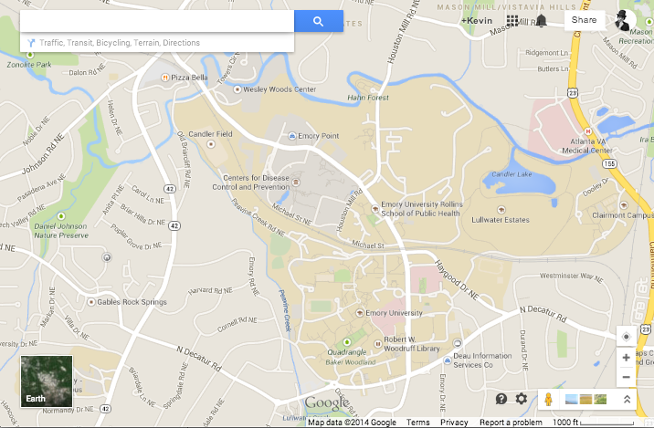
Focus on content
Maps.Google.com

Slide 16

Use Design to emphasize your content
EducationAboveAll.org

Slide 17
Be on the look out for cool stuff
WEBSITES
Awwwards.com
theDieLine.com
TheFoxIsBlack.com
VIGNELLI CANON
www.vignelli.com/canon.pdf

