Slide 1

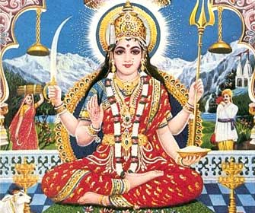
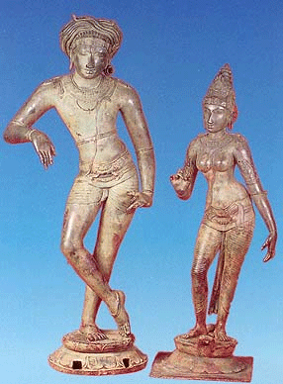
Parvati
(Parvati, patheos.com)
(Shiva with Parvati, 12th Century Chola sculpture, Tamil Nadu,India)

Slide 2
Introduction to Parvati
Meaning of the name is "she of the mountain“
the wife of Shiva
She has 108 different names
The Hindu goddess of love, fertility and devotion
She is the gentle and nurturing aspect of the Hindu goddess Shakti
According to some Puranas, her reincarnation is Sati (the first wife of Shiva)

Slide 3
How Parvati is born
The Puranas tell that Sati's marriage to Shiva against her father Daksha's wishes
The conflict gets to a point where Daksha does not invite Shiva to a major fire ceremony, and Shiva does not come, humiliating Sati.
She self-immolates (burns herself) herself at Daksha's ceremony
Sati is then reborn as Parvati

Slide 4
The love story between Parvati and Shiva
Shiva is shocked after Sati’s death and becomes very grief-stricken, loses interest in worldly affairs, retires and isolates himself in the mountains
She approaches the god Kama and asks him to help her make Shiva fall in love with her
Kama reaches Shiva and shoots an arrow of desire. After that Shiva is in love with Parvati but later Shiva realizes what happens to him
He opens his third eye in his forehead and burns Kama to ashes

Slide 5
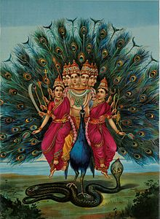
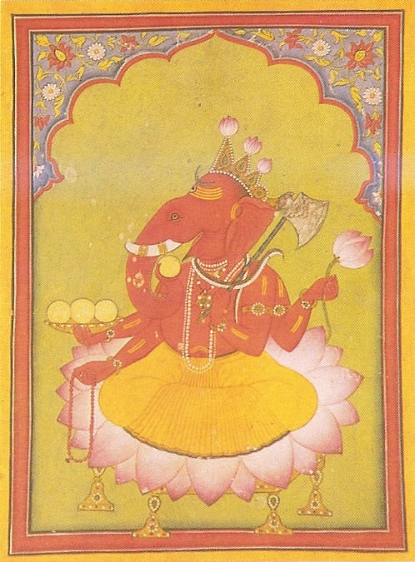
Parvati does not lose her hope and begins to live in mountains like Shiva, engage in the same activities as Shiva such as yogin and tapas.
She finally wins Shiva’s heart and they get married
They have two children, Kartikeya and Ganesha
(Murugan with his wives by Raja Ravi Varma)
(Basohli miniature, circa 1730. National Museum, New Delhi)

Slide 6
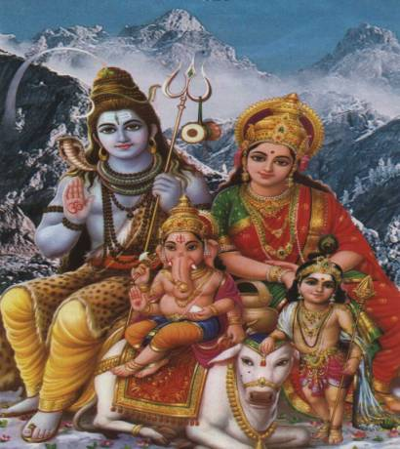
Why worshipping Parvati?
As a Goddess of family and love, she can help with marriage, parenting, and fertility
She has remarkable strength and determination
Some say that a worship of Shiva is useless without also worshiping Parvati
Shiva and his family, www.haddonfield.k12.nj.us

Slide 7
How to worship Parvati
Swayamvara Parvati Mantra（54 Chants by Krishna）
Bringing marriage, or resolving conflict between couples, or help prevent miscarriage
While chanting, recite this mantra 1008 times for 108 days in a row
https://www.youtube.com/watch?v=WbnBoqwDDkY

Slide 8
Hindu songs about Parvati
https://www.youtube.com/watch?v=-1D85S-vMA0#t=65
https://www.youtube.com/watch?v=BgQRRE6OQGE#t=29

Slide 9
Article related to Parvati
Parvati-A Goddess of Diversity
http://www.haddonfield.k12.nj.us/hmhs/academics/english/parvatithediversegoddess.htm

Slide 10
Reference
“Pavati" Wikipedia: The Free Encyclopedia.
“Shiva" Wikipedia: The Free Encyclopedia.
Parvati: Everything You Need to Know (http://www.patheos.com/blogs/whitehindu/2014/09/parvati-everything-you-need-to-know/)
“Parvati " I love India (http://www.iloveindia.com/spirituality/goddesses/parvati.html)
Parvati-A Goddess of Diversity (http://www.haddonfield.k12.nj.us/hmhs/academics/english/parvatithediversegoddess.htm)
https://www.youtube.com/watch?v=BgQRRE6OQGE#t=29
https://www.youtube.com/watch?v=-1D85S-vMA0#t=65

