Slide 1
Goddess Lakshmi
Meredith Broyles

Slide 2
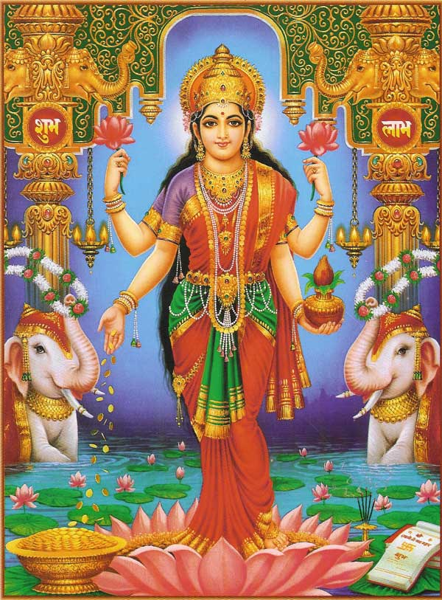
Lakshmi
Goddess of wealth and prosperity
She is known in pre-Vedic literature as Sri, and later developed into the well known deity of Lakshmi
“Mother of the World”
http://www.goddessgift.com/images/goddess-Lakshmi.jpg

Slide 3
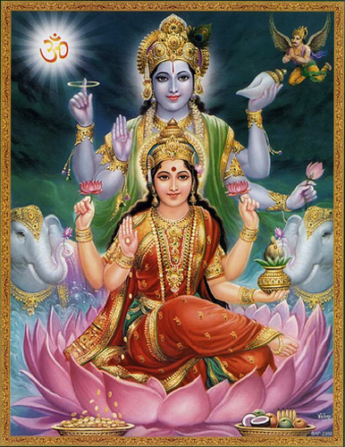
Lakshmi and Vishnu
She is the loyal wife of Vishnu
The shakti (“energy”)of Vishnu
Vishnu is meaning and Lakshmi is speech, Vishnu is knowledge and Lakshmi is insight, Vishnu is behavior and Lakshmi is conduct, etc.
https://www.flickr.com/photos/arjuna/3505573638

Slide 4
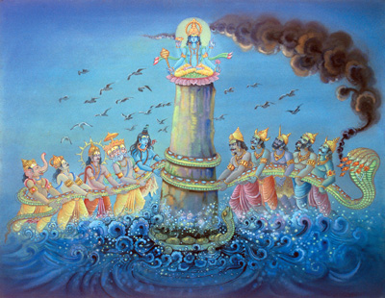
Churning of the Ocean of Milk
The rebirth of Lakshmi
Lakshmi disappeared into the ocean
The demons and the deities fought, churning the ocean for 1000 years
Lakshmi appeared on a lotus flower with many other treasures
http://www.sanatansociety.org/indian_epics_and_stories/the_churning_of_the_ocean.htm#.VlPkZWSrRPM

Slide 5
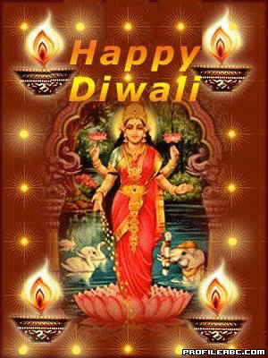
Diwali
The “Festival of Lights”
On the third day of Amavasya, Lakshmi is celebrated with a Puja
Sri “showers her blessings on man for plenty and prosperity”
Many turn on lamps in their homes to light her path
http://indigointernational.org/wp-content/uploads/2012/03/lakshmi.jpg

Slide 6
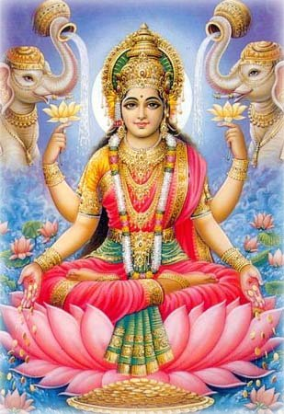
Associated symbols
The lotus flower: fertility and spiritual purity
The elephants: provide showers of water, royal authority, four ends of human life, spread wealth, etc.
Her four arms and four hands: omnipresence and omnipotence and four ends of human life
The red dress: prosperity
http://www.koausa.org/Gods/God6.html

Slide 7
Works Cited
"Churning of the Ocean of Milk | Hindu Mythology." Encyclopedia Britannica Online. Encyclopedia Britannica, 19 Feb. 2015. Web. 24 Nov. 2015.
Dimmitt, Cornelia. Classical Hindu Mythology: A Reader in the Sanskrit Purāṇas. Philadelphia: Temple UP, 1978. Print.
Kinsley, David R. Hindu Goddesses Visions of the Divine Feminine in the Hindu Religious Tradition. Berkeley: U of California, 1988. Print.
"Lakshmi." BBC News. BBC, 24 Sept. 2009. Web. 24 Nov. 2015.
"Lakshmi Puja on Diwali." Lakshmi Puja,,Lakshmi Pujan,Laxmi Diwali Pujan,Laxmi Puja 2015. Society for the Confluence of Festivals in India (SCFI). Web. 24 Nov. 2015.
Molloy, Michael. Experiencing the World's Religions: Tradition, Challenge, and Change. 4th ed. Boston: McGraw Hill Higher Education, 2008. Print.
"New World Encyclopedia." New World Encyclopedia, . 27 Jun 2009, 11:12 UTC. 24 Nov 2015, http://www.newworldencyclopedia.org/p/index.php?title=New_World_Encyclopedia:Terms_of_Use&oldid=943147.
Pandit, Bansi. "Hindu Deities: Goddess Lakshmi." Hindu Deities: Goddess Lakshmi. Kashmir. Web. 24 Nov. 2015. http://www.koausa.org/Gods/God6.html

