Slide 1
Georgia Drug Overdose & Prescribing Surveillance
Laura Edison DVM, MPH, CDC Career Epidemiology Field Officer

Slide 2
DPH Comprehensive Opioid and Substance Use Program
Started in 2016 with 3 CDC grants
Now supported by the Overdose Data to Action (OD2A) CDC grant, which will combine surveillance and prevention
3 Program areas
Epidemiology and surveillance (Drug Surveillance Unit)
Prescription Drug Monitoring Program (PDMP)
Statewide strategic Planning
https://dph.georgia.gov/stopopioidaddiction

Slide 3

Drug Surveillance Unit
Team of epidemiologists, biostatisticians, and information technologists
Goals
Identify and respond to overdose clusters
Produce data reports
Fulfill data requests
Facilitate data access
Create visual displays
Website: https://dph.georgia.gov/drug-surveillance-unit
Notes:
Data repository will be used to integrate data sources
Sidenote: Due to the constant changing nature of this epidemic, we look at data for all drug overdoses (not just overdoses related to opioids)

Slide 4
Opioid Overdose Surveillance
How do we determine the scope of the problem in Georgia?
Surveillance is essential to any public health prevention or containment strategy
Surveillance is hard to do!
How do you know how many people are at risk of addiction, overdose, death? Many limitations to every data source!
Use available data to describe the epidemic and detect clusters and hotspots
Inform partners to direct prevention, treatment, enforcement, and policy decisions
Work to improve our data

Slide 5
Current Surveillance Data Sources
Hospital and Emergency Department (ED) discharge data
Syndromic surveillance
Prescription Drug Monitoring Program (PDMP)
Death certificates, Coroner/Medical Examiner & toxicology reports
GBI Drug seizure data
Emergency Medical Services (EMS) reports
Neonatal Abstinence Syndrome reports (dph.ga.gov/nas)
Overdose Detection Mapping Application Program (ODMAP)
Behavioral surveys
Notes:
-Hospital and ED discharge data is ICD10 coded and received quarterly from all Georgia hospitals
-SS is a daily feed of ED and Urgent Care Facility visits used to rapidly identify clusters and trends
-Death certificate data comes from Vital Records
-Drug seizure data are crime lab submissions to the Georgia Bureau of Investigation (GBI)
-Real-time data entered by first responders (LE, Fire, EMS)

Slide 6

Surveillance Reports
https://dph.georgia.gov/drug-surveillance-unit
Annual opioid overdose surveillance reports
Hospital discharge data, vital records death certificates, GBI Crime Lab seizure data
2016 and 2017 report (revised reports coming soon)
County level data tables
PDMP reports 2016-2018
County-level data tables
Monthly Syndromic Surveillance reports
2018 surveillance reports, county profiles, and a stimulants report coming soon
Additional death data available on OASIS
https://oasis.state.ga.us/oasis/webquery/qryDrugOverdose.aspx
Notes:
All pending reports will be posted to our website upon completion

Slide 7
Opioid-Involved Overdoses in Georgia

Slide 8
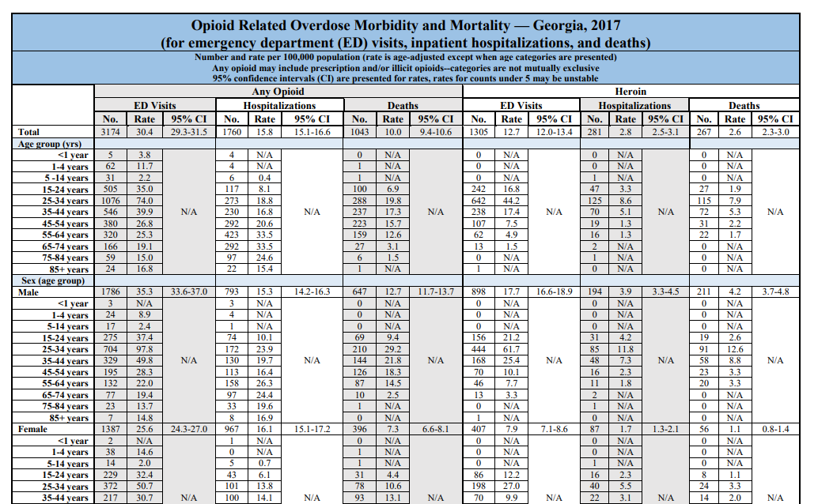
Data Available in Overdose Surveillance Reports
Overdose morbidity and mortality
2016-2017 (updates and 2018 coming very soon)
County level death, ED visit and hospitalization counts and rates
Statewide demographics and trends
More available upon request at the DPH Public Heath Information Portal (PHIP) https://dph.georgia.gov/phip-data-request
Notes:
-Hospital and ED discharge data is ICD10 coded and received quarterly from all Georgia hospitals
-SS is a daily feed of ED and Urgent Care Facility visits used to rapidly identify clusters and trends
-Death certificate data comes from Vital Records
-Drug seizure data are crime lab submissions to the Georgia Bureau of Investigation (GBI)
-Real-time data entered by first responders (LE, Fire, EMS)

Slide 9
Understanding Case Definitions
Use ICD codes and sometimes text to identify drug overdoses by drug type
Some case definitions overlap, drug categories are NOT mutually exclusive
Geographic data may mean different things
Place of residence vs. place of injury (overdose)
ED visits or hospitalizations occurring in GA vs. among GA residents
ED visits may also be represented in the hospitalization data (in updated reports)
Etc.
KNOW YOUR DATA AND WHAT IT REALLY REPRESENTS!
Notes:
-Hospital and ED discharge data is ICD10 coded and received quarterly from all Georgia hospitals
-SS is a daily feed of ED and Urgent Care Facility visits used to rapidly identify clusters and trends
-Death certificate data comes from Vital Records
-Drug seizure data are crime lab submissions to the Georgia Bureau of Investigation (GBI)
-Real-time data entered by first responders (LE, Fire, EMS)

Slide 10
From 2010 to 2018, the number of opioid-involved overdose deaths increased by 70% in Georgia, from 514 to 876 deaths.
Beginning in 2013, illicit opioids, such as heroin and fentanyl, drove the sharp increase in opioid-involved overdose deaths in GA. Note: fentanyl is included in the synthetic opioid category
Notes:
Preliminary 2017 data is represented by the dotted lines on this graph. Again, please keep in mind that this data is subject to change

Slide 11
From 2017-2018:
Heroin-involved overdose deaths increased by 16%, from 261 to 303 deaths
Fentanyl-involved overdose deaths decreased by 17%, from 363 to 311 deaths
Notes:
Specify that all data is preliminary, but especially 2018 since all death certificates for that year are not yet finalized

Slide 12
In 2018, Whites were 3.5 times more likely to die from an opioid-involved overdose than Blacks/African-Americans

Slide 13
In 2018, males were 1.9 more likely to die from an opioid-involved overdose than females, and 3.1 times more likely to die from a heroin-involved overdose than females

Slide 14
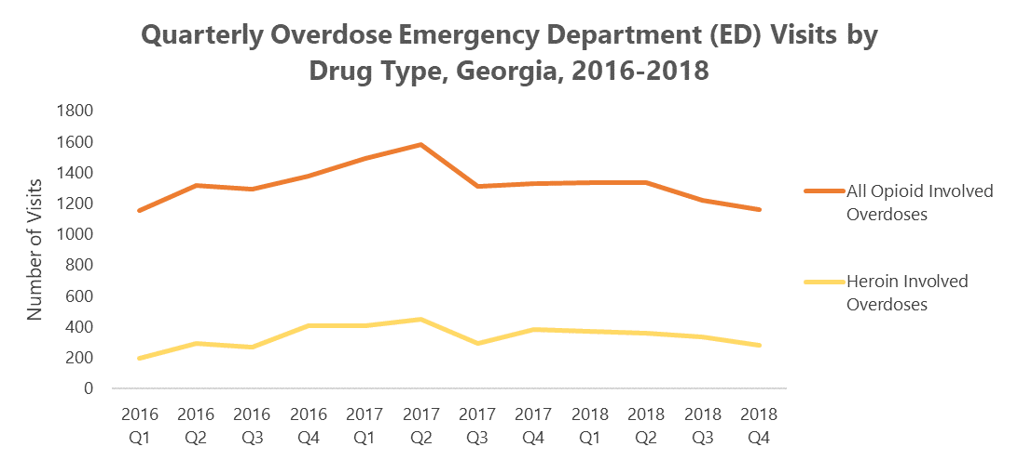
Opioid-involved overdose ED visits appear to be trending downward in 2018
These data are preliminary, and it is too soon to determine if this trend will hold

Slide 15
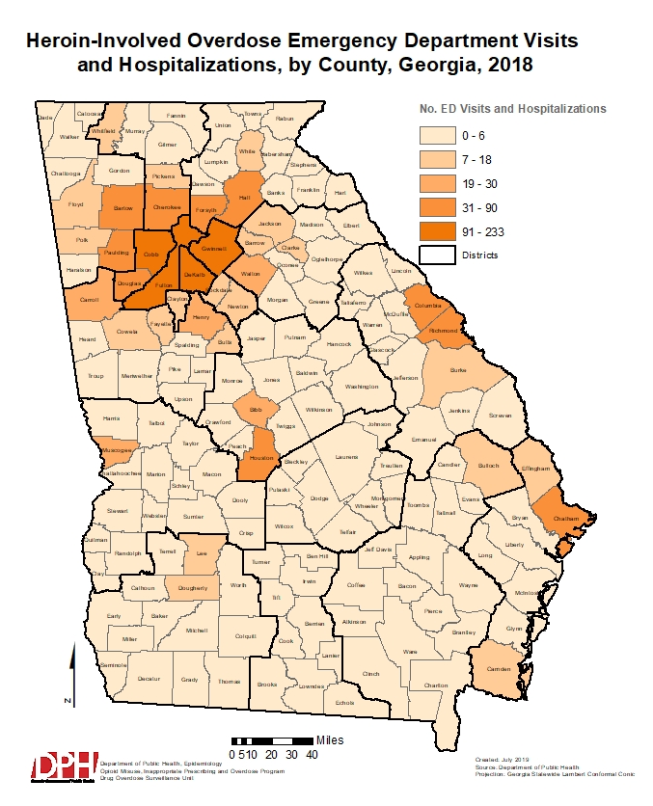
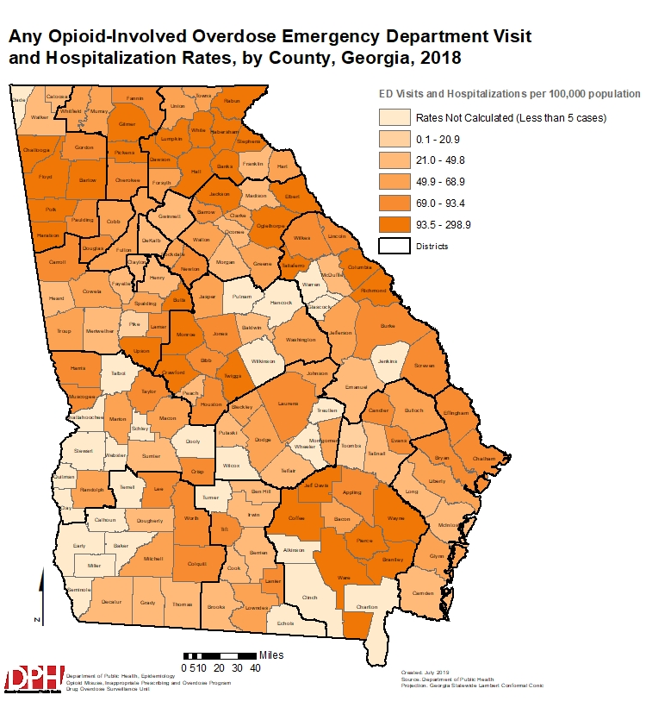
Notes:
When accounted for population size. more rural counties are represented for opioid-involved ED visits and hospitalization rates, in comparison to heroin-involved ED visits and hospitalization counts

Slide 16
State Unintentional Drug Overdose Reporting System (SUDORS)
Uses information from Death Certificates, Coroner/Medical Examiner reports, EMS and Law Enforcement reports to provide a complete picture of opioid-involved overdose deaths in Georgia
Information can be used to characterize opioid overdose deaths in Georgia, and Inform, develop, and guide overdose prevention programs
Mixed Coroner/Medical Examiner (C/ME) system in GA
Death certificate data obtained from vital records for import into NVDRS
Investigation summary, autopsy, and toxicology reports requested from 5 different ME entities (Cobb, Dekalb, Fulton, Gwinnett, GBI)
EMS and PDMP records pulled manually
Data abstracted into a CDC database
The first SUDORS report is coming soon!
Notes:
Mention time frame for data periods/deadlines and long lag times (Avg timeframe between death and certification of SUDORS deaths from July 2017 – June 2018 was 66 days. Long lag times are often due to pending toxicology results)

Slide 17
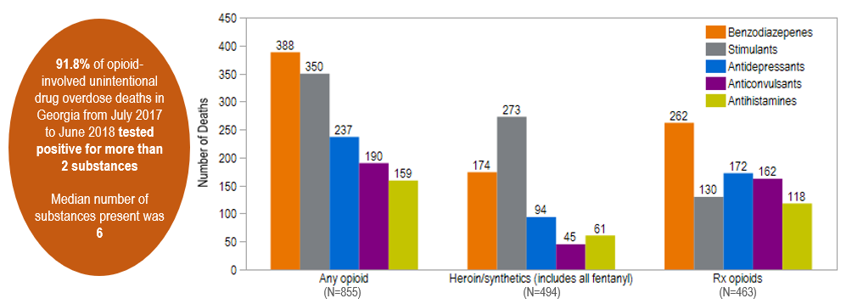
SUDORS Deaths by Drug Type (continued)
Unintentional Opioid-involved Overdose Deaths by Drug Type & Non-opioid Drug Pairings, Georgia, July 2017 – June 2018
Notes:
Looking forward to analyzing these data in more detail for other fields

Slide 18
Prescription Drug Monitoring Program
Database of all dispensed schedule II-V controlled substances
PDMPs are in all states with some data sharing between states
Purpose of PDMP
Reduce abuse of controlled substances
Ensure legitimate use of controlled substances
Reduce duplicative prescribing and overprescribing
Georgia dispensers are required to submit information for dispensed substance within 24 hours
All Prescribers (except veterinarians) are required to register in PDMP
Prescribers are required to check PDMP prior to prescribing schedule II opioids or cocaine derivatives, or benzodiazepines as of July 2018

Slide 19
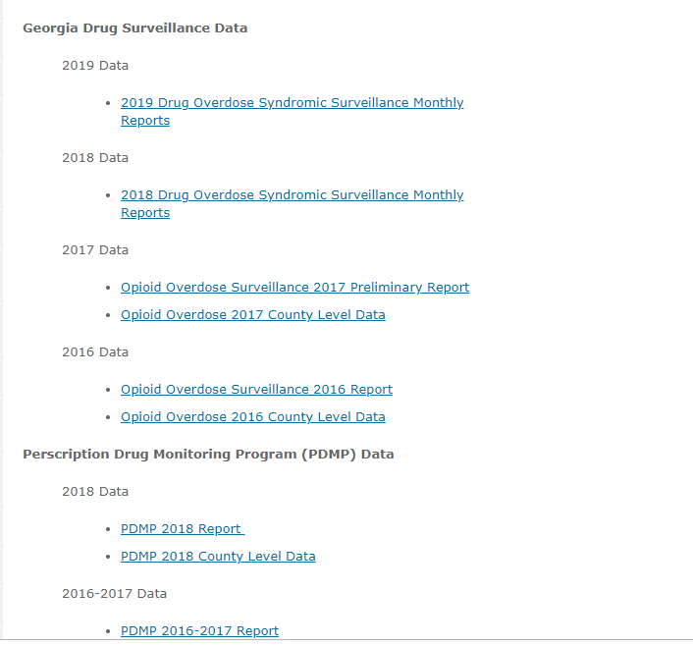
Data Available in PDMP Reports
2016-2018
Prescription and patient counts and rates
Various indicators of prescribing (e.g., high dosage prescriptions, multiple provider episodes, overlapping prescriptions, etc.)
County level data for some indicators, more available upon request
Notes:
-Hospital and ED discharge data is ICD10 coded and received quarterly from all Georgia hospitals
-SS is a daily feed of ED and Urgent Care Facility visits used to rapidly identify clusters and trends
-Death certificate data comes from Vital Records
-Drug seizure data are crime lab submissions to the Georgia Bureau of Investigation (GBI)
-Real-time data entered by first responders (LE, Fire, EMS)

Slide 20
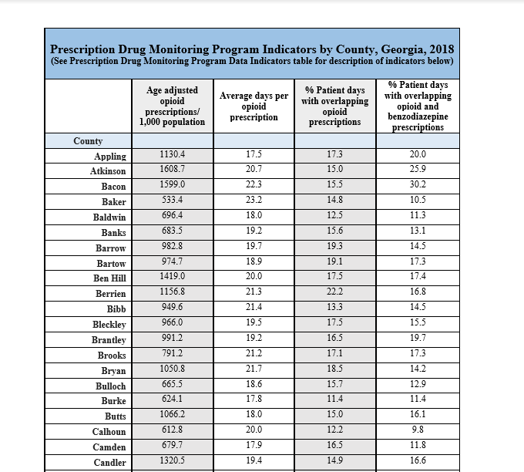
County Level PDMP Data Available Online
https://dph.georgia.gov/drug-surveillance-unit

Slide 21
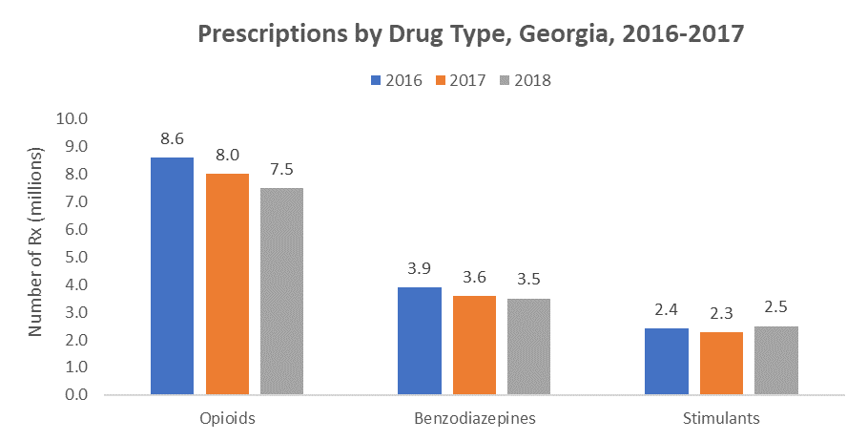
From 2017 to 2018, the number of opioid prescriptions decreased by 6%, benzodiazepine prescriptions by 3%, and stimulants increased by 12%.
Notes:
Opioids are the most frequently prescribed controlled substance in Georgia, followed by benzodiazepines. From 2017 to 2018, the number of opioid prescriptions decreased by 6%, benzodiazepine prescriptions decreased by 3%, and stimulants increased by 9%.

Slide 22
From 2017 to 2018, the rate of opioid prescriptions decreased by:
12% among persons aged 5-54 years
7% among those aged 55-64 years
7% among both males and females

Slide 23
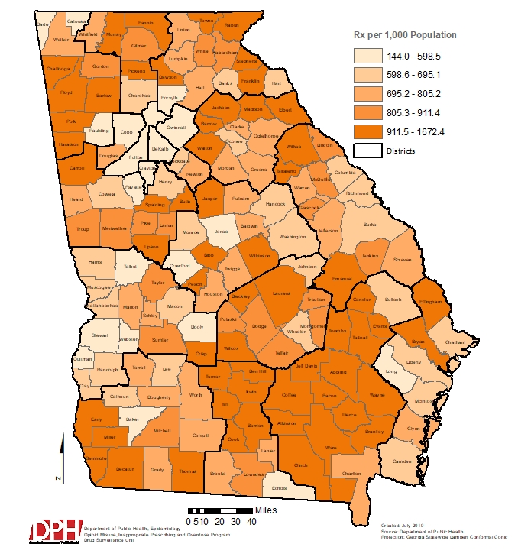
Opioid Prescription Rate, by County, Georgia, 2018

Slide 24
Data Improvement & Next Steps

Slide 25
Data Improvement Project: Coroner Database
Developing a database in SendSS for coroners to document death investigations
Web-based
Free to use for all coroners, but getting them to use it may be difficult
Decrease duplicative reporting for coroners and improve data access
Will interface into GAVERS to electronically start death certificate
SUDORS and NVDRS teams will have access to all data as soon as it is entered
Will enable easy report generation for other stakeholders
Will be ready to pilot at the end of 2019
Training of all coroners will begin in 2020

Slide 26
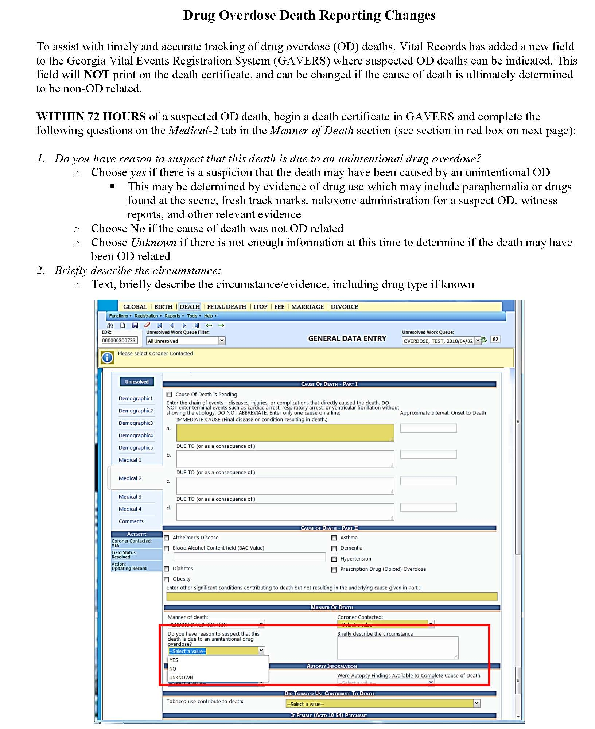
Suspect Overdose Death Reporting
Rapid notification of overdose deaths can inform stakeholders working to address this epidemic about the changing trends, and may identify OD death clusters that could indicate a dangerous new drug
Average time for OD deaths to be certified in 2017 was 71 days!
New suspect overdose field added to the electronic vital records system
Asked to report within 72 hours
Does NOT print on death certificate
DPH can monitor these deaths on a daily basis to rapidly identify clusters or changing trends

Slide 27
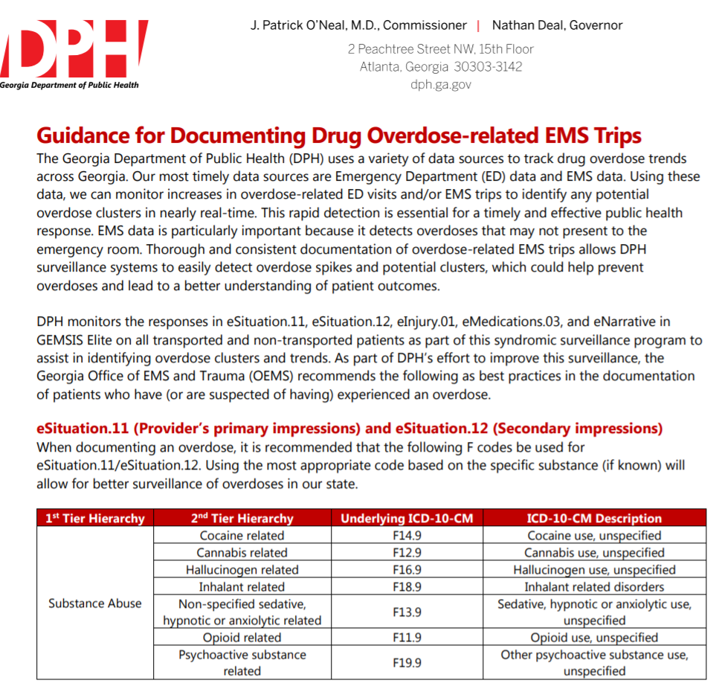
EMS Data Quality Improvement
EMS data catches ODs that don’t make it to healthcare facilities
Timely data source
Important intervention point
Developing an electronic interface to EMS data
Adding EMS data to syndromic surveillance
Developed best practices for documenting OD trips
EMTs across GA trained on the protocol
dph.georgia.gov/EMS
Notes:
One current DSU activity is EMS data quality improvement
We are in the process of adding EMS data to our syndromic surveillance system
However, EMS data is inconsistent in terms of completed fields, ICD codes used, richness of narrative, and so on
We wanted to have the best possible data, so we worked with the office of EMS to create guidance for documenting drug-overdose related EMS trips
This guidance uses recommended fields and ICD codes from NEMSIS. It details which fields should be used to report overdoses, as well as ICD code options. It also details key words and information to include in the narrative field
EMS personnel across the state are being trained on this guidance
We used a variety of dissemination methods: the document was sent to every EMS service across the state (with the help of OEMS), the guidance was integrated into state-wide trainings which were occurring around the rollout of the new version of NEMSIS, and we presented this guidance at a statewide EMS conference
It was also posted on the OEMS website, which you can find at the following URL
We are working on an evaluation of these guidelines, to determine if they resulted in more complete data. Will keep yall posted!

Slide 28
Other Projects
Matching data sources for predictive analyses (e.g., death and PDMP data)
Data needs assessment and data inventory
Data repository and data visualization tools in SendSS for improved data access and analyses
Public facing data dashboard
Rural/urban analyses, spatial analyses to look beyond county boundaries
Stimulants report coming soon
Funding Medical Examiners to do enhanced opioid toxicology testing

Slide 29
How You Can Use the Data
Determine the burden and population affected in your district/ counties
Evaluate programs
Share data with stakeholders to raise awareness, etc.
County level profiles, additional reports, and a data dashboard coming soon!
If the data you need is not available on our website: https://dph.georgia.gov/drug-surveillance-unit, you can submit a data request through PHIP: https://dph.georgia.gov/phip-data-request
Know the data! Understand the limitations, case definitions, and what it really represents!

Slide 30
Overdose Data to Action (OD2) Grant
Continue existing data surveillance projects
Improve timeliness and completeness of data
Expand SUDORS to all OD deaths
Work with other states to track multi-jurisdictional outbreaks
GPHL will begin to perform toxicology testing and offer free testing to hospitals, and support ME/Cs with testing as needed
Various PDMP improvements
PHAs to work on the opioid crisis in each health districts
Continue statewide strategic planning
Support linkages to care projects in EDs, create guidance for EDs to improve response to OD patients
Various educational campaigns, And much more!

Slide 31
THANK YOU!
Laura Edison, DVM, MPH
CDC Career Epidemiology Field Officer
Georgia Department of Public Health
Phone: 404-657-6542
Email: laura.edison@dph.ga.gov

