Slide 1
Implementation of syringe service programs in rural Kentucky: preliminary findings of a qualitative study
Umed Ibragimov,
BSHES, Rollins School of Public Health, Emory University
Notes:
Hello, thank you for coming, my name is Umed Ibragimov, RAP at BSHE department, at Rollins. Today I would like to share some preliminary findings from an implementation science study of syringe service programs in Rural Ky

Slide 2
Acknowledgements
Research team:
  Hannah Cooper, Katie Cooper, Monica Fadanelli, Skylar Gross, April Ballard, Emma Klein (Emory)
  April Young, Evan Batty, CARE2HOPE staff (UK)
Kentucky River and Gateway District Health Departments and SSP staff
NIDA/NIH
Notes:
First of all, I want to say thank you to our great team, Hannah Cooper, and April Young, MPIs, and GRAs Kathy Cooper, Monica Fadanelli, Skylar Gross, April Ballard, Emma Klein, Evan Batty, KY river and gateway district health departments, SSP staff and our donor

Slide 3
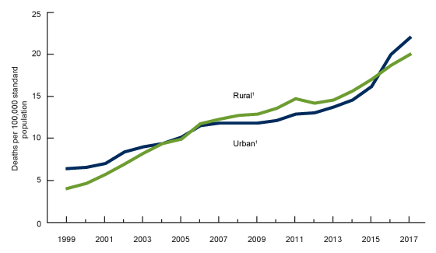
Substance use disorder in rural US
Epidemics of substance use disorder and related harms expanding to rural US
Figure 1. Age-adjusted rates of drug overdose deaths, by urban and rural residence: United States, 1999–2017 (CDC)
Notes:
As all of you know, opioid and other substance use disorder epidemic is no longer an urban problem only, recently for example rural areas had higher rates of OD mortality.

Slide 4
Vast majority of 220 US counties at highest risk for HIV and HCV due to injecting drugs are rural and located in the Appalachian region
Notes:
Rural areas are also at high risk of bloodborne infections outbreaks. Recently CDC conducted a study to estimate counties at high risk of HIV and HCV outbreaks due to IDU, most of top 220 counties at highest risk are rural, and located in the US appalachia

Slide 5
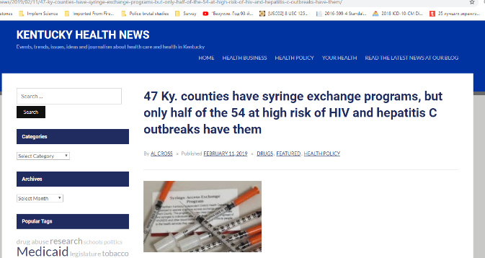
SSPs in rural areas
Syringe service programs (SSP) are effective in reducing HIV and HCV among PWID
SSPs expanding rapidly in rural US
  2013: only 30 SSPs in rural US
  2013-2017:
    40 SSPs in Kentucky
    20 in North Carolina
    9 in West Virginia
      2 SSPs closed since then
Notes:
SSP are an effective way to reduce the risk of bloodborne infections, they also provide access to Naloxone, link PWID to HIV and HCV testing and treatment. Untill recently, there were very few rural SSPs, but in the last years, there was a rapid expansion of SSPs in rural areas, in particular in Appalachia, At the same time, SSPs in rural areas are also under risk of closure, as 2 SSPs were closed in WV
As you can see, Kentucky is a national leader in expanding SSPs. In 2015 a legislation legalizing syringe services has been passed allowing counties to make decision whether to adopt SSPs. This process has been triggered by an outbreak in Scott county, Indiana.

Slide 6
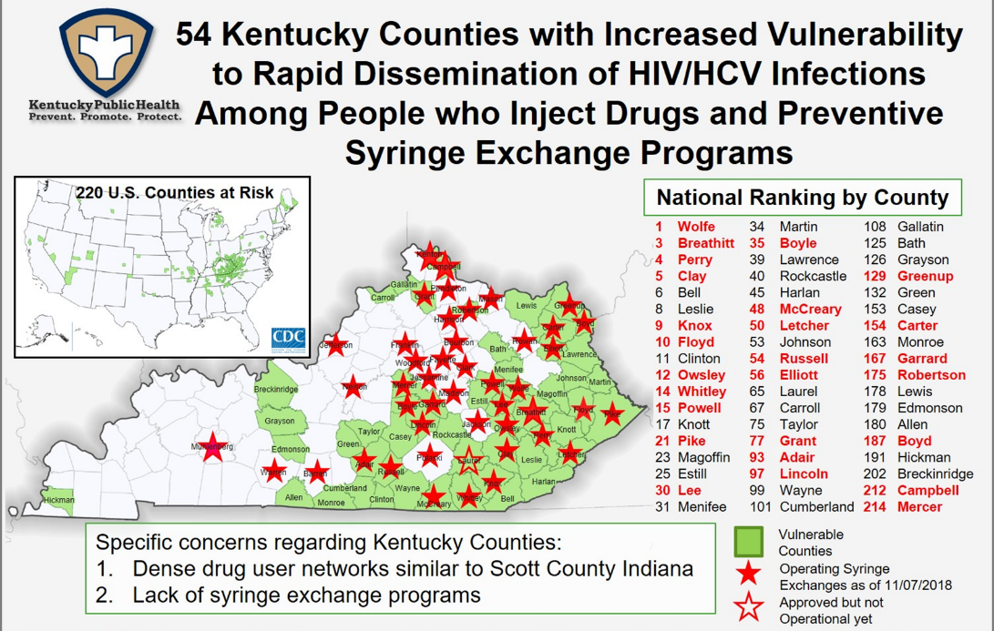
Notes:
Counties at high risk of HIV/HCV outbreak are shown in green on the map and red in the list. And SSPs are indicated by stars

Slide 7
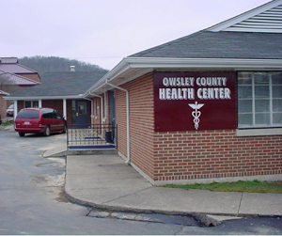
Implementation science on rural SSPs
Implementation science on SSPs in general is limited
  Even less is known on rural SSPs
Harm reduction context in rural areas:
- Geographical remoteness and lack of transportation
- High stigma in small, tight-knit communities
- Lack of economic and recreational opportunities
- Limited health resources and infrastructure
Notes:
Since this rapid expansion of SSP in rural areas is unprecedented, little is known about rural SSPs, and in general implementation science on SSPs is limited. At the same time, rural SSPs are established and operated in a unique context, featured by geographical remoteness and limited transportation, small communities with high stigma against PWUD, limited employment and entertainment opportunities, shortage of health care resources and infrastructure.

Slide 8
Study aims
1-year supplement NIDA/NIH UG3 grant (PIs Cooper, Young, Ibragimov), 2018 – 2019
Specific Aims:
  Rural implementation context and adoption and sustainability of SSPs
  Rural implementation context and fidelity of SSPs to best practices
  Perceived impact of SSP practices on service utilization and risky behaviors
Notes:
To address this gap in implementation science of rural SSPs, we proposed a one-year supplement to a parent U grant to study how rural implementation context affects adoption and sustainability of SSPs, (Aim 1) how implementation context affects fidelity of SSPs to recommended practices, and what are clients’ perceptions of SSP services and their impact on risky practices. This presentation is focused on Aim 3 findings.

Slide 9
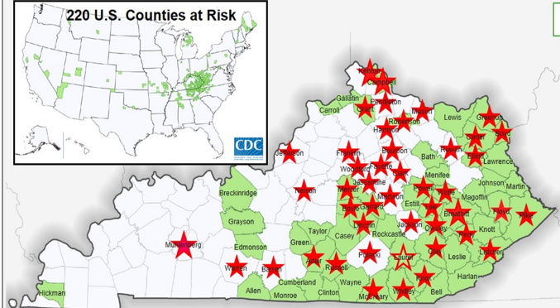
Study methods
  Qualitative multiple case study in 7 rural KY counties with new SSPs
  100 interviews with municipal and public health officials, SSP staff and clients
  Qualitative analysis: grounded theory, CFIR (Aims 1 & 2), Andresen’s Health Service Utilization model and Social Ecological Model (Aim 3)
Notes:
To accomplish these aims, we are implementing a qualitative multiple case study targeting 7 rural counties denoted by blue circles here, and as you can remember from the previous map, green areas show counties with high risk of HIV and HCV outbreaks, 6 of 7 SSPs are in these high risk counties. We planned to interview 21 county leaders (Charis of BoH, fiscal court and city council that approved establishment of SSP in their county, 21 staff members, 56 PWID and 2 district health directors. We are analyzing interviews using grounded theory method, but also apply Consolidated framework for Inplementation research (CFIR for Aims 1 and 2, and Andersen’s health services utilization model and socioecological model for Aim 3.

Slide 10
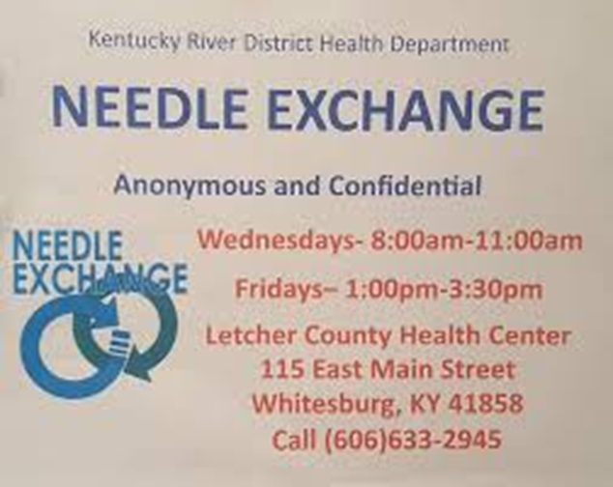
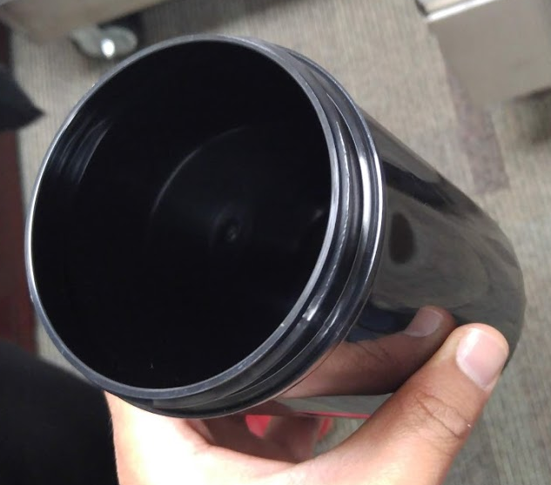
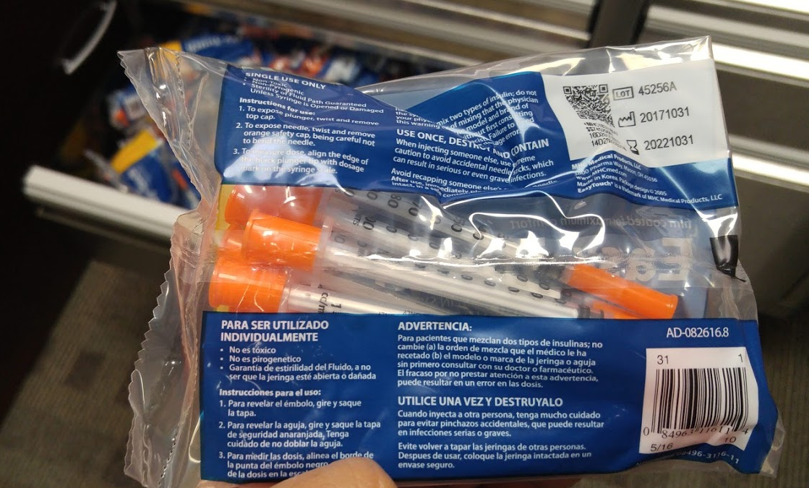
Aim 3: Perceived impact of SSP practices on service utilization and risky behaviors
Factors influencing PWID’s first visit to SSP
Notes:
One particular paper that we are working now within Aim 3 is exploring what factors may influence clients’ 1st visit to SSPs

Slide 11
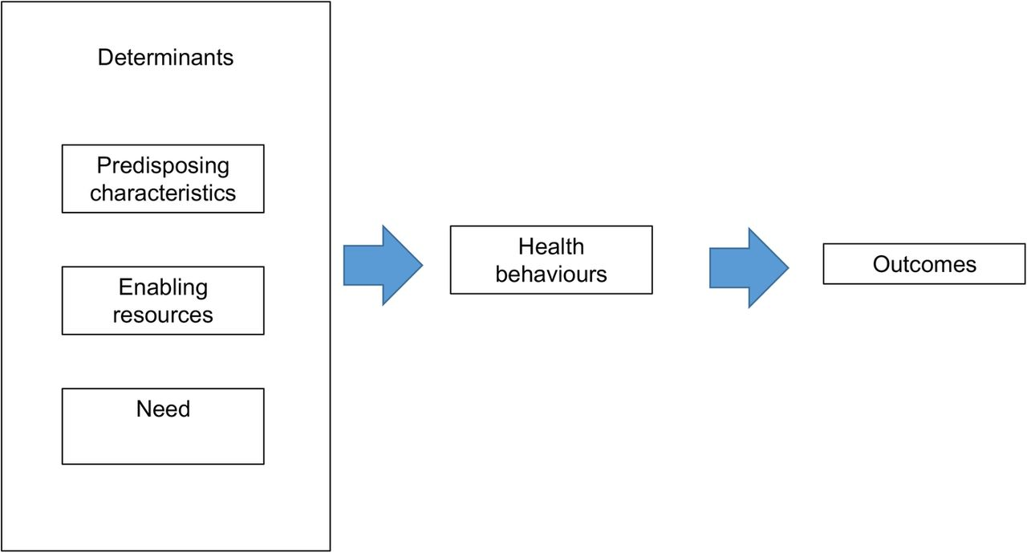
Aim 3 theoretical framework.
Andersen’s behavioral model
of health services use
Notes:
A brief overview of theoretical framework for Aim 3 – Andersen’s model posits that health outcomes depend on individual’s health utilization behaviors, that depend on need in services – perceived and actual; predisposing characteristics such as gender, age for individuals, demographic composition for communities, enabling or impeding factors such as health insurance for individuals or availability of services for communities. So basically we mapped the barriers and facilitators of SSP service utilization to these determinants of service utilization

Slide 12
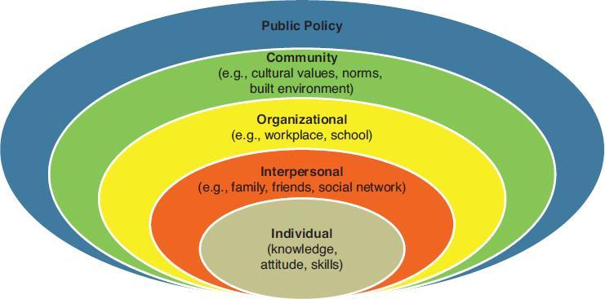
Aim 3 theoretical framework.
Social Ecological Model
Notes:
In addition, using Social Ecological model, that

Slide 13
Model of SSP initiation by PWID based on SEM and Andersen’s behavioral model of health services use
Contextual (policy and community) characteristics
Drug policies and policing practices
HCV/HIV prevalence
Organization and network enabling characteristics
PWID networks
SSP core components
Individual characteristics
“Scouting” of SSP
Low threshold
services
Need-related contextual characteristics
Enabling
contextual characteristics
Predisposing:
Gender, job, children;
HCV/HIV ;
access to syringes
Enabling:
Fear of stigma;
SSP awareness and experience
First visit to SSP
Encouragement by early adopters
Recognizing clients’ dignity
SSP reputation
Need: safer injection;
HCV treatment
Meeting clients‘ needs in injecting supplies
Secondary syringe exchange
Stigma in a small community
Secondary syringe exchange policy
Cost of non-SSP syringes
Notes:
This diagram maps our findings of factors influencing 1st visit to SSP at SEM levels – individual, networks, organizations, community and policies. We also mapped these factors to Andersen’s constructs of needs, enabling and predisposing factors. Overall, we found that factors belonging to various SEM levels and healthcare utilization determinants do not operate or manifest in isolation. There is an intricate interplay of factors from various levels. In my presentation I will focus on stigma-related factors as multilevel determinants of the 1st visit

Slide 14
Stigma and 1st visit – individual factors
Impeding factor - fear of stigma:
  Being seen by family/colleagues/friends
  Being judged by SSP staff
  Police harassment (SSP as police set-ups)
  Repercussions of disclosure (job, child custody)
I: How important would you say it is to keep your visits here confidential?
R: Very important. Because if my dad was to ever find out, it would kill me. He doesn’t know.
- Female SSP client, 41, Rowan County (RCR09)
Notes:
At individual level, fear of stigma is the main impeding factor, making people reluctant to visit SSP because they fear to be seen by their family or friends, or judged by staff, harassed by police, many clients perceived SSPs as some sort of police set-up, and repercussion sof their drug use becoming known for their jobs, child custody. Here is a quote from a female client of SSP in Rowan county describing her fear of family learning about her drug use.

Slide 15
Stigma and 1st visit – individual factors
Enabling factor – prior awareness of or experience with SSPs
R: When I first heard about [SSP in Perry], everybody thought they were setting people up to put them in jail. I was like, "That don't sound right. I've been to other cities. I do know they actually work, if you don't want to catch something."
- Female SSP client, 47, Perry County (ACP02)
Notes:
Individual level factor that enabled PWID to visit SSP was their awareness of such programs, or if they have experience with visiting these programs. As a female client from Perry county shared,

Slide 16
Stigma and 1st visit – individual factors
Predisposing factors:
  Gender, children, job, social status
I: How does privacy influence your decision to attend the program?
R: Because I have two children, and where it's privacy here, I don't have to worry about it getting back to my cousin that's got my kids, what am I doing, and stuff I get. Because I don't want her knowing, because if she knows, I'll never see my kids again.
- Female client, age unknown, Perry County (ACP10)
Notes:
We also found that certain individual characteristics may make people more vulnerable to stigma and, therefore, reluctant to visit SSP. For example, men were more embarrassed to visit SSP since it is usually the place where women and children go. Having children may also make people hesitant since they are afraid that they may loos custody if their drug use becomes known. Also people with job or higher social status are also afraid to visit SSPs/ A female SSP client in perry was asked (quote)

Slide 17
Stigma and 1st visit – networks
Network-level enabling factors:
  “Scouting” of SSP by non-PWID network members
  Reputation of SSP among PWID-early adopters (“word of mouth”)
  Assurance and accompanying to SSP by trusted peers
  Secondary syringe exchange
I: So since you’ve started coming here, have you encouraged other people to come?
R: Oh yeah, word of mouth is the best thing you’ve got.
I: What do you usually tell them?
R: Tell them that -- you know, I’ll give them a couple [of new syringes] and switch them if they’ve got some old ones and stuff. Look, just walk down the street. They aren’t going to bite you, they won’t hit you, you know, I’ve been in [SSP]. They aren’t going to arrest you. So why not? You haven’t got nothing to lose really.
- Male SSP client, age unknown, Lee County (ACL03)
Notes:
Here enabling factors that operate at network level. Reluctant people may ask their partners or friends to scout SSP to see if it there is any risk for them, then reputation about SSP as a safe and friendly service is spread via word of mouth. In many cases hesitant PWID were assured and accompanied to SSP by trusted peers – friends, partners, family. This is a quote from a participant who persuaded others to visit SSP. Here we also see the element of secondary syringe exchange as the way to promote SSP

Slide 18
Stigma and 1st visit – social networks
Resistance to SSP by family members
I: Who else, if anyone, did you talk to about coming before you actually came?
R: My mom. And she was completely against it. […] We got into a couple arguments over it. […] She was like, “I don’t give a damn, I don’t want this. I think it’s going to be worse on the county, on our community.” I can understand where she was coming from, but now a couple months down the road, she says, “I think that needle exchange down there, that’s a good thing.” I was like, what?
- Male SSP client, 32, Lee County (ACL01)
Notes:
However, sometimes members of social networks may impede visit to SSP. I talked already about individual-level fear that family or friends will learn about drug use. Here is an example of family member resisting son’s visit to SSP

Slide 19
Stigma and 1st visit – SSP
Organization-level enabling factors
  Anonymous, low-threshold services
I: So that’s like a big misconception and that people think they have to have an ID to attend the syringe exchange program?
R: No, I mean, it’s the only thing they don’t understand. If you call to the health department, they will let you know you don’t need an ID. You do not need anything of that nature. You just need to bring yourself and that’s it. And then we’ll go from there.
- Male SSP client, 32, Lee county (ACL01)
Notes:
Now, how organization of services at SSP may enable access to services and alleviate fears. The main feature is anonymous provision of services that lowers threshold to services, and this nes is quickly spread via word of mouth. Here is a quote:

Slide 20
Stigma and 1st visit – SSP
Organization-level enabling factors
  Friendly staff attitudes boost SSP reputation among PWID networks
I: So I know you were really hesitant about trying the program at first, sort of related to people seeing you come in and out. So what would you say was the thing that really changed your mind?
R: Well, probably the people that work here. They were real supportive and they understood what people would be going through, through the stigma and the talk that would be going on around town. The confidentiality that they provide here is really good. They're on point. You walk in, they see you. It's within minutes your back here. You do your thing and you're out the back door. It's a good system they got going.
  - Female SSP client, 62, Owsley county (ECO06)
Notes:
Another important feature is friendly services provided by trained SSP staff, and this is also becomes known to PWID via word of mouth

Slide 21
Stigma and 1st visit - communities
Community-level impeding factors:
  High anti-PWID stigma in small, tightly knit communities
I: How did you feel about the program?
R: Well, my main concern was people seeing you with the [syringe-disposal] containers, being seen coming and going here. Because, like I told you, this place has wagging tongues, and we're in a small community, and everybody knows everybody.
- Female SSP client, 62, Owsley County (ECO06)
Notes:
At community level, stigmatizing attitudes is the key impeding facors, especially in small communities where people know each other.

Slide 22
Stigma and 1st visit – policies and policing
War-on-drug policies and policing practices as impeding factors
Arrangements between SSP and police as enabling factor
  SSP ID card, sharp boxes and education for police
Well, law enforcement is always a tricky thing, because it varies. Some of the officers working in our small counties, are all for it. They’re very helpful, very onboard with the program, but then you have some that are just totally against it and think it’s a horrible idea. You know, they have dealt with some of [SSP clients] a lot, so when they pull them over, and [clients] have their [SSP ID] cards and their sharps container, they don’t care. […] They’ve arrested them, you know, 15 other times.
- Lee County SSP staff member
Notes:
War on drug policies and policing factors is another way stigma affects PWID and becomes a barrier to services. It is not just policies, it is also how individual officer interpret and enforce them.

Slide 23
Stigma and 1st visit – policies and policing
Before this program started, [district and county public health officials] had many, many meetings with the law enforcement officers in our areas. […] And I know that we’ve given them sharps containers to have in their cruisers and stuff, and they’ve come to our Narcan trainings. So, you know, I feel like [police officers] probably are a little better with [SSP] now than maybe in the very beginning. But I mean there’s been multiple meetings and sit-downs and educational opportunities leading up to this, so […] I feel like that kind of paved the way. And [SSP managers] showed [police] what our [SSP ID] cards look like, you know, so they would be aware of what was [provided by SSP] and what wasn’t. So I feel like it’s gotten better.
- Lee County SSP staff member
Notes:
To address the problem of law enforcement, SSPs reached some agreements with local law enforcement, agreed that clients will have individual cards so police do not confiscate syringes, also provided sharp boxes and education on harm reduction to police. SO here organization-level factor mitigates policy-related factors

Slide 24
Preliminary conclusions
Interplay of factors manifesting at various levels of SEM influence SSP initiation
  Stigma is a key contextual barrier
  Individual, network and organization-level factors may moderate the impact of stigma
Notes:
So, in conclusion, we see that factors operating at various levels of socioecological model interact with each other in their impact on participants intitating their visits to SSPs. And Stigma is a key impeding factor as relates to access to services, and at the same time, certain individual, network and organization-level factors may amplify or mitigate the effects of stigma on access to services

Slide 25
Implications
Addressing stigma at various levels while setting up and launching rural SSPs:
  Engaging PWID networks
    Peer outreach, secondary exchange
    Promoting and maintaining reputation of low threshold and friendly program
  Engaging police
    Advocacy, education, emphasis on mutual goals and benefits, tangible help
  Engaging families and communities
    Advocacy and education targeting family members
    Focus on SSP benefits for communities (reducing littering by used syringes, preventing outbreaks)
Notes:
Our recommendations are for local public health officials and SSP managers to address stigma at various levels of social ecology. First of all, this should be done by engaging stakeholders, first of all police, by advocating for SSP, educating on SSP benefits that may be beneficial for police as well. Providing tangible assistance. PWID networks are also very important, so enhancing peer outreach, allowing secondary syringe exchange, promoting the reputation of a low threshold, safe and friendly service may be important.
Families and general public should be engaged y public advocay campaigns that focus on SSP benefits for the community.

Slide 26


Slide 27
Thank you!

