Slide 1
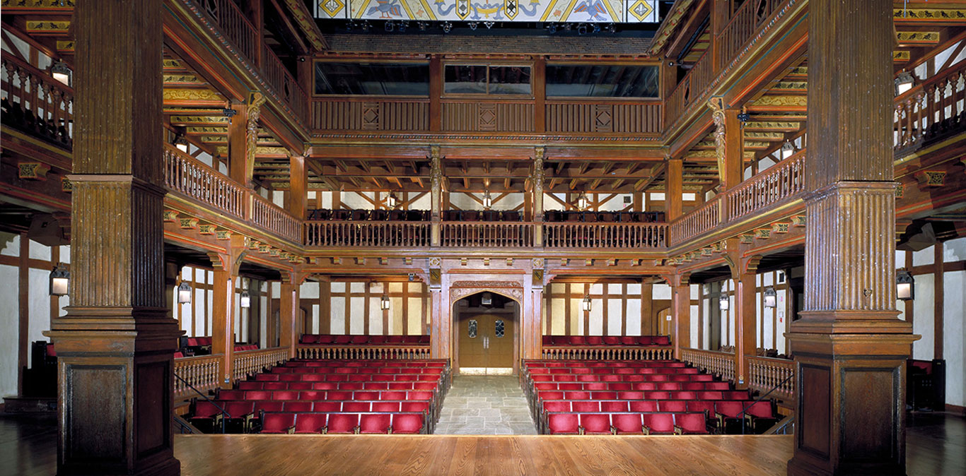
pychoanalytical theory
cultural materialism
postcolonialism
disability theory
masculinities
formalism
law and literature
critical race theory
feminism
queer theory
eco-criticism

Slide 2
social movements
feminism
Structures of punishment
King Lear
political regimes

Slide 3
Lessons from first essay
Sometimes you write yourself into a revised central claim: review and revise essay with that in mind
When Saul Bellow was asked how it felt to win the Nobel Prize, and he famously replied, “I don’t know, I haven’t written about it yet.”
Paragraphing
Turn signal
You don’t diminish the strength of your argument when you acknowledge counter-evidence
“While the play implicitly invites the audience to critique how “power, property, and inheritance” diminish family ties, Shakespeare merely uses these hegemonic forces as a vehicle for exploring the family…”
Mapping the conversation

Slide 4
Author | Date | Notes | Quotes | Source
Samuel Johnson | 1765 | First significant English literary theorist. Edited Shakespeare’s plays for 18th c | A play in which the wicked prosper, and the virtuous miscarry, may doubtless be good, because it is a just representation of the common events of human life: but since all reasonable beings naturally love justice, I cannot easily be persuaded, that the observation of justice makes a play worse; or, that if other excellencies are equal, the audience will not always rise better pleased from the final triumph of persecuted virtue….” | Preface to Shakespeare
August Wilhelm Schlegel | 1835 | Romantic period Values “the sublime” (beauty + terror) | “But two such unheard-of examples taking place at the same time have the appearance of a great commotion in the moral world: the picture becomes gigantic, and fills us with such alarm as we should entertain at the idea that the heavenly bodies might one day fall from their appointed orbits. ”
Jonathan Dollimore | 1984 | Founded ”cultural materialism”: analyzes the processes by which hegemonic forces in society appropriate canonical and historically important texts | “King Lear is, above all, a play about power, property, and inheritance.” (p. 190) | Radical Tragedy: Religion, Ideology, and Power in the Drama of Shakespeare and his Contemporaries, Jonathan Dollimore, Harvester Wheatsheaf, 1999,

