Slide 1
The Material Culture of Early Modern Letters

Slide 2
“The great feasibility of letter writing must have produced—from a
purely theoretical point of view—a terrible dislocation of souls in
the world. It is truly a communication with spectres, not only with
the spectre of the addressee but also with one's own phantom,
which evolves underneath one's own hand in the very letter one is
writing or even in a series of letters, where one letter reinforces the
other and can refer to it as a witness.”
Franz Kafka, Briefe an Milena

Slide 3
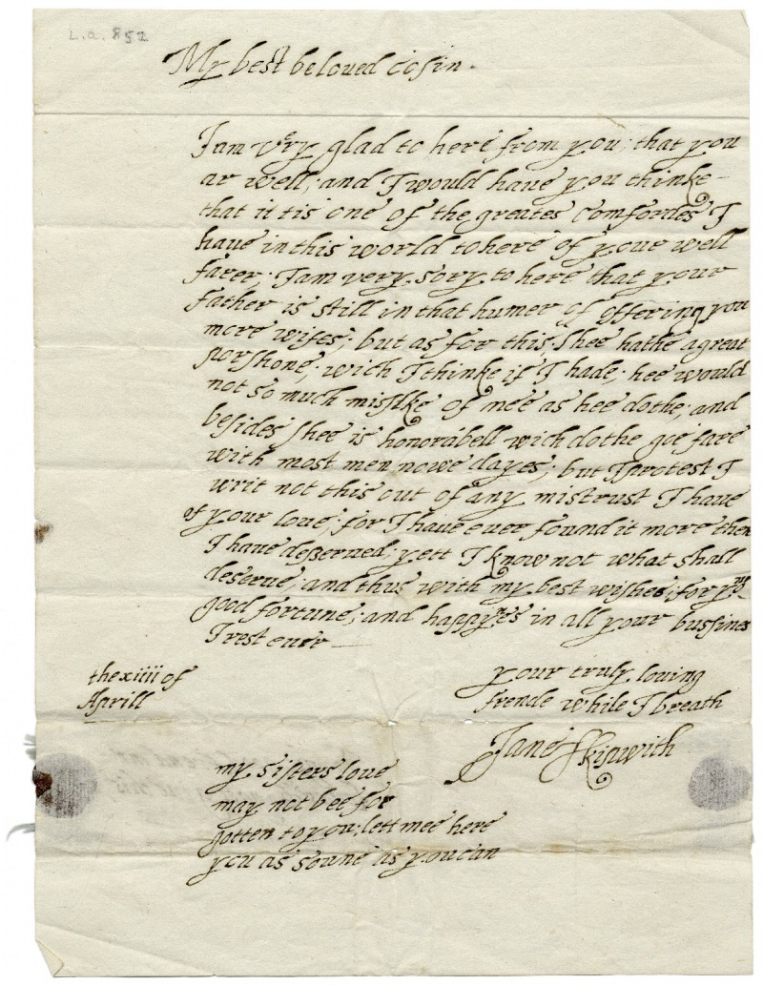
Let’s start with a typical early modern letter!
Jane Skipwith's ca. 1610 love letter to her cousin. Folger Digital Image 5762

Slide 4
Transcription of Jane Skipwith's Letter To her Cousin Lewes Bagot
[superscription]
To my good frend mr
Lewes Bagott giue this
[letter]
My best beloued cosen I am v^e^ry glad to here from you, that you ar well, and I would haue you thinke that it tis one of the greates[t] comfordes I haue in this world to here of your well farer; I am very sory to here that your father is still in that humer of offering you more wifes; but as for this; shee hathe a greate porshone; wich I thinke if I hade; hee would not so much missl[i]ke of mee as hee dothe; and besides shee is honorabell wich dothe goe fare with most men nowe dayes; but I protest I writ not this out of any mistrust I haue of your loue; for I haue euer found it more then I haue desserued; yett I know not what shall deserue; and thus with my best wishes; for your good fortune; and happy^n^es in all your bussines I rest euer –
[subscription]
your truly louing
frende while I breath
Jane Skipwith
the xiii of
Aprill
my sisters loue
may not bee for
gotten to you; lett mee here
you as soune as you can

Slide 5
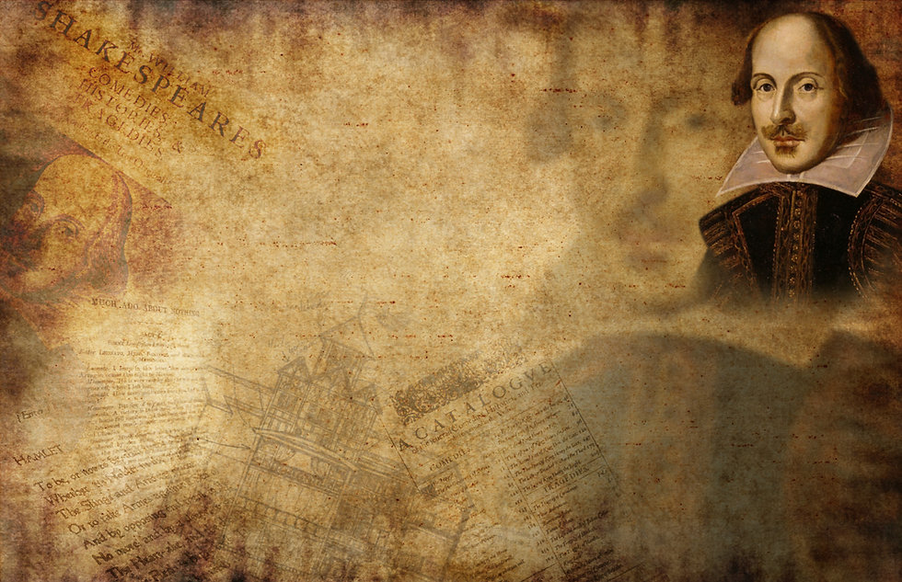
Shakespeare

Slide 6
Can you recall any letters in Much Ado About Nothing?

Slide 7
Letters in his Tragedies

Slide 8
Hamlet & King Lear

Slide 9
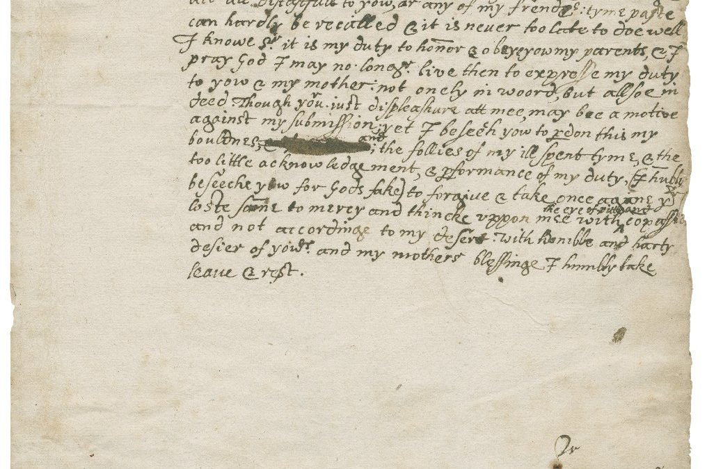
Letter Writing Culture in Early Modern England

Slide 10
To my Lorde and my Lady
geue thes.
Pleaseth yt your honores tunderstand that synce our last lettars to you, whych
we sent from Spyres we haue traueled thorough the cuntry of Swycerland
into Italy whear for the shorte tyme of our trauel we haue seen many goodly
Cittyes, as Myllan, from whence we traueled to Pauia, and so to Genua: and
from that Cytty dyrected our iourney to Venyce, betwyxt wth (sic) tow townes
lyeth the greatest bredthe of al Italy, and tooke thes famous Cyttyes in our waye
Fortona, Placentia, Parma, Mantua, Verona, Vicenza, Padua, to whych towne
we came the ix of October, whear after we had rested tyl the xxviijth of the same
moneth we went to see Venyce, whych doonne we returned agayne to Padua
whear we remayne tyl we knowe farthe your honoures pleasures, eyther for our
farther trauel, aboode hear, or returne: whych your .H. myndes to vs once
knowne we shal accordynge to our dewtyes very wyllyngly dooe any of thes.
what we haue seen in thys iourney and the decryption of the townes to the best
of our poure, with eych dayes trauel (accordynge to your honors commaundements)
would we haue now sent wrytten in bookes, but that at thys present we had not
fully fynyshed them and so ar constrayned to let them staye tyl the next post.
Thus most humbly crauynge your .H. daly blessynges I end beshechynge god longe to
to contynew your honors in perfect health and great prosperytye. From Padua the
iiijth of Nouember. ~ ~
[significant space]
Your honors obedient sonne
Henry. Cauendishe.

Slide 11
To my Lorde and my Lady geue thes.
Pleaseth yt your honores tunderstand that synce our last lettars to you, whych we sent from Spyres we haue traueled thorough the cuntry of Swycerland into Italy whear for the shorte tyme of our trauel we haue seen many goodly Cittyes, as Myllan, from whence we traueled to Pauia, and so to Genua: and from that Cytty dyrected our iourney to Venyce, betwyxt with (sic) tow townes lyeth the greatest bredthe of al Italy, and tooke thes famous Cyttyes in our waye Fortona, Placentia, Parma, Mantua, Verona, Vicenza, Padua, to whych towne we came the ix of October, whear after we had rested tyl the xxviijth of the same moneth we went to see Venyce, whych doonne we returned agayne to Padua whear we remayne tyl we knowe your honoures pleasures, eyther for our farther trauel, aboode hear, or returne: whych your Honours’ myndes to vs once knowne we shal accordynge to our dewtyes very wyllyngly dooe any of thes. what we haue seen in thys iourney and the decryption of the townes to the best of our poure, with eych dayes trauel (accordynge to your honors commaundements) would we haue now sent wrytten in bookes, but that at thys present we had not fully fynyshed them and so ar constrayned to let them staye tyl the next post. Thus most humbly crauynge your Honours’ daly blessynges I end beshechynge god longe to to contynew your honors in perfect health and great prosperytye. From Padua the iiijth of Nouember.
Your honors obedient sonne
Henry. Cauendishe.

Slide 12
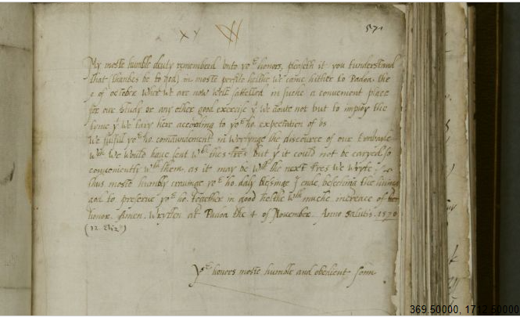

Slide 13
To my Lorde & lady geue thes
My moste humble deuty remembred vnto your honors, pleaseth it you tunderstand that (thankes be to god) in moste perfite helthe we came hither to Padoa the 9 of october wher we are now well sattelled in suche a conuenient place for our study or any other good exercise yat we doute not but to imploye the tyme yat we tary here according to your honours' expectation of vs./
We fulfill your honours' commaundement in wrytynge the discource of our travayle which we would haue sent with thes lettres but yat it could not be caryed so conueniently with them as it may be with the next lettres we wryte./ thus moste humbly crauinge your honours' daly blessinge I ende, beseching the liuing god to preserue your honours together in good helthe with muche increace of honor. Amen. Wrytten at Padoa the 4 of Nouember. Anno Salutis . 1570
Your honors moste humble and obedient sonne
Gilbert Talbott

Slide 14
Tools and Manuals

Slide 15
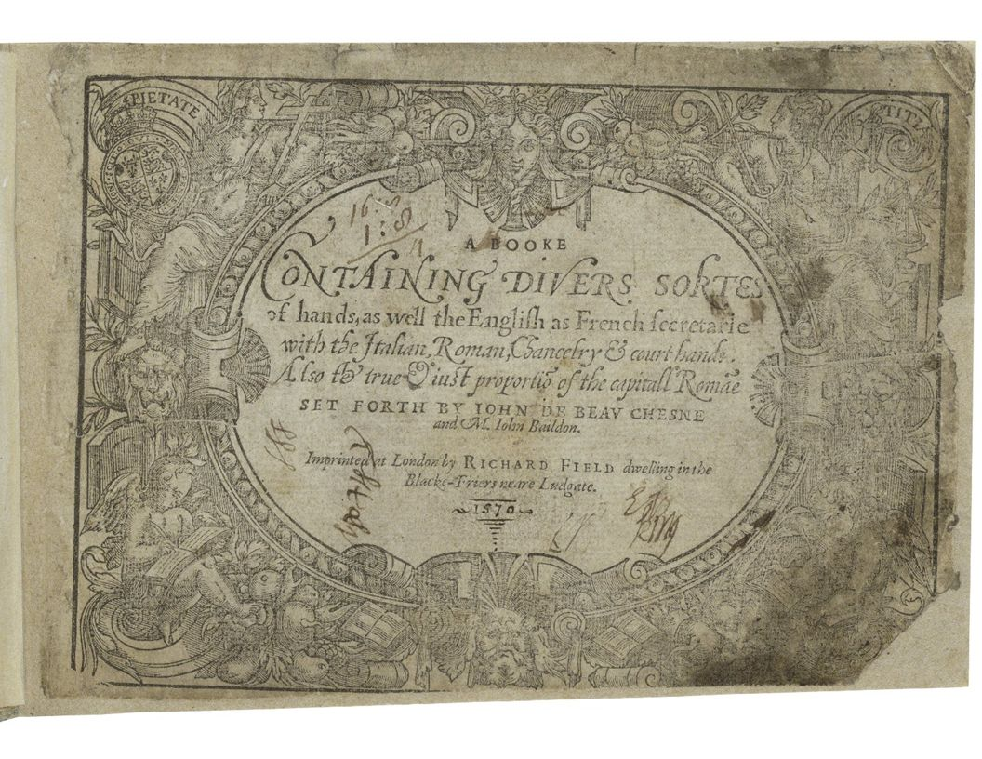

Slide 16
“Inke always good store on right hand to stand, // Browne paper for great haste, or else boxe with sand: // Dip pen, and shake pen, and touch pen for haire: // Waxe, quills and pen knife see alwayes ye beare:”
Beau-Chesne and John Baildon, A Booke Containing Divers sortes of handes

Slide 17
“To make common ink, of wine take a quart // Two ounces of gumme let that be a part, // Fiue ounces of gals, of copres take three, // Long standing doth make it better to be: // If wine ye do want, raine water is best, // And then as much stuffe as aboue at the least: // If inke be too thicke, put vinegar in, // For water doth make the colour more dimme.”
Beau-Chesne and John Baildon, A Booke Containing Divers sortes of handes

Slide 18
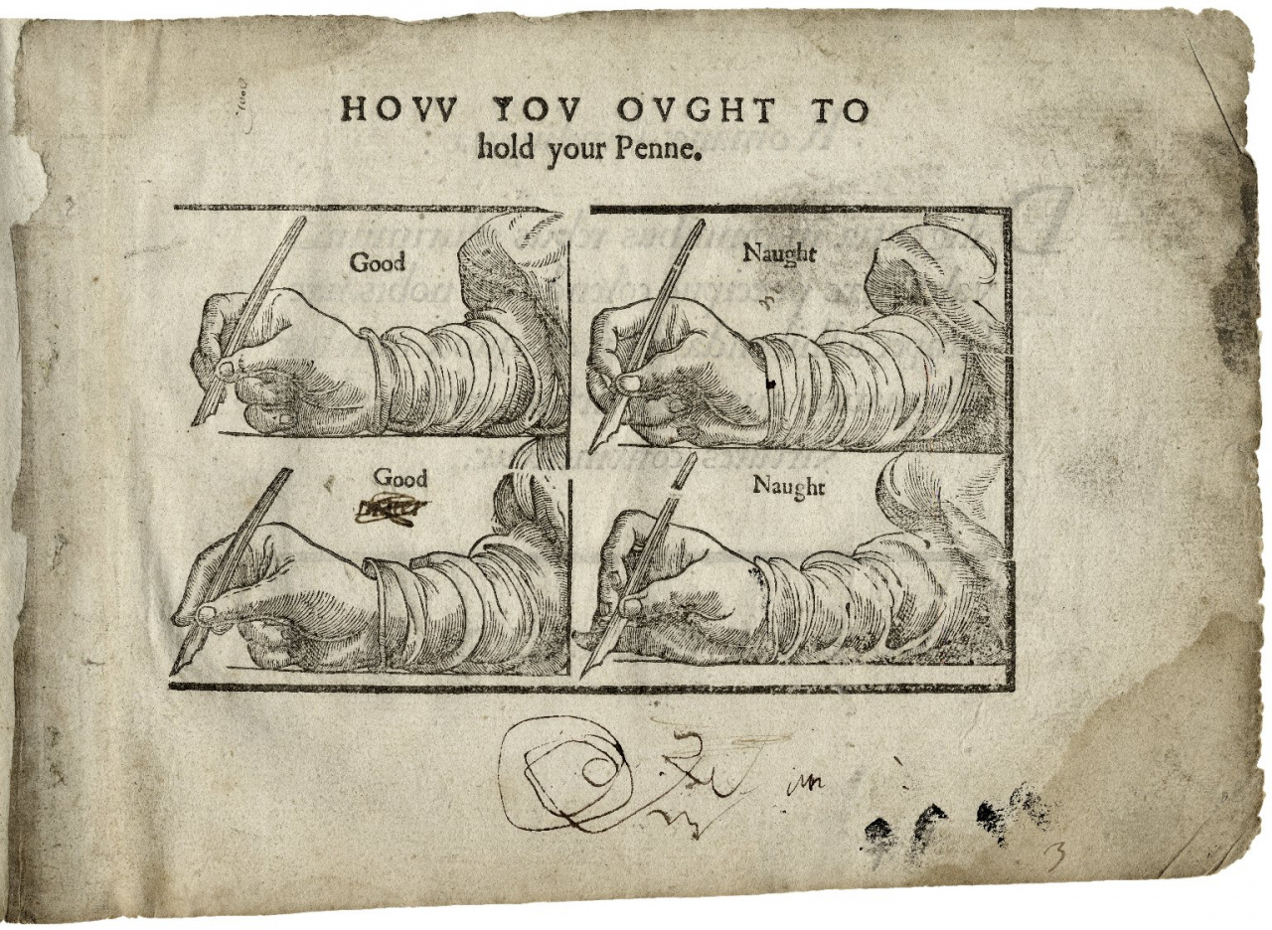
Demonstration of the proper ways to hold a pen in A booke containing diuers sortes of hands, 1602. Folger Digital Image 154

Slide 19
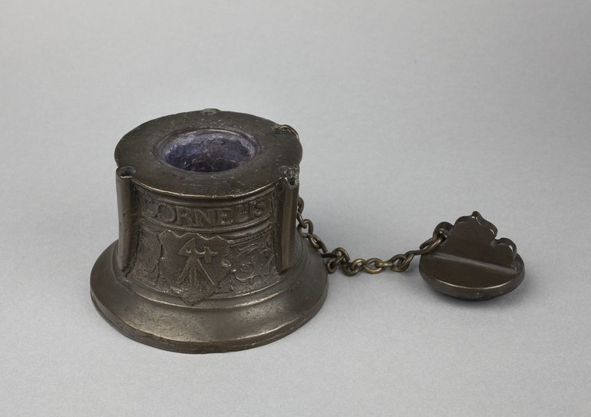
An early 17th-century bell-metal Inkwell, dated 1607.

Slide 20
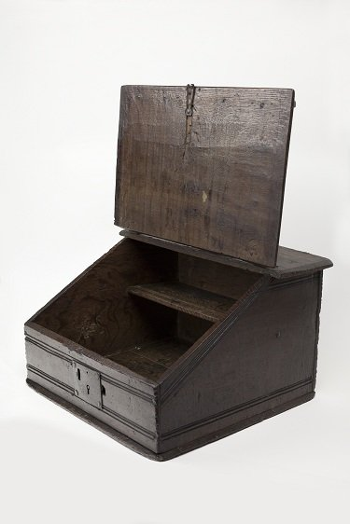
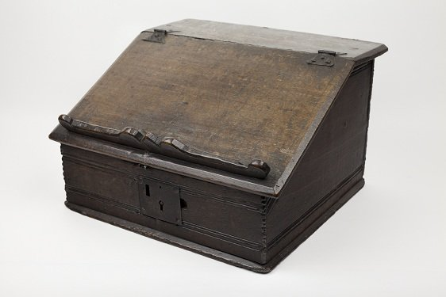
An early seventeenth century desk box, in the Shakespeare Birthplace Trust collections.

Slide 21
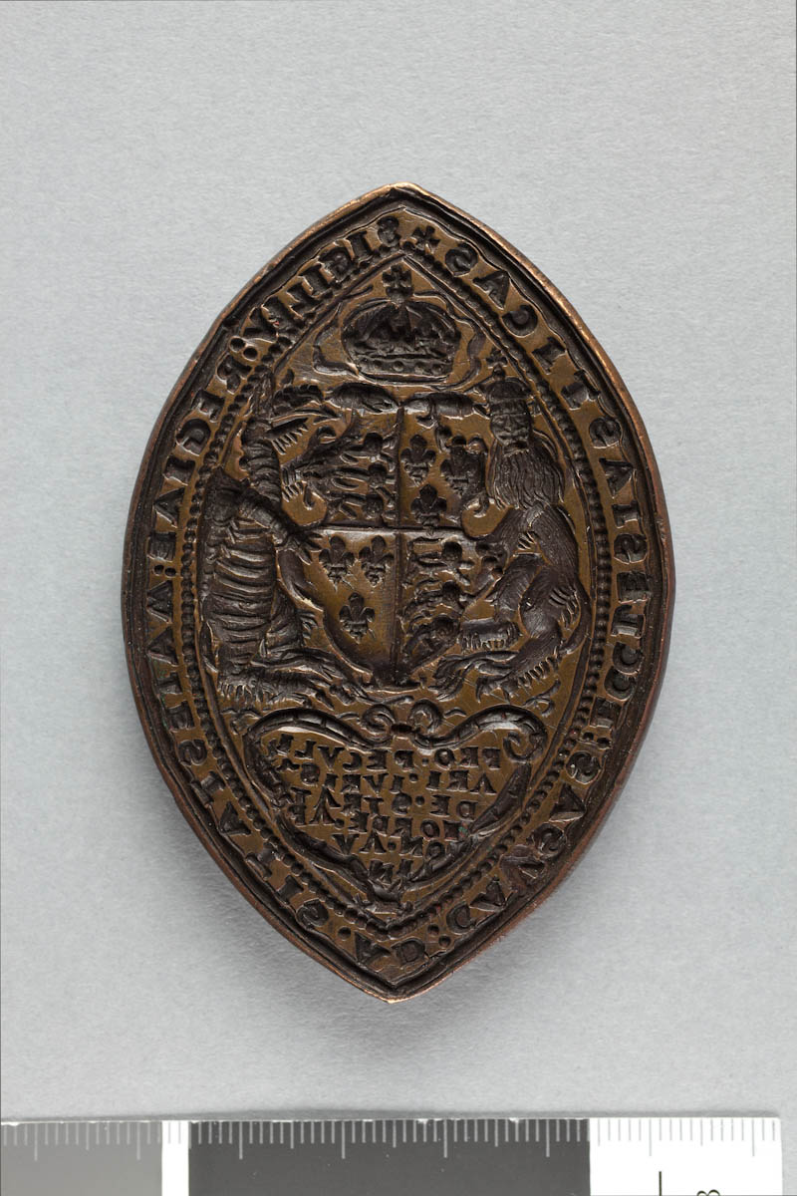
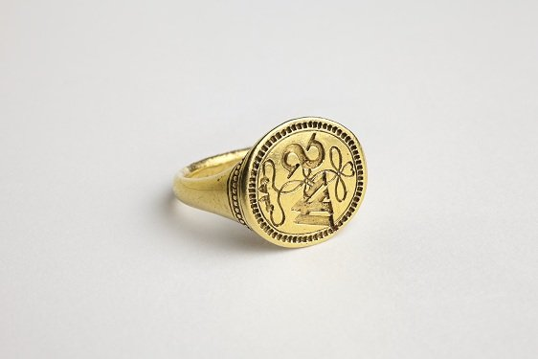
A signet ring, thought to have belonged to William Shakespeare, late sixteenth or early seventeenth century, and a seal matrix of the Court of Peculiar Juristiction of Stratford-upon-Avon from the time of Edward VI

Slide 22
The Material Letter and Social Signals

Slide 23
How Letters in Shakespeare Contrast with Conventional Letters/Letter Writing

Slide 24
How things have changed/evolved in the following century (18th century)

Slide 25
Thank you so much for having me!
Any questions?

Slide 26
References
Shakespeare’s Letter: Dramatic Language and Elizabethan Letters
Letterwriting in Renaissance England
Daybell, James. “The Scribal Circulation of Early Modern Letters.” Huntington Library
Quarterly, vol. 79, no. 3, Fall 2016, pp.
George Bickham, et al, The Universal Penman. London, 1733-41.
Habinek, Lianne. “Lear Volée: How Letters Killed the King.” Textual Practice, vol. 33, no. 6,
Aug. 2019, pp. 1047–1070.
Hopkins, Lisa. “Reading Between the Sheets: Letters in Shakespearean Tragedy.” Critical
Survey, vol. 14, no. 3, Sept. 2002, pp. 5-12.
Lee, Hermione. “A Dangerous Letter.” Essays in Criticism, vol. 62, no. 4, Oct. 2012, pp.
461–473
Lerer, Seth. “Hamlet’s Poem to Ophelia and the Theater.” ELH, vol. 81, no. 3, Fall 2014, pp.
841–863.
Shakespeare, William. Hamlet. Second Norton Critical ed., edited by Robert S. Miola, W.W.
Norton & Co., 2019.
Stewart, Alan. “Early Modern Lives in Facsimile.” Textual Practice, vol. 23, no. 2, Apr. 2009,
pp. 289–305.
Walker, Sue. “The Manners of the Page: Prescription and Practice in the Visual Organization of
Correspondence.” Huntington Library Quarterly, vol. 66, no. 3/4, Aug. 2003, pp. 307–329.

