Slide 1
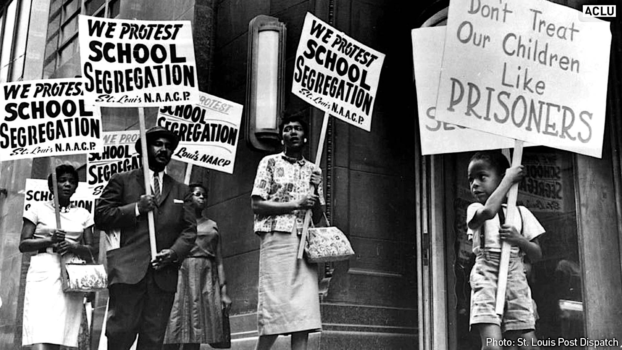
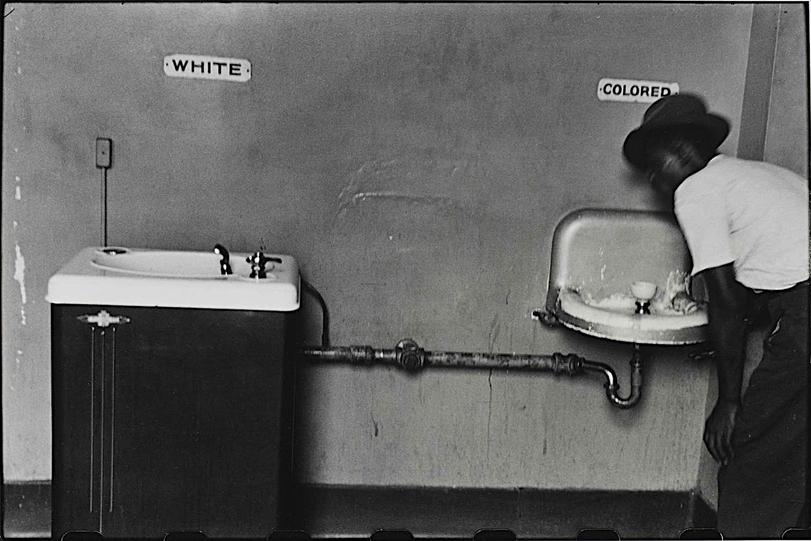
Exposing the History and Current Racial Discrimination Against African Americans
Eri Hirashima
Eng-101-016: “The Personal is Public”
Dr. Cooke
10/31/2016

Slide 2
Racism has been a very sensitive topic since
Alike any other American, African Americans are people of the United States. It is their ancestors,
Hadnt it been for slaves

Slide 3
Clive James, The New Review, May 1974, Black and White Photo
In the picture on the left, the woman wearing an expensive-looking fur coat and styled hair is smoking a cigarette with a nonchalant facial expression. She is the renowned author, Lillian Hellman who wrote “The Little Foxes”. Hellman was born in 1905, in New Orleans, Louisiana, to Julia Newhouse who was from an affluent banking background, and Max Hellman who was from a liquor dealer’s family. According to an article from “American Masters”, she “was a smoker, a drinker, a lover, and a fighter” who “maintained a social and political life as large and restless as her talent” in writing. Hellman was a headstrong, independent, and argumentative woman who was known as a rebel since her childhood. Her experiences of rebelling against her mother’s side of the family for their different views on money and social attitudes, and their unfair ways of maintaining lucrative business, were the inspirations for “The Little Foxes”. She would run away from home in her teens, and would sell the presents given from her maternal side. Having grown up as a child who was disaffected from family and school, Hellman turned to books and art, which continued to become her place of respite until her death in 1984. Throughout her life, she maintained a successful career as a writer, despite the countless critics that she was involved in due to the controversial topics in her works. In the end, Lillian Hellman left manuscripts and sources that were shaped by her perception of social matters, and life experiences, for the future generation to review, making us reconsider to realize what our values and opinions truly are.

Slide 4
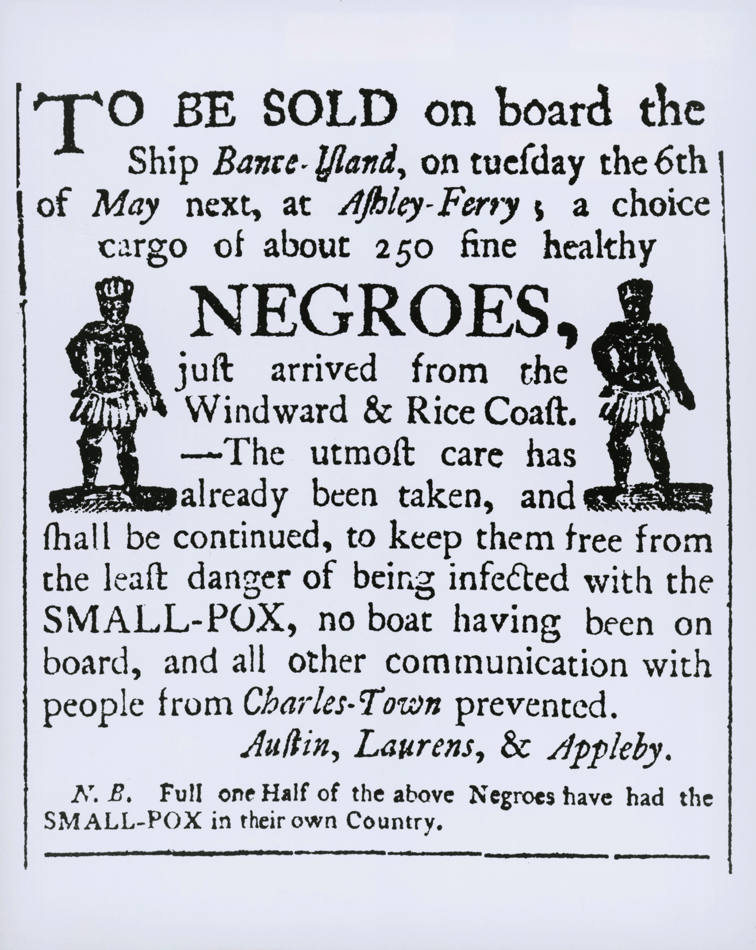
Caryl-Sue, National Geographic Society, Library of Congress, “Slave Sale”, Jan. 18, 2013, Advertisement This poster above is an advertisement of a slave auction “held in 1760 in Charleston, South Carolina [which] would have been displayed weeks before the sale in the windows of local businesses and in newspapers” (The English Historical Review 905). Slaves from Windward and Rice Coast were valuable to the South Carolina farmers, as the African slaves were very knowledgeable about growing and harvesting crops, rice and indigo. During this slavery era, the African slaves were treated as though they were simply resources and objects that could be sold and bought, as they received monetary price tags depending on their health, age, and sex. Although mentioned in the advertisement above that slave traders took the "utmost care" to keep the slaves from smallpox, journey to the American homeland was harsh with deadly diseases on-board and dirty living conditions that resulted in many deaths. According to National Geographic Society, today, there are “as many as 40% of African Americans trace their ancestry to Charleston”. These people are the first generation of African Americans who have sacrificed their mother-land and culture, and crossed the oceans to help build up America to be what it is now, especially in the South through their great contributions to the crop-based economy, which was second to economic value for the newly developing nation.

Slide 5
Despite the historical contributions of African Americans, they have been treated unfairly in daily lives such as health care, education and employment. In the next few slides, we will be examining some events that showcase how some African Americans are treated in the past and present society.

