Slide 1
African American Identity and Oppression through Music
Daniel Genzelev

Slide 2
Overview
This Exhibit is centralized around Shirley Graham Dubois’s 1932 Opera/Play Tom-Tom.
African American Identity and Oppression Through Music conveys the simultaneous development of African American music and African American people. Beginning from the classic tom-tom drum, brought over from Africa, the exhibit demonstrates the music in each era: from pre-slavery to the 1930’s. Unique rhythms correspond to the state of each African American generation, conveying generational identity. One musical aspect, the consistent beat of the tom-tom, withstands time by consistently being included in each era’s music. While time changes people, this exhibit also portrays what time has not changed. Throughout this time period, African Americans did not lose sight of their core values, which the tom-tom’s inclusion in music from each era conveys, but more nefarious aspects, such as oppression due to race, also withstood time. Finally, the exhibit relates modern racial tensions and events to Tom-Tom.

Slide 3
Biography of Shirley Graham Dubois
On the Shoulders of Giants
Shirley Graham Dubois
2014
Video
This video illustrates the eventful academic, personal and political life of Shirley Graham Dubois, the author of the core artifact of this exhibit, Tom-Tom. The video even delves into Dubois’s childhood, describing the events that led to Dubois’s future in activism, such as being denied entry into her public YMCA pool as a thirteen-year-old.
https://www.youtube.com/watch?v=ir0Dqxm_s9c

Slide 4
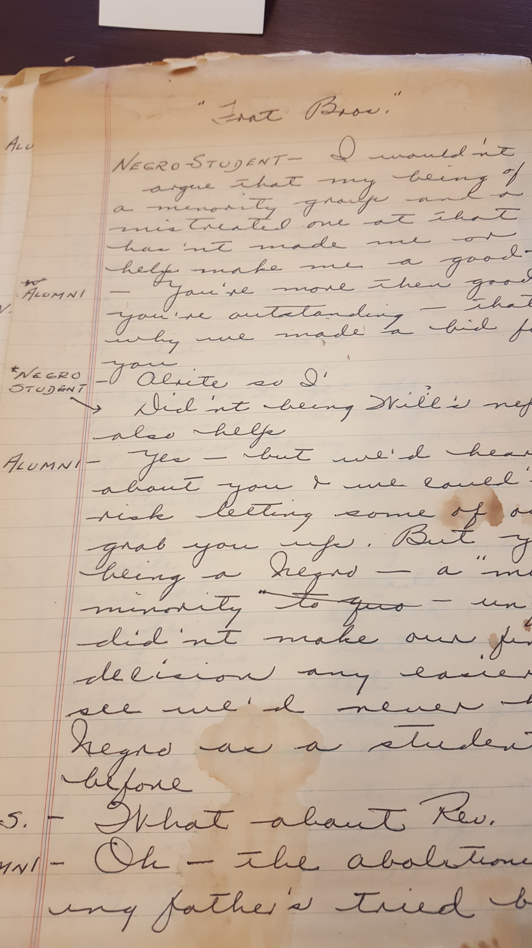
The Play
Shirley Graham Dubois
Tom-Tom
1932
Opera/Play
Dubois displayed her passion through the physical nature of Tom-Tom. Her play was handwritten on delicate papyrus paper, with a copious amount of notes in the margins. The coffee stains in combination with the meticulous notes and intricate prop list convey the effort Dubois exerted to ensure her tale was created to the best of her ability. Furthermore, by choosing an all-black cast to perform her play, Dubois augmented the first-person perspective she creates throughout the work, which in turn grants viewers a deeper insight into African American life.

Slide 5
The Tom-Tom
Tom-Tom picture
Anonymous
Ti-Roro, Le Roi du Tamour = The king of drum, (Port-Au-Prince, Haiti)
No Date
Postcard
This stoic drum is the heart of West-African music and culture. Throughout the play, the drum beats consistently, almost like the beating heart of African Americans. Along with being used for communication, the drum is the original form of musical expression, and serves as the base of the African American culture. Each new era augments to the tom-tom, but does not fully replace it. The durability of the drum is representative of that of African Americans.
http://www.digitalgallery.emory.edu/luna/servlet/detail/emoryuniv~2~2~9101~567156:MSS1218_B076_I274?qvq=q:tom-tom;lc:CARLOS_VC~1~1,EMORYUL~3~3,emoryuniv~2~2&mi=0&trs=1

Slide 6
Sound of Tom-Tom
Audio Enabled
Tom Tom Drum Sound Effect
2015
Video
According to multiple critics, this sound can be heard throughout the majority of Tom-Tom: listeners can feel the steady, powerful beat of the drum resonating through their entire bodies. Hearing the mighty, pulsating boom helps instill the tom-tom’s symbol as the soul of the African American into the audience.
https://www.youtube.com/watch?v=4zLj2ICjndc

Slide 7
The Slaveship: exit from Africa
Anonymous
African men, women and children sitting on a ship
No Date
Postcard
This image represents the chaotic conclusion of the first Act. The music transitioned from purely African rhythms to a cacophony of reed instruments as well, which overwhelms the listener, causing him/her to feel uncomfortable. Likewise, the image is congested. Many people are looking through the crowd, perhaps hoping to locate lost loved ones.
http://www.digitalgallery.emory.edu/luna/servlet/detail/emoryuniv~2~2~8638~566687:MSS1218_B074_I353

Slide 8
Slavery: Cotton Plantation
Havens Artistic Studies
Men, women and children picking cotton on a plantation
No Date
Photograph
This image corresponds to the second Act of Tom-Tom, which focuses on slavery and plantation life. The slaves can be seen wearing identical uniforms, which symbolizes how masters attempted to strip slaves of their humanity by taking away their individuality. The plantation songs in the second Act reflect this forced conformism: some focus on the hatred of captivity, while others are more traditional African songs to boost morale. Furthermore, a new genre, call-and-response, stemmed from the plantation era. Tom-Tom’s musical accompaniment gradually shifts to call-and-response as the second Act progresses, signifying the African American generational transition.
http://www.digitalgallery.emory.edu/luna/servlet/detail/emoryuniv~2~2~116~558244:MSS1218_B001_I122

Slide 9
Freedom: Jazz Era
Anonymous
King’s Orchestra playing jazz music
No Date
Photograph
This image represents the beginning of the free era for African Americans. For the first time in this exhibit, the African Americans portrayed in the image are smiling. Jazz music symbolizes freedom: artists could express themselves through improvisation and scat singing. Hence, it was fitting that jazz became prominent early in the free era. Life was finally beginning to brighten for African Americans, as jazz sparked the development of the Harlem Renaissance, America was finally beginning to appreciate their long-oppressed talent. However, increased African American prominence in the artistic community did not quell racial tensions.
http://www.digitalgallery.emory.edu/luna/servlet/detail/emoryuniv~2~2~1734~559862:MSS1218_B022_I091(jazz)

Slide 10
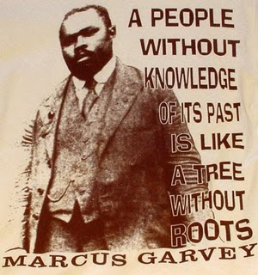
Marcus Garvey
Anonymous
Marcus Garvey
No Date
Drawing
This image depicts the famous Marcus Garvey and one of his most popular quotes: “A people without knowledge of its past is like a tree without roots”. Throughout Tom-Tom, beat of the drum symbolizes the African American people staying true to their roots. While Dubois emphasizes how each generation changes throughout the acts of the play, the consistent pounding of the tom-tom conveys her dedication to the core values African Americans cherished upon arriving to the United States.

Slide 11
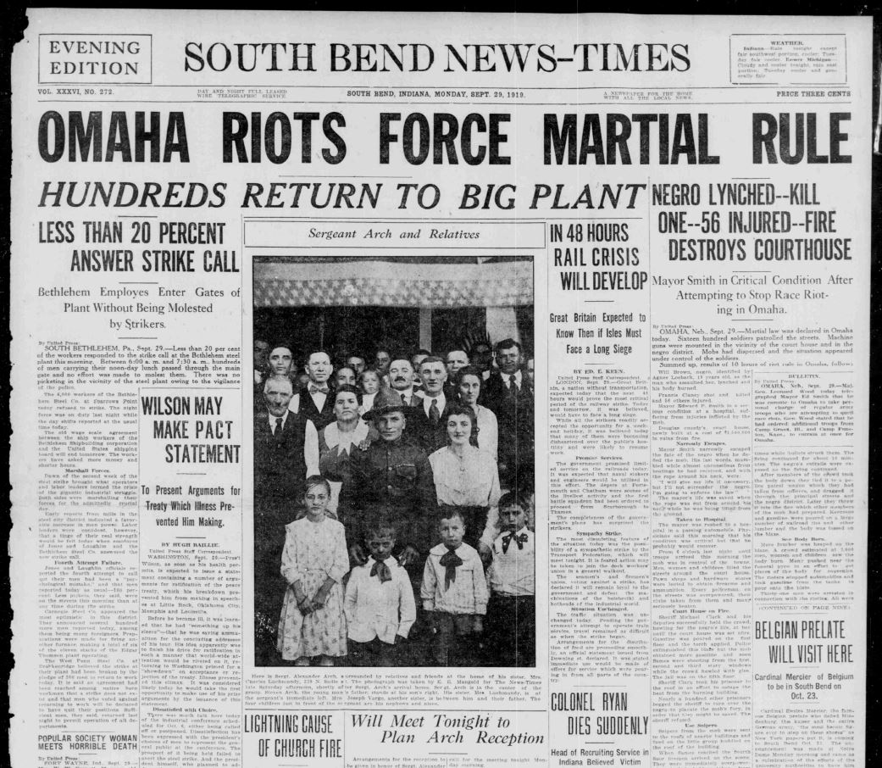
Tension Overshadows Progress
New York Times
Omaha Riots Force Martial Rule
1919
Newspaper Clipping
This newspaper clipping was released the day after the 1919 Omaha Race Riots, the time period Tom-Tom’s Third Act takes place. While tension had been brewing for years in Omaha due to the hiring of African Americans as strikebreakers for the meatpacking industry, the event that finally triggered rioting was the alleged sexual assault of Agnes Loebeck, a nineteen-year-old white woman. Will Brown, a forty-one-year-old African American man was identified as a suspect, and prior to his trial, a large crowd of 4,000 white men forced their way into the courthouse, despite heavy police presence. The crowd proceeded to lynch Brown, and the riots ensued. Although African Americans were liberated and places such as Harlem began flourishing, this newspaper clipping highlights the still-powerful forces of racial oppression.

Slide 12
Modern Day
The next section of the Exhibit will connect Tom-Tom to modern events.

Slide 13

Ferguson: Racial Profiling
New York Post
Streets of Rage
2014
Newspaper Clipping
Although race-relations improved in the 21st century since lynchings and other heinous 20th century acts were extremely diminished, racism and racial profiling are still prevalent. Police often treat suspects with bias depending on their race, a phenomenon which was exemplified by the slaying of Michael Brown. African American music shifted to rap: a brutally honest form of relaying the harsh events. While rap appears to be distant from jazz, plantation songs, and the tom-tom, its core purpose, like African American values, has survived time. Each prior genre of African American music served as a method of communication, free expression, and identity development. Rap maintains the strong beat of the tom-tom, the freedom of jazz, and relays a story like the call-and-response plantation songs.

Slide 14

Black Lives Matter: New Hope
Wiki Commons
Black Lives Matter Protesters
No Date
Photograph
Yet again, the current generation of African Americans must fight racial profiling and oppression. Perhaps by incorporating the work and knowledge of their predecessors, this generation will write the Act 4 of Tom-Tom, one in which racism actually substantially diminishes. The unity of this generation, along with the unprecedented support of large amounts of whites, provides hope that racial profiling could truly be fought.

Slide 15
Conclusion
The exhibit highlights how, like the African American identity-shaping values, both African American music and race-relations have maintained a similar set of core principles throughout the generations. Due to oppression, African Americans could at times only communicate and express themselves via music. Hence, in order to truly understand the identity of a group, one must look not only at written works such as Tom-Tom, but also at honest forms of expression, such as music. While words can tell the story of a generation, music can relay the true state more powerfully. Dubois illustrates this phenomenon in Tom-Tom by her focus on music: the play/opera itself is short, consisting of only brief conversations. Likewise, The new generation of African Americans must once again face the same problem African Americans have faced since their arrival in the United States: racial oppression. However, newfound unity and the joint efforts of progressive whites offer hope that the time for breakthrough has finally arrived.

