Slide 1
KKK versus Blacks in the South: A Visual History of the Development of Race Relations From the Reconstruction Era through the Civil Rights Movements of the 1960’s
Oliver Whelan
October 26, 2016
Professor Cooke
Curated Exhibit
English 101 The personal is public: Writing with Archives and the Arts

Slide 2
Introduction
During the Reconstruction era, the Ku Klux Klan preserved and perpetuated the notion of white supremacy through violence. After the 13th Amendment was passed, freeing all slaves from bondage, blacks earned their constitutional rights. The KKK, however, was determined to prevent blacks from exercising these rights, especially their right to vote, because they viewed them as a threat to the natural social order of the South. Thus, the KKK responded with violence, in hope that they would deter blacks from exercising their newfound rights and freedoms.
While laws, like the 15th Amendment, were created to prohibit intimidation of black voters, they were rarely enforced; as a result, the KKK could relentlessly attempt to prevent blacks from exercising their rights. Their ruthless intimidation and violence towards blacks prompted black activists, such as Yusef Iman, to begin protesting peacefully through the arts. One of Iman’s more renowned plays, Praise the Lord, But Pass the Ammunition, directly addresses KKK violence towards blacks. Throughout, Iman discusses violent versus non-violent retaliation in response to KKK intimidation and violence.
Although Iman’s play depicts a black family retaliating against the KKK with violence, this rarely happened in reality. Even peaceful protests against the Klan were dangerous, as the Klan viewed them as threats to their widespread social and political power; as a result, it was almost impossible for blacks to publicly express their disdain and disapproval of the Klan. Consequently, blacks in the South endured a long and oppressive journey in order to obtain their deserved rights, and this exhibit traces the development of their relations with the Klan from the end of the Civil War through the Civil Rights Movement.

Slide 3
The Foundation of the Klan
This picture depicts the founding of the KKK in Nashville on December 24th, 1865. Its first members were largely Confederate veterans, who were looking to restore white supremacy in the South. The Klan’s influence spread remarkably quickly throughout the South, as many other groups arose, adopting the same name, beliefs, and intentions.
West Virginia State Archives, Ku Klux Klan Members, 1865, Still Image

Slide 4
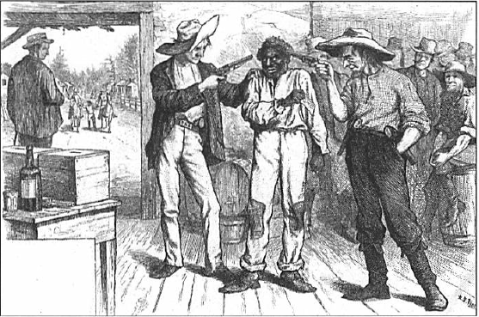
KKK Inhibits Blacks Right to Vote through Intimidation and Violence
The KKK viewed black suffrage as a threat to whites’ political power, as the black population in the South was substantial enough that if their right to vote had not been inhibited by KKK threats, intimidation, and violence, they would have had considerable political leverage. Once KKK members and white supremacists entered local and state governments, however, they were able to legally prevent blacks from voting through legislation.
Iman’s opening scene in Praise the Lord, But Pass the Ammunition depicts two Klan members beating John Simmons, a black man, and his family because Simmons had tried to vote. As they beat the family, they shout at Simmons, “You still feel like voting now, nigger” (1). Eventually, the two Klansmen kill the entire family, showing that voting as a black in the South was highly dangerous, as the KKK wanted Democrats to hold the majority of the political power in the South.
A. B. Frost, Of Course He Wants to Vote the Democratic Ticket, October 21, 1876, Cartoon
Yusef Iman, Praise the Lord, But Pass the Ammunition, 1967, Play Script

Slide 5
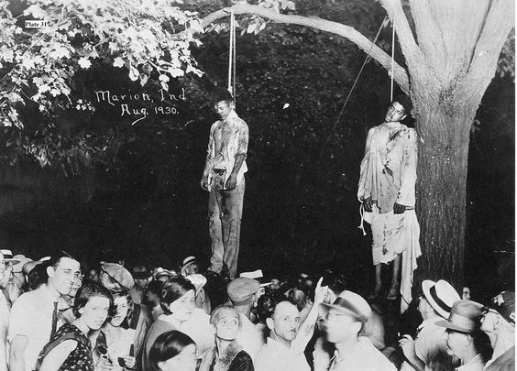
Ben Johnson Interview
In an interview in 1933, Ben Johnson, a former slave, provides a firsthand account of the violence he witnessed and experienced around Hillsboro, North Carolina just after the end of the Civil War. He recounts, “The most that I can tell you ‘bout is the Klu Klux. I never will forget when they hung Cy Guy. They hung him for a scandalous insult to a white woman an’ they comed after him a hundred strong… They scratches Cy’s arm to get some blood, an’ with that blood they writes that he shall hang ‘tween the heavens and the earth till he is dead, dead, dead, and that any nigger that takes down the body shall be hanged too.” The Klan viewed any slight misdemeanor committed by blacks as an opportunity to show their power through violence. Lynching sent powerful messages to blacks, as the horrific sight of a friend or neighbor dangling from a tree likely invoked fear, sorrow, and anger. Klan violence was effective in that it invoked fear in blacks, however, it also provoked unrest and rebellion from black communities, which led to stronger legislation, like the Enforcement Act of May 1870, to protect blacks from Klan intimidation and violence.
Lawrence Beitler, Lynching of Thomas Shipp and Abram Smith, August 7, 1930, Photograph
Federal Writer’s Project, Ben Johnson Interview, 1933, Interview Script

Slide 6
Violent Retaliation or Peaceful Protest?
In his play, Iman shows the social unrest in the South through a rebellious character named Luke. Following the death of Simmons and his family, Luke wants to retaliate against the Klan with violence because he and his family had told Simmons to vote, which makes Luke believe that the Klan is coming for them next. In turn, he tries to persuade his family to join him, “It will be more dangerous waiting until they come here. Look, these are the choices we have. One, we can run like dogs with our tails between our legs and get killed running. Two, we can stay here and pray, and still get killed. Or three, we can go down there and get them before they get us” (4). The KKK’s attempts to prevent blacks from voting prompted violence from the KKK and protest from blacks. As the KKK was determined to have Democrats in control of local and state legislation, they took extreme measures to ensure that the conservative politicians that supported their ideas of white supremacy would be in office. Because of the Klan’s widespread power across the South, blacks rarely retaliated against the Klan with violence of their own, as they were simply less powerful and prepared compared to the Klan.
Yusef Iman, Praise the Lord, But Pass the Ammunition, 1967, Play Script

Slide 7
The Resurgence of the Klan in 1915
Because the KKK largely contributed to the Democratic success in the 1870 state elections, they did not have as much political incentive to intimidate blacks from voting in the following years. Thus, in tandem with the Enforcement Acts passed in 1870 and 1871 that restricted the KKK from using intimidation and violence to prevent blacks from voting, the KKK experience gradual diffusion throughout the 1870’s. In the 1910’s, however, Klan fervor was rekindled by KKK literature and film. The article on the right, written in 1920 and printed Georgia’s Columbus Enquirer Sun, opens with a statement of the Klan’s growth since its revival in 1915, “Proof that the noble spirit that actuated the members of the famous Ku Klux Klan in the reconstruction period still lives among the sons is shown in the remarkable growth of the organization…” Through this, the Klan asserted their power, implying that they would reestablish their social and political power to reform the South.
Columbia Enquirer Sun, Col. Simmons Discusses Knights of Ku Klux Klan, 1920, Newspaper Article

Slide 8
The Klan Establishes Political Power Across the Country
Throughout the 1910’s and 1920’s, the Klan expanded into the North. Even states like Ohio and Pennsylvania had 300,000 and 200,000 members, respectively, in the 1920’s. The picture on the right shows a Klan parade in Washington D.C. and is representative of their rapid expansion into the North. The KKK expansion across the country coincided with widespread hate crimes against blacks, including murders, lynchings, and even church bombings.
In order to reclaim their political power in local and state governments, the KKK devised a political plan called the “decade.” This plan entailed that each Klan member recruit ten people to vote for KKK politicians. By 1924, the Klan had strong political presences from coast to coast, as KKK politicians had been elected in Portland, Maine and in Portland, Oregon. In states, such as Indiana and Colorado, enough Klansmen had been elected that they practically
AP Photo, Thousand of Ku Klux Klan members parade past the U.S. Treasury building in Washington D.C. ,1925, Still Image
controlled the state governments. In this way,
the Klan formed an “invisible empire,” as their social and political power extended across the country.

Slide 9
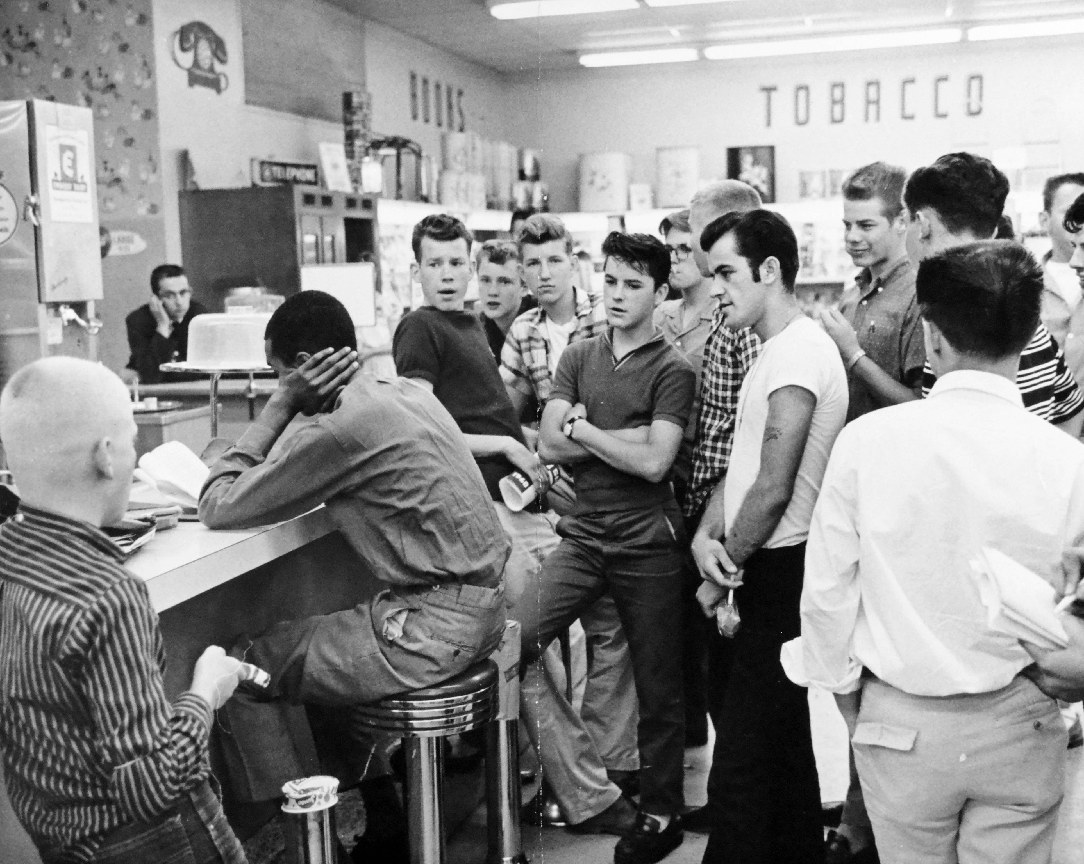
Blacks Attempt Peaceful Protests
The Klan’s expansion throughout the 1920’s provoked blacks to peacefully protest the violence and oppression of blacks that the KKK stood for. The NAACP (National Association of the Advancement of Colored People) tried to persuade the government to create and enforce new laws that would prohibit KKK violence, but their attempts were relatively unsuccessful. In turn, peaceful protests and sit-ins, like those shown in the pictures on the right, became the more common types of protest that blacks used to combat KKK violence and segregation.
Unknown, Stand Off between KKK and Blacks, 1938, Still Image
Unknown, Harassment during a Civil Rights Sit-in at the Cherrydale Drug Store, 1960, Still Image

Slide 10
The Decline of the Resurgent Klan
As blacks and other minority groups, such as Jews and Catholics, organized more peaceful protests, the Klan’s numbers started to rapidly decline, beginning in 1926, just after the peak of their resurgence. Additionally, D.C. Stephenson, the Grand Dragon of Klan’s across twenty-three states, was convicted trial for rape and murder of a white schoolteacher in 1925, which put the Klan’s morality and intentions in question. Along with increased protest, this specific incident altered views of the KKK, prompting many people to disassociate from the Klan.

Slide 11
The Klan’s Final Phase
The Klan’s final resurgence in the 1950’s and 1960’s was an unorganized and extremely violent movement. In response to frequent Civil Rights protests, the Klan reestablished its power in Birmingham, Alabama by bombing homes of blacks throughout the city. The most memorable and impactful of these bombings was the 16th Street Baptist Church bombing in 1963, which killed four innocent black girls and injured twenty-two others. The implications of this bombing were exactly the opposite that the KKK intended it to have: outrage over the death of these four girls increased support to end segregation and helped push the Civil Rights Movement forward.
Unknown, 16th Street Baptist Church bombing, 1963, Still Image

Slide 12
Conclusion
For an entire century, the KKK had heavy influence on social and political affairs. Most of their success, however, stemmed from their willingness to use intimidation and violence against blacks in the South to prevent them from voting. Although Congress did pass Enforcement Acts in 1870 and 1871 that prohibited violence so that blacks would not vote, these laws were not strictly enforced, which allowed for the growth of the Klan’s political power in the late 19th century. There was little that blacks could do for themselves in response to KKK violence, as white southerners had more social and political power than blacks and did not want to accept the change in social order that resulted from the abolition of slavery.
When the Klan resurged in the 1910’s and 1920’s, blacks began protesting more publicly through peaceful protests and sit-ins, however, Congress did not implement any further legislation that would protect blacks from the violence of the KKK. In turn, black activists, like Yusef Iman, furthered and strengthened peaceful protests through the arts. His play provided a visual representation of the daily atrocities that blacks faced during the KKK’s reign in the South, thereby showing oblivious and unaware audiences the oppression and danger they endured because of the KKK. In this way, the arts played a crucial role for black activism, as it provided black activists with mediums through which they could protest segregation and further the Civil Rights Movement.

