Slide 1
Data Management for
Digital Projects
Presentation to TPC+R
November 6, 2014
Jennifer Doty, Research Data Librarian
Emory Center for Digital Scholarship
Robert W. Woodruff Library

Slide 2
Data Management for Digital Projects
What are Data? What is Data Management?
Why Manage Your Data?
Data Lifecycle
Best Practices for Data Management
Special Considerations

Slide 3
What are Data?
Wide variety across domains:
Physical and life sciences—data are gathered or produced by researchers, such as by observations, experiments, or models.
Social sciences—researchers may gather or produce their own data, or they may obtain data from other sources such as public records of economic activity.
Humanities—data most often are drawn from records of human culture, whether archival materials, published documents, or artifacts.
Borgman, C. L. (2011). The Conundrum of Sharing Research Data. Journal of the American Society for Information Science and Technology, 63(6), 1–40. doi:10.2139/ssrn.1869155

Slide 4
What is Data Management?
“Data management covers all aspects of handling, organising, documenting and enhancing research data, and enabling their sustainability and sharing.”
(UK Data Archive)

Slide 5
Why Manage Your Data?
Consider this case study:
A scholar with the Center for Advanced Study in the Behavioral Sciences at Stanford lost all three copies of his fieldwork notes, representing decades of research, when the center’s offices were firebombed in 1970.
Case study: Data storage and backup. Stanford University Libraries, Data Management Services.
https://library.stanford.edu/research/data-management-services/case-studies/case-study-data-storage-and-backup

Slide 6
Data Lifecycle
data
creation
Before Data Creation
Plan data management (file formats, storage locations, etc.)
Locate existing data
During Data Creation
Capture and create metadata
Back-up data
data
re-use
data
processing
data
sharing
data
analysis
data
preservation
Notes:
Ideally, good data management practices should be applied at each stage of the research data lifecycle. And, actually, good data management starts even before data is created. For example, you may want to think about the best file formats to use that will allow for the most efficient processing of the data. You may want to identify the best places to store your data, such as on departmental or university servers and systems that provide regular back-ups.
During the creation of data is perhaps the best time to capture and create metadata, which are descriptions of your data that give them meaning so that they can be understood by yourself and others in the future. Examples of metadata could include dates and geographic places, and other information about the conditions under which the information was collected. Think of essential metadata elements as the information that one would need to be able to understand what the digital objects collected represent. In many cases, it’s best to compile that information while you are collecting data, because many of these details are easily forgotten.

Slide 7
Best Practices: File Formats
All digital data are dependent on software, and thus all data are endangered by obsolescence
Safest option to guarantee long-term usable data is to convert to open and standard formats that most software are capable of interpreting
UK Data Archive File Formats & Software, http://www.data-archive.ac.uk/create-manage/format/formats

Slide 8
Best Practices: File Formats
Type of data | Acceptable formats for sharing, reuse and preservation | Other acceptable formats for data preservation
Digital image data | TIFF version 6 uncompressed (.tif) | JPEG (.jpeg, .jpg) but only if created in this format TIFF (other versions) (.tif, .tiff) Adobe Portable Document Format (PDF/A, PDF) (.pdf) standard applicable RAW image format (.raw) Photoshop files (.psd)
Digital audio data | Free Lossless Audio Codec (FLAC) (.flac) | MPEG-1 Audio Layer 3 (.mp3) but only if created in this format Audio Interchange File Format (AIFF) (.aif) Waveform Audio Format (WAV) (.wav)
Digital video data | MPEG-4 (.mp4) motion JPEG 2000 (.mj2)
Documentation and scripts | Rich Text Format (.rtf) PDF/A or PDF (.pdf) HTML (.htm) OpenDocument Text (.odt) | plain text (.txt) some widely-used proprietary formats, e.g. MS Word (.doc/.docx) or MS Excel (.xls/.xlsx) XML marked-up text (.xml) according to an appropriate DTD or schema, e.g. XHMTL 1.0
UK Data Archive File Formats Table, http://www.data-archive.ac.uk/create-manage/format/formats-table

Slide 9
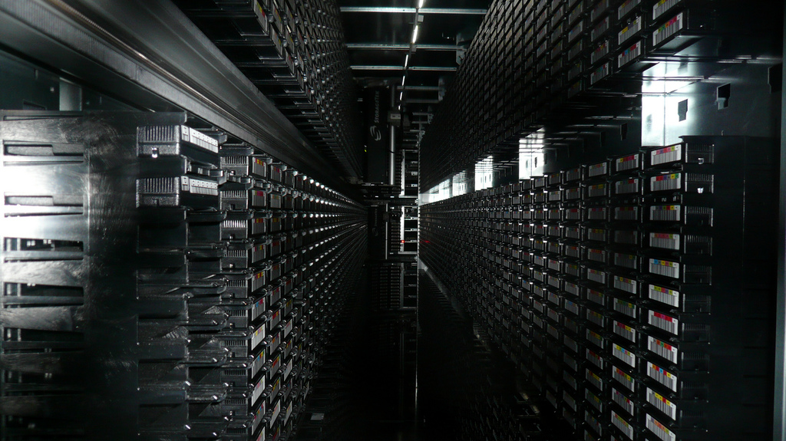
Best Practices: Storage
Tape library, CERN, Geneva by Cory Doctorow / CC BY-SA 2.0

Slide 10
Best Practices: Storage
Storage Considerations:
Accessibility
Read/Write speed
Size limits—overall vs. file size
Options:
Local—PC drive, flash drive, external hard drive
Server—department/organization server space
Cloud—Box, Dropbox, Google Drive, etc.

Slide 11
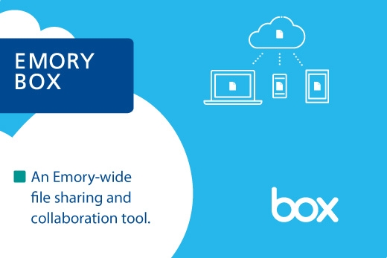
emory.box.com

Slide 12
emory.box.com
25GB storage per user (5GB file size limit)
Login with your Emory ID and password
Collaborative sharing and editing of files—Emory and external users
Sync with mobile devices and desktop computers
Some types of sensitive data allowed (see Rules)—never FISMA or PCI

Slide 13
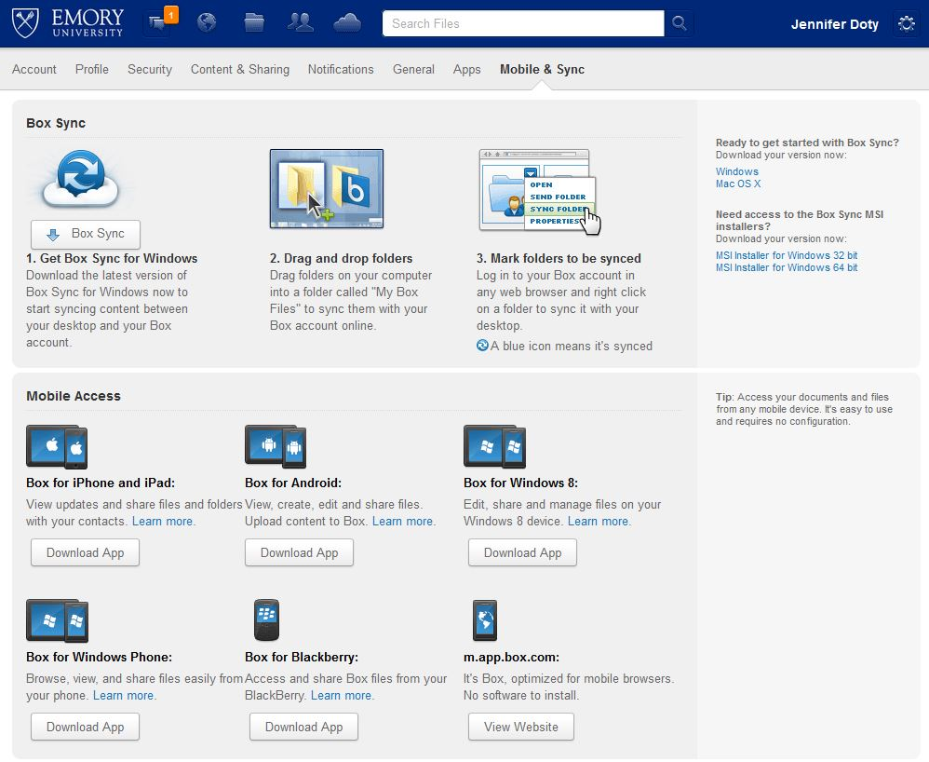

Slide 14
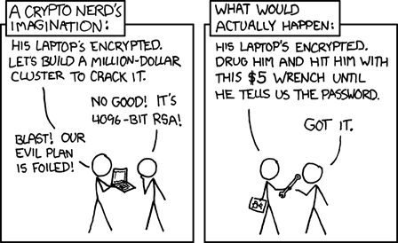
Best Practices: Security
Security, http://www.xkcd.com/538/

Slide 15
Best Practices: Security
Method for strong password selection:
Pick a favorite book/movie title or a familiar phrase: One Flew Over the Cuckoo’s Nest
Take the first letter of every word (include or add punctuation): ofotc’sn
Add some random capitalization and numbers to reach 8+ characters: 1fotC’sN75!

Slide 16
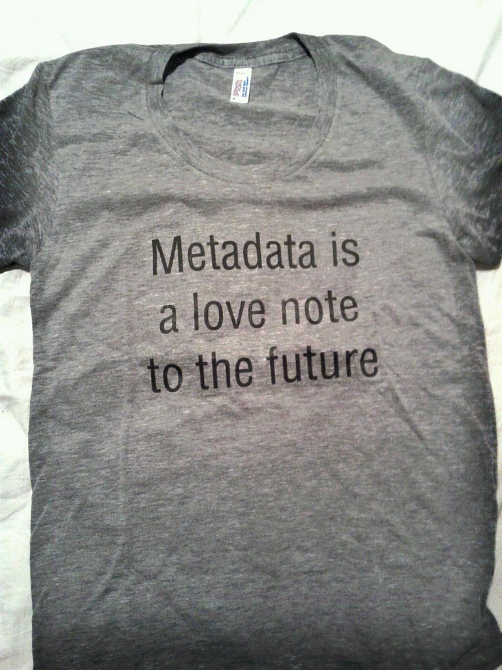
Best Practices: Documentation
Metadata is a love note… by sarah0s / CC BY-NC-ND 2.0

Slide 17
Best Practices: Documentation
Basic metadata characteristics:
Who
Who created the data
What
What the data file contains
When
When the data were generated
Where
Why
How
Where the data were generated
Why the data were generated
How the data were generated

Slide 18
Best Practices: Documentation
What contextual details (metadata) are needed to make the data you capture or collect meaningful?
What form will the metadata describing & documenting your data take?
How will you create or capture these details?
Which metadata standards will you use and why have you chosen them?
IMLS Summary of Research and Data, Metadata section, https://dmptool.org/requirements_templates/40/basic.rtf

Slide 19
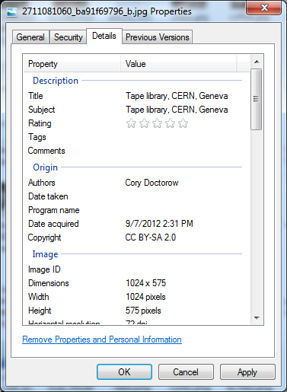

Slide 20
Data Lifecycle
data
creation
Data Processing & Analysis
Transcribe/digitize data
Check, validate, and clean data (document the process)
Organize data (file naming system, file organization, etc.)
Back-up data
data
re-use
data
processing
data
sharing
data
analysis
data
preservation
Notes:
During the data processing and analysis stages, data in physical formats, such as written documents, photographs, or audio and video recordings, can be transcribed or digitized. Data should be checked, validated, and cleaned, and you may want to write up a description of this process that can be attached to your data files so that, in the future, you and others can understand how this raw data was processed and verified. If you are dealing with a large number of digital files, come up with a system to organize those files by using consistent file naming rules and structural hierarchies. And, again, to protect against data loss, you should back up your data at frequent, regular intervals and across multiple locations or mediums.

Slide 21
Best Practices: File Naming
Avoid using special characters (& % @ \ /).
Use under_scores instead of periods or spaces.
Err on the side of brevity (<25 characters).
Include all necessary descriptive information independent of where it is stored.
Include dates, format consistently.
Include a version number when applicable.
Be consistent.
Adapted from http://www.records.ncdcr.gov/erecords/filenaming_20080508_final.pdf
Notes:
Adapted from http://www.records.ncdcr.gov/erecords/filenaming_20080508_final.pdf

Slide 22
Best Practices: File Naming
Descriptive Information:
If the following files were pulled out of their individual folders, they would appear to be the same file:
  \World_War_I\Posters\Owens\0001.tif
  \World_War_I\Posters\RedCross\0001.tif
  0001.tif lacks context, but
  wwI_poster_owens_0001.tif contains all necessary descriptive information

Slide 23
Best Practices: File Naming
Date & Time Formats:
The best way to list the date is based on an international standard (e.g. ISO 8601):
  YYYY_MM_DD or YYYY-MM-DD or YYYYMMDD
  November 6, 2014 becomes 20141106
The best way to list the time is to use 24-hr notation:
HH:MM:SS or HHMMSS (include time zone)
4:05pm (in Atlanta, after 1st Sunday in November) becomes 16:05:00EST

Slide 24
Best Practices: File Naming
Versioning:
useful to indicate file revisions or edits, especially in collaborations
can be through discrete or continuous numbering, depending on minor or major revisions (think of software versioning)
  CoolProgram 2.0 is significant change from 1.4, but CoolProgram 2.1 is (relatively) minor change to 2.0

Slide 25
Best Practices: Back-up
Back-up Considerations:
Accessibility—local, server, cloud
Redundancy—3 copies, geographically distributed (here, near, far)
Frequency—incremental and full, automated if possible

Slide 26
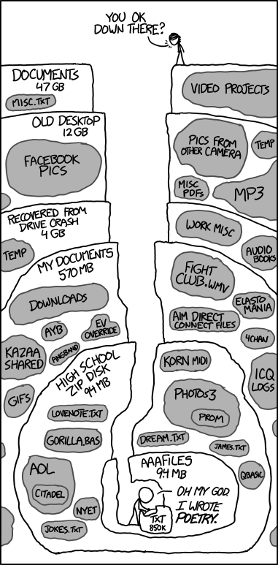
Old Files, http://www.xkcd.com/1360/

Slide 27
Data Lifecycle
data
creation
Data Preservation
Choose what data to preserve
Anonymize data, if needed
Migrate data to best format (uncompressed, non-proprietary file formats)
Finalize metadata
Choose most appropriate place to archive datasets
data
re-use
data
processing
data
sharing
data
analysis
data
preservation
Notes:
If you preserve and openly share your data, it can potentially be re-used in new ways, thereby increasing in value over time and giving you more recognition for your work. Also, data preservation and sharing are major concerns of federal granting agencies, whose positions are that data from publically-funded research should be open to the public and that such open access ensures the best possible investment of their funding.
When you are preparing to preserve and share your data, you will need to consider several things. First is that not ALL of your data may need to be saved. Perhaps it would be better to preserve processed or transformed data as opposed to raw data. If your data contain personal identifiers or other confidential information, you will need to remove that information before sharing your data. Your data should be preserved in formats that are most likely to survive changes in software and technology. In general, uncompressed files and non-proprietary, open file formats are the best way to go. You’ll need to make sure that your metadata are complete and finalized, so that your data will be meaningful to others, and yourself, at a later date. And you’ll need to consider the most appropriate place to archive your data. A long list of repositories can be found at databib.org.

Slide 28
Best Practices: Preservation
Should all data be preserved?
Should data be preserved in its original/raw state, or after it has been transformed?
  access copies vs. archival objects
Which file formats should be used for long-term preservation?
What description or contextual information (metadata) should accompany data to make them meaningful to others in the future?
Where will data be preserved? Is that location stable and likely to endure?

Slide 29
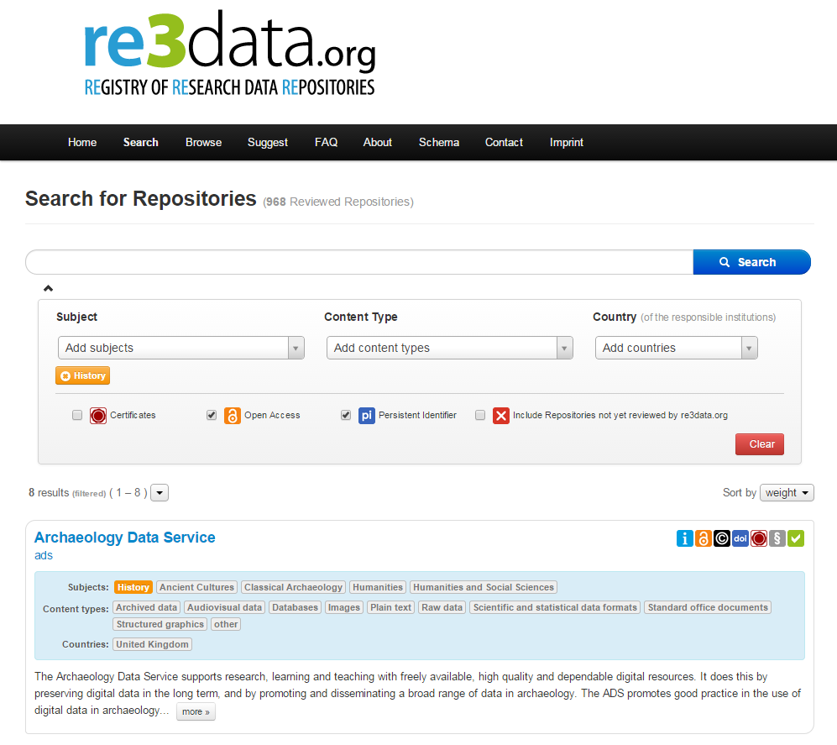

Slide 30


Open Access
to data
Persistent identifier
Terms of use & licensing of data
Certified or supports standard

Slide 31
Data Lifecycle
data
creation
Data Sharing & Re-Use
Publish data (data can be cited)
Control access
Replicate research
Propose new research questions
Meta-analysis
Use as teaching resources
data
re-use
data
processing
data
sharing
data
analysis
data
preservation
Notes:
Our hope that the open sharing and re-use of data will accelerate scholarly research, making research efforts more efficient and leading to new discoveries. By sharing and allowing your data to be re-used, this makes it easier for your findings to be replicated and may inspire new research questions. Meta-analyses that combine data from several different studies can reveal patterns in results that otherwise would not have been discoverable. And also, actual datasets are valuable for teaching students about methodology and analysis.
I hope that this description of the research data lifecycle makes it clear that data can have a very long lifespan, and care must be taken at each stage to ensure its longevity and potential value. Many of these issues will be pertinent when you are creating a formal data management plan.

Slide 32
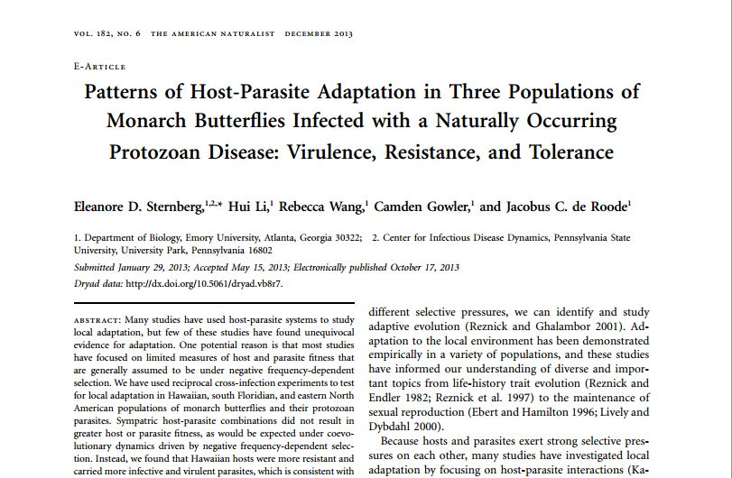

Slide 33
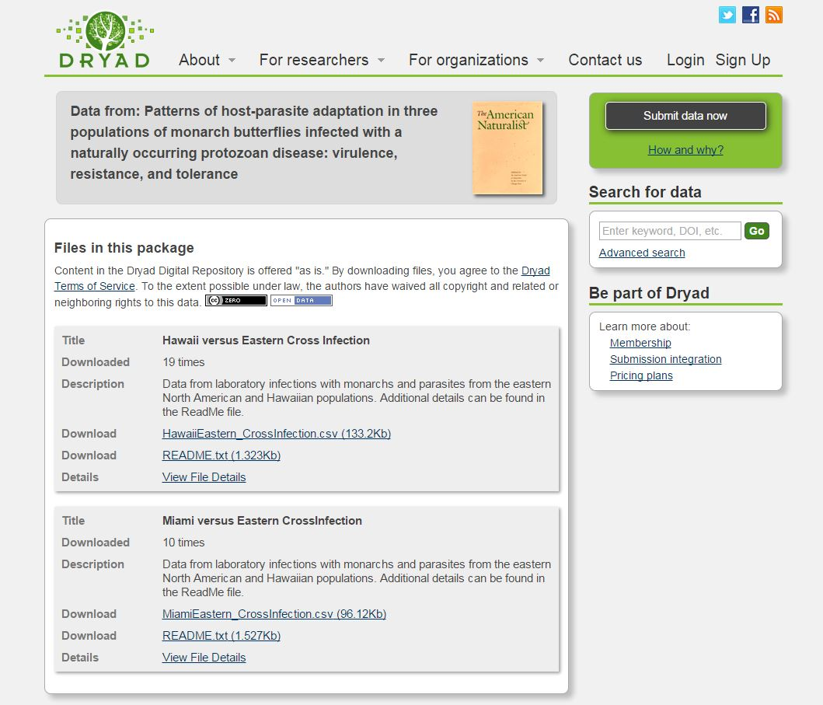
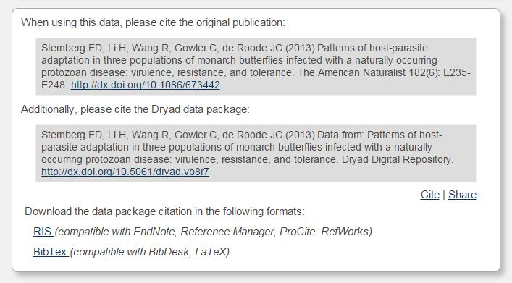

Slide 34
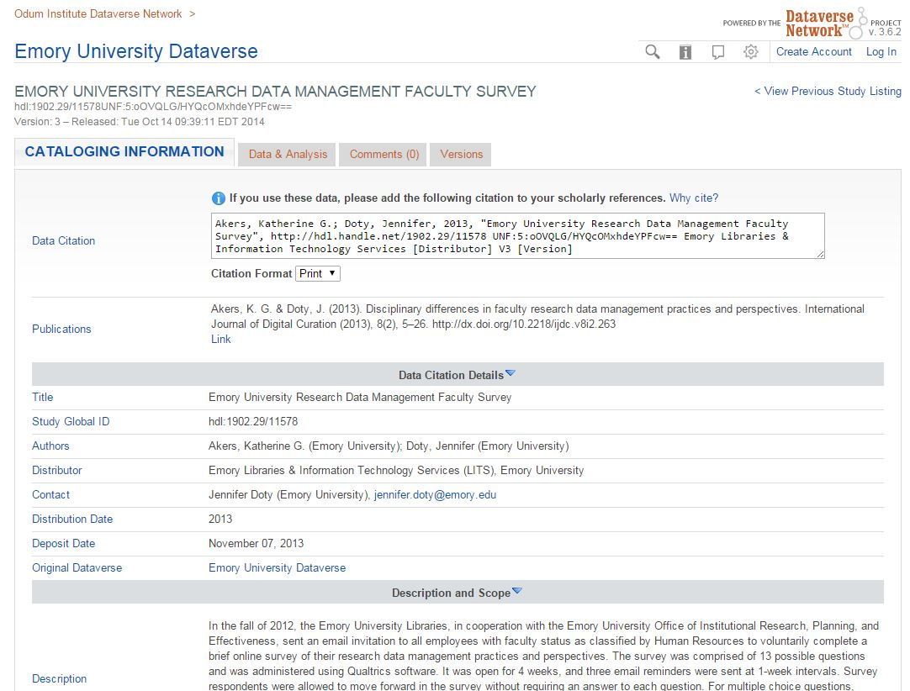

Slide 35
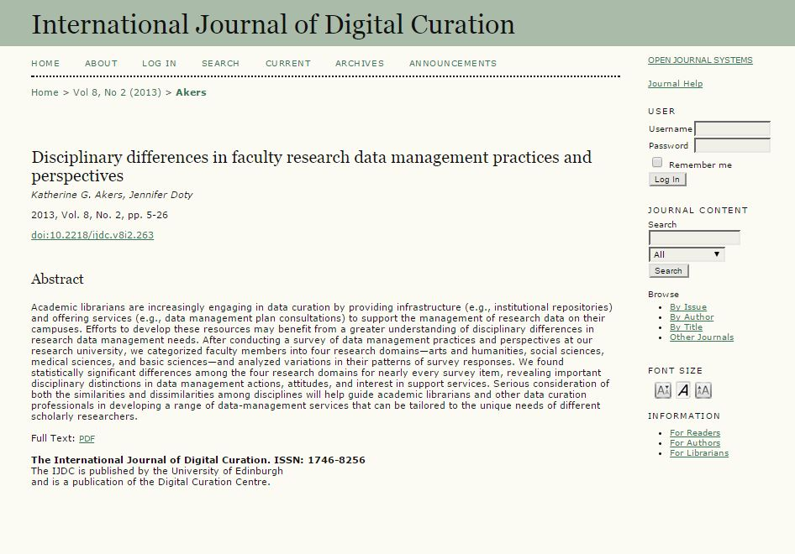
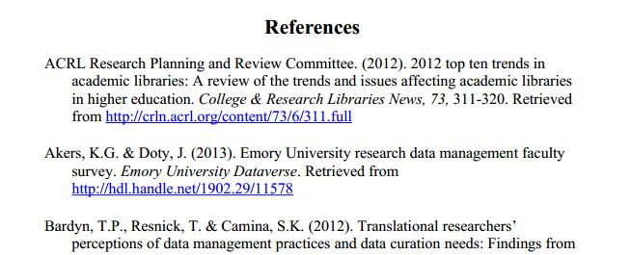

Slide 36
Special Considerations
Content in web systems
  Backing Up Your Database (for WordPress)
  Exporting/Archiving Courses (for Blackboard)
Sustainability
  “Health Check” Tool for Digital Content Projects

Slide 37
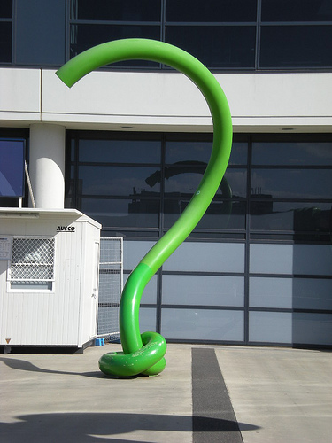
Green Question Mark by mikecogh on Flickr / CC BY

Slide 38
Thank You!
Jen Doty
jennifer.doty@emory.edu

